Slide 1
L.O. To investigate and interpret the past.
C: Greece

Slide 2
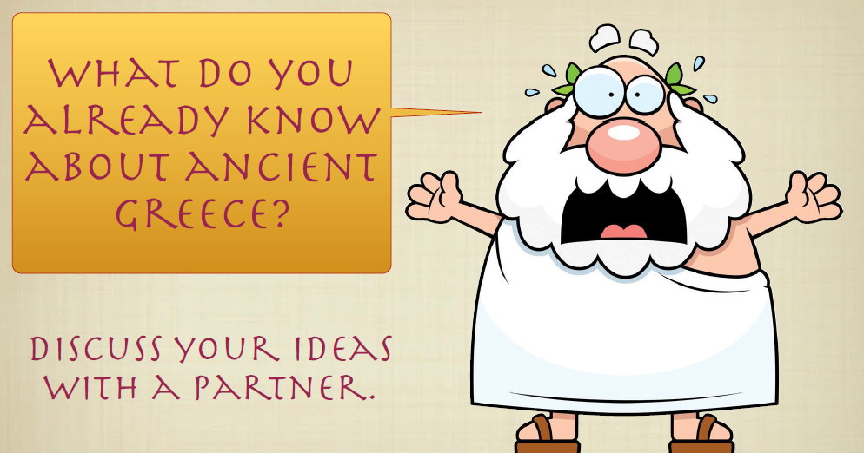

Slide 3
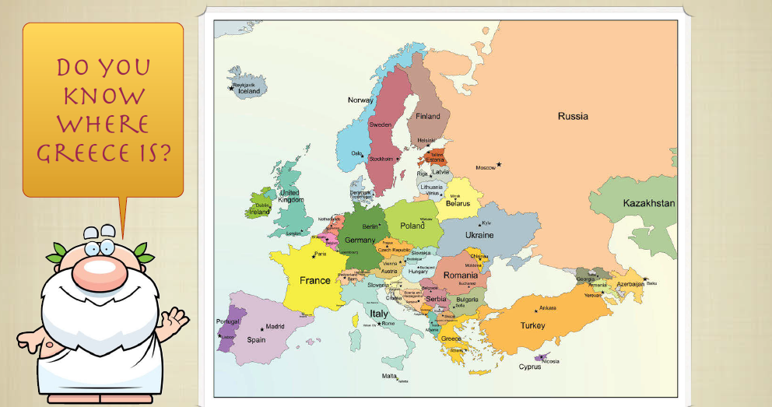
You have 3 minutes to find Greece in an atlas. Think about how to describe it.

Slide 4
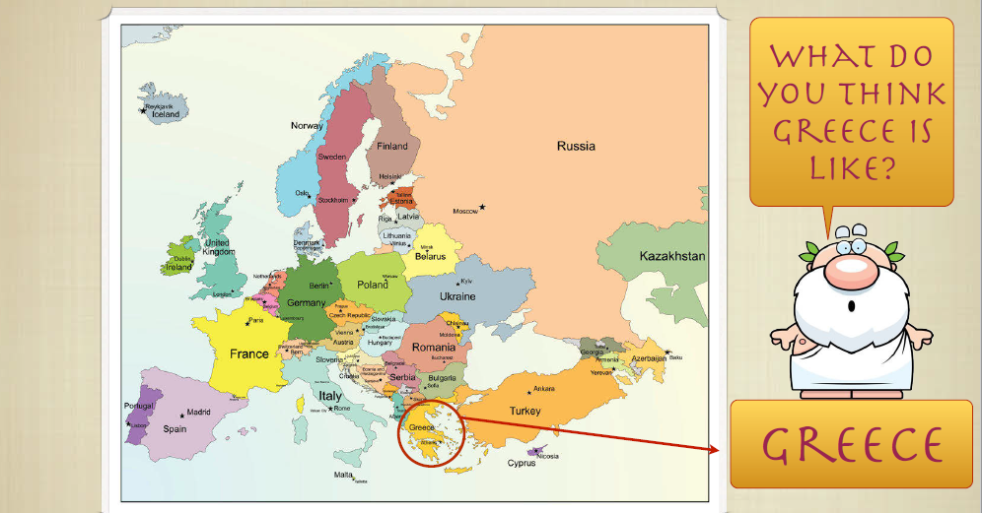

Slide 5
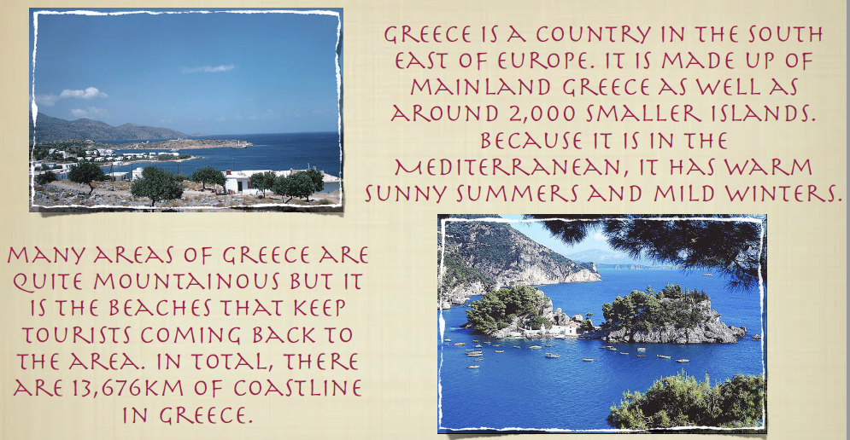

Slide 6
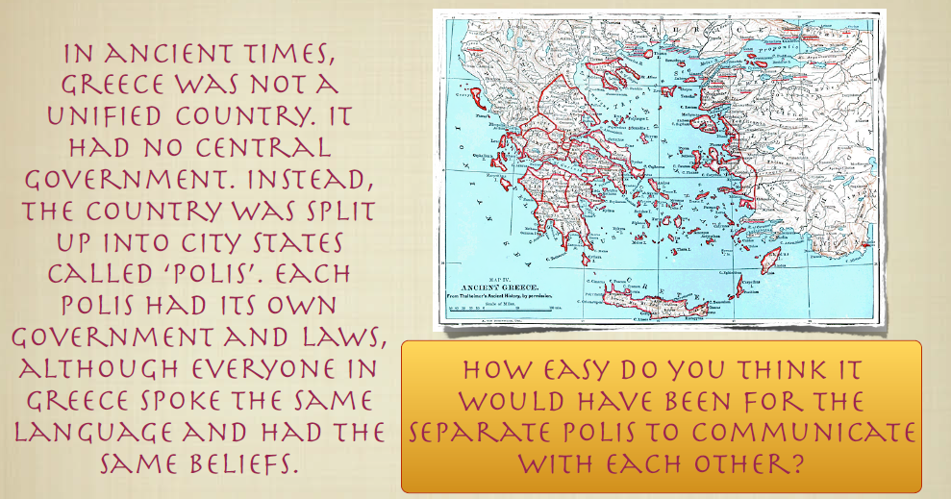

Slide 7
Your Task
Paddling- Use the atlas and the fact sheet to present the information on the template poster in your book.
Snorkelling- Use the atlas and the fact sheet to create a poster to present the information on the template fact sheet in your book.
Diving- Use the sources available to present the information on a full page in your book.
Your work must be:
Well-presented
Eye-catching
Informative
Neat

Slide 8
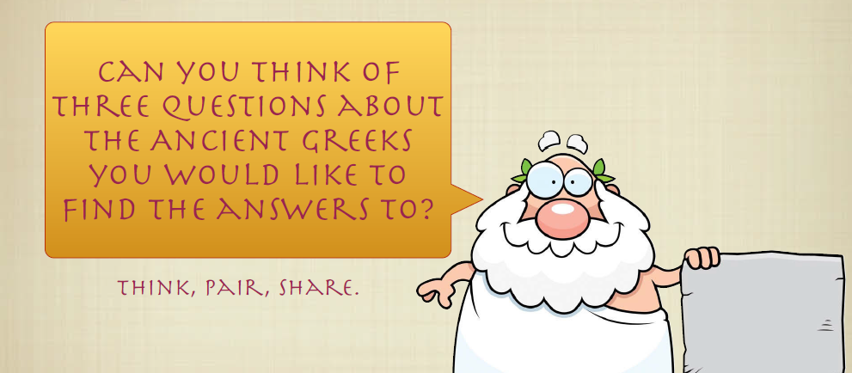
Plenary

