Slide 1
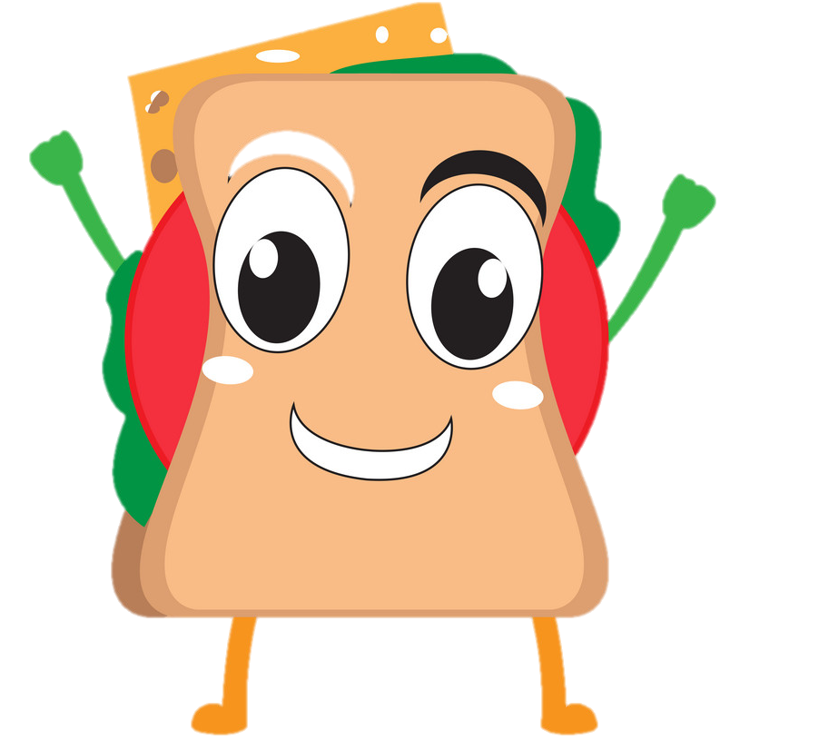
Healthy Eating: bringing the Eatwell Guide to life
Year 3’s Sandwich Project!
8.2.2021
Research!
Alex White
British Nutrition Foundation

Slide 2
Healthy Eating: bringing the Eatwell Guide to life
Year 3’s Sandwich Project!
Why are we making a balanced sandwich?
Alex White
British Nutrition Foundation

Slide 3

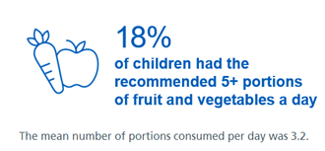
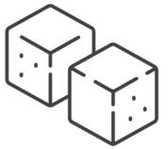
Context
Low intakes of some vitamins and minerals.
Low intake of fibre.
Eating too much sugars, salt and saturated fat.
NDNS 2018, Health Survey England 2017

Slide 4
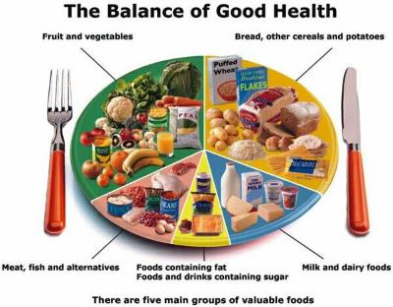
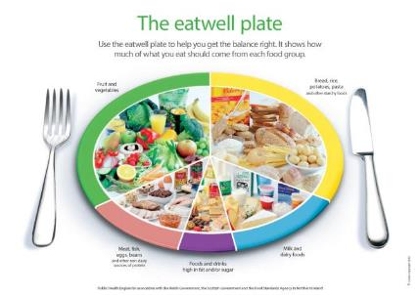
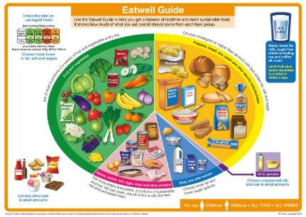
The progression of UK food based models
1994
2007
2016

Slide 5
Healthy Eating: bringing the Eatwell Guide to life
Year 3’s Sandwich Project!
How does the Eatwell Guide apply to?
Alex White
British Nutrition Foundation

Slide 6
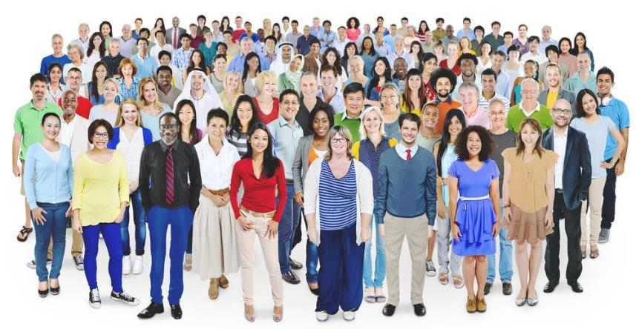
Notes:
The Eatwell Guide is suitable for most of the general population in the UK, regardless of weight, dietary preferences, ethnic origin, religious or cultural beliefs.
The Eatwell Guide does not apply to children under the age of 2, as their nutritional needs are different.
Children aged between 2 and 5 should gradually begin to follow the proportions illustrated in the Eatwell Guide.
People with medical conditions may need to seek advice from their GP or health professional about their diet.

Slide 7

The Eatwell Guide
Notes:
The UK’s healthy eating model.
Shows the proportions in which different food groups are needed in order to have a well-balanced and healthy diet.
We should choose a variety of different foods from each group.
The proportions shown represent food intake over a day or a week, not necessary each meal time.

Slide 8
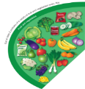
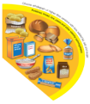
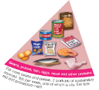
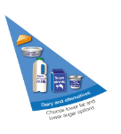
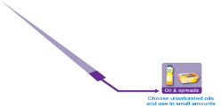
The Eatwell Guide – main groups
Fruit and vegetables
Potatoes, bread, rice, pasta and other starchy carbohydrates
Beans, pulses, fish, eggs, meat and other proteins
Dairy and alternatives
Oil and spreads

Slide 9
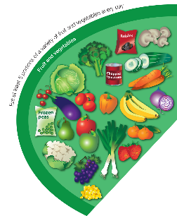
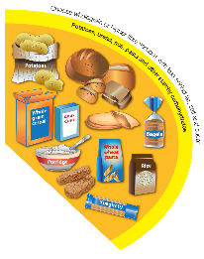
The Eatwell Guide – main groups
Fruit and vegetables
Potatoes, bread, rice, pasta and other starchy carbohydrates
Base meals on potatoes, bread, rice, pasta or other starchy carbohydrates; choosing wholegrain versions where possible
Eat at least 5 portions of a variety of fruit and vegetables every day

Slide 10
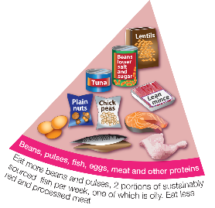
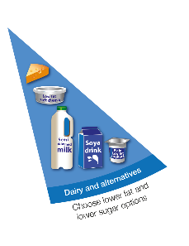
The Eatwell Guide – main groups
Beans, pulses, fish, eggs, meat and other proteins
Dairy and alternatives
Eat some beans, pulses, fish, eggs, meat and other proteins (including 2 portions of fish every week, one of which should be oily)
Have some dairy or dairy alternatives (such as soya drinks); choosing lower fat and lower sugar options.

Slide 11
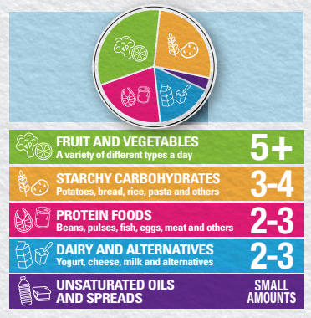
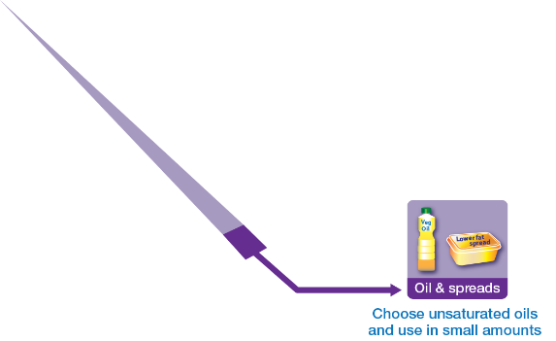
The Eatwell Guide – main groups
Oils and spreads
Choose unsaturated oils and spreads and eat in small amounts.
Find your balance - get portion wise!

Slide 12
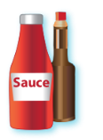






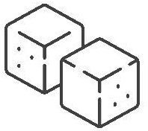

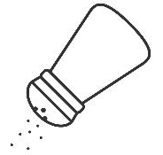
Foods high in fat, salt and sugars
Throughout the UK we consume excess amounts of:
Saturated fat;
Salt;
and Free Sugars.
If consuming foods and drinks high in fat, salt or sugar have these less often and in small amounts.

Slide 13
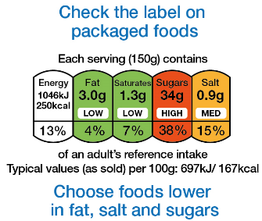

Labelling

Slide 14
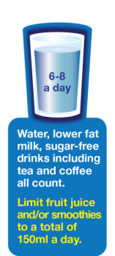
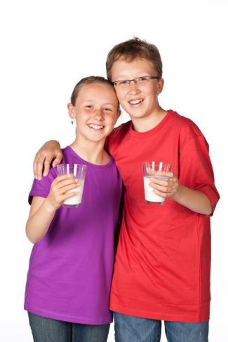
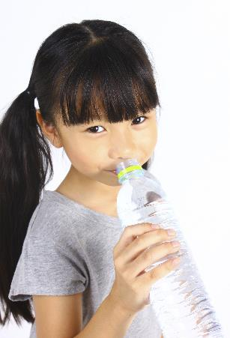

Drink 6-8 cups/glasses of fluid a day
Notes:
Aim to drink 6-8 glasses of fluid every day.
Water, lower fat milk and sugar-free drinks including tea and coffee all count.
Fruit juice and smoothies also count towards your fluid consumption, although they are a source of free sugars and so you should limit consumption to no more than a combined total of 150ml per day.
Sugary drinks are one of the main contributors to excess sugar consumption amongst children and adults in the UK.
Swap sugary soft drinks for diet, sugar-free or no added sugar varieties to reduce your sugar intake in a simple step.

Slide 15
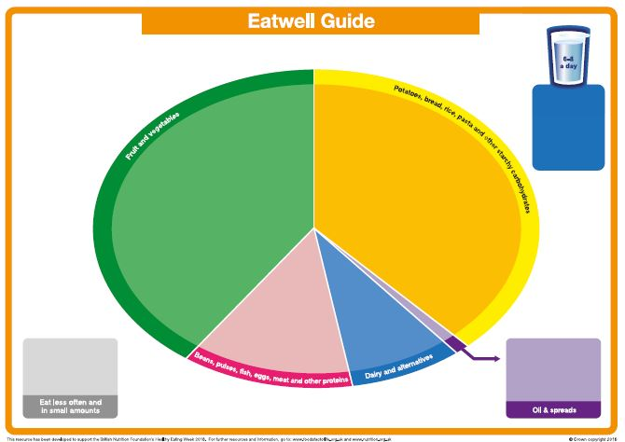
The blank Eatwell Guide
Blank Eatwell Guide

Slide 16
Healthy Eating: bringing the Eatwell Guide to life
Year 3’s Sandwich Project!
What about keeping safe in the kitchen?
Alex White
British Nutrition Foundation

Slide 17
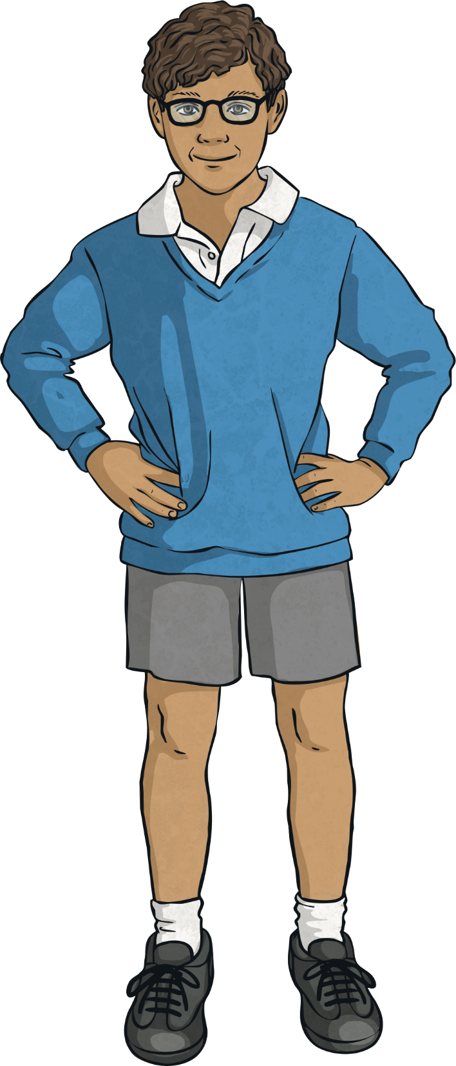
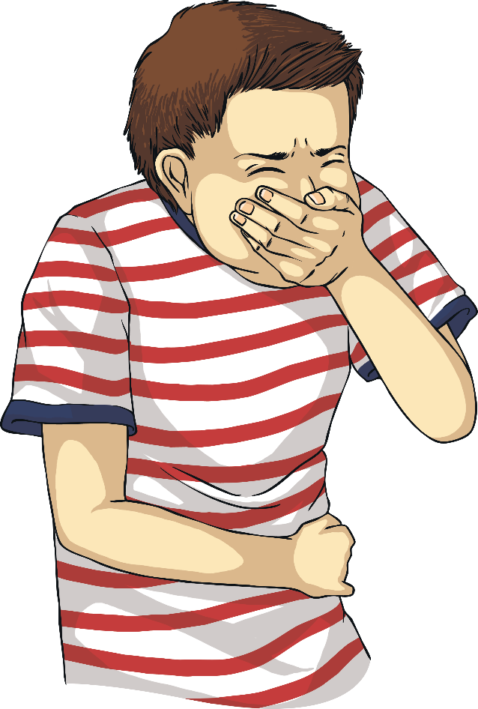
However, even healthy food can make us ill if we do not use safe and hygienic practices when we handle, prepare, cook or store it.
The correct food choices can make us strong, fit and healthy.
Food and Health - Safe, Clean and Hygienic

Slide 18
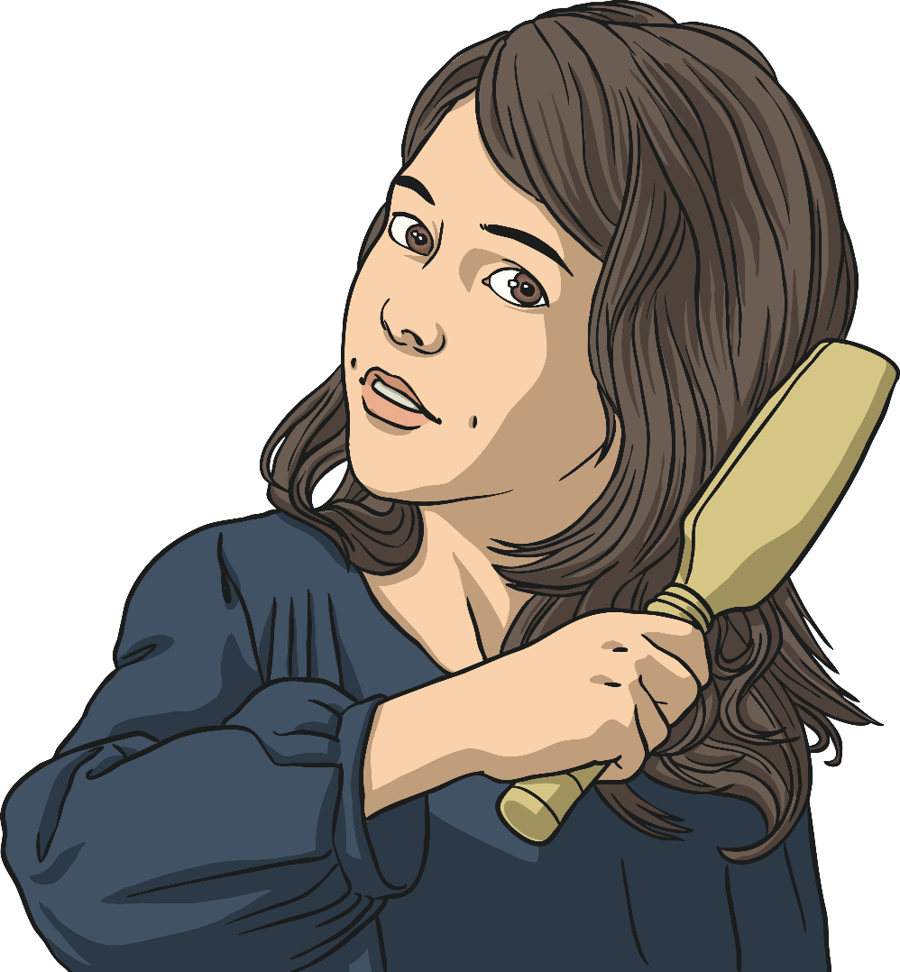
What should we remember before handling food?
Food and Health - Safe, Clean and Hygienic
First of all think about your personal hygiene.
Remove any jewellery, e.g. rings, watches or bangles.
These could spread germs or could fall into what you’re cooking. Taking them off also stops them getting messy.
Tie back your hair.
Hair can dangle in food, fall into food or get caught in equipment.

Slide 19
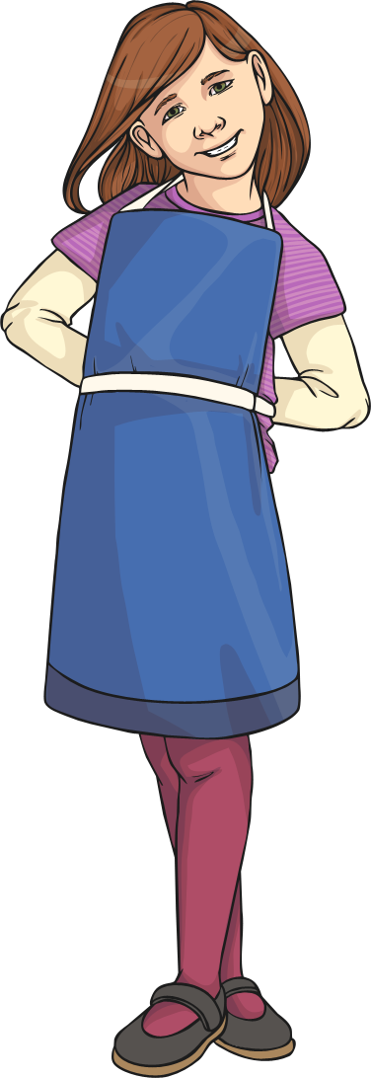
What should we remember before handling food?
Food and Health - Safe, Clean and Hygienic
In some factories or restaurants where food is prepared, workers have to wear hair nets or hats.
Wear an apron and roll up your sleeves.
This stops any germs from your clothing contaminating the food and it stops your clothes getting messy.
Wash your hands with hot water and antibacterial soap.
Washing your hands stops dirt and germs from contaminating food. You must wash your hands before, during and after food handling.

Slide 20
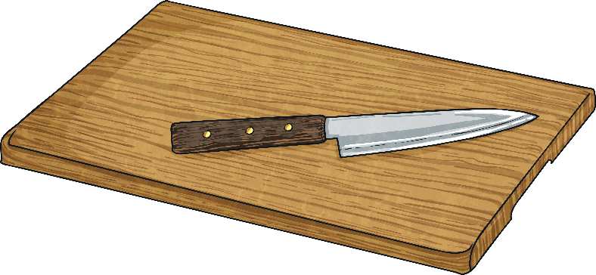
Food and Health - Safe, Clean and Hygienic
Apart from personal hygiene, what else should we be aware of when handling food?
Cross contamination
Cross contamination is when bacteria gets from one food to another.
Raw food can contain bacteria that could make us ill. It’s important that raw and cooked foods are not in contact so that bacteria aren’t spread.

Slide 21


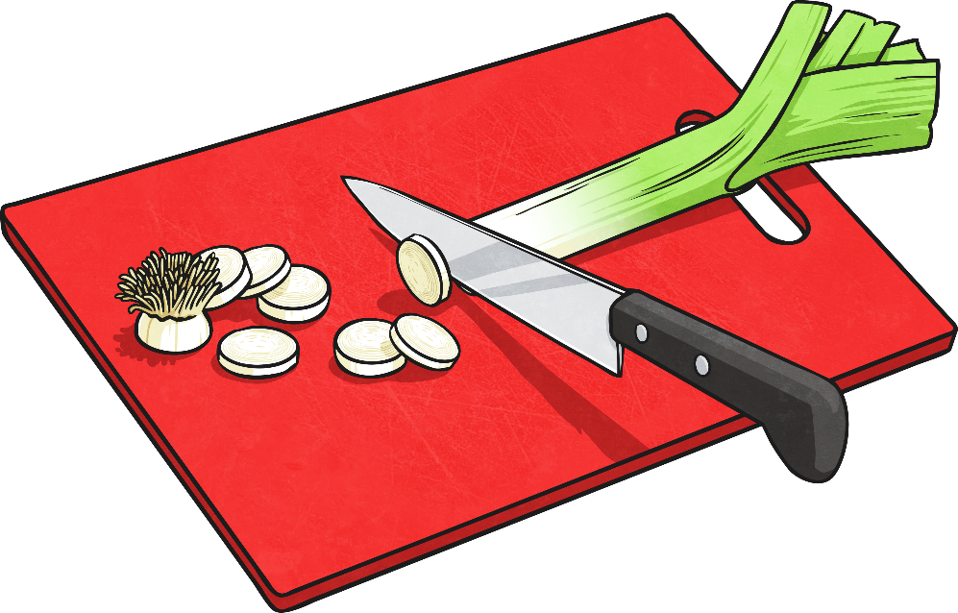
Food and Health - Safe, Clean and Hygienic
To avoid any risk of cross contamination pay attention to this advice:
Don’t use the same equipment for raw and cooked foods.
Use different chopping boards for raw meat and vegetables, fish or bread. Some come colour-coded so this is easier to do.
Keep raw and cooked foods separate.
Be careful when storing raw food so it cannot drip or come into contact with cooked food.

Slide 22
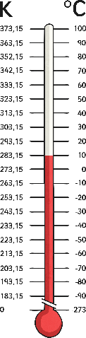
Cooking, Reheating and Chilling Food
Food and Health - Safe, Clean and Hygienic
Food must be cooked all the way through to remove any harmful bacteria.
Cooked food should be served immediately or kept warm (above 63ºC).
Bacteria can multiply quickly in a warm room if food is kept there for a long time. Food should never be served or reheated if kept under those conditions.
It’s important that food that has been cooked and cooled is reheated until it is piping hot. Food shouldn’t be reheated more than once.
Chilling food stops bacteria growing.
If you want to keep some food you’ve cooked to use later, cool it down as quickly as possible and put it into a container you can cover with a lid or film. Store your cooked food in the fridge or freezer.

Slide 23
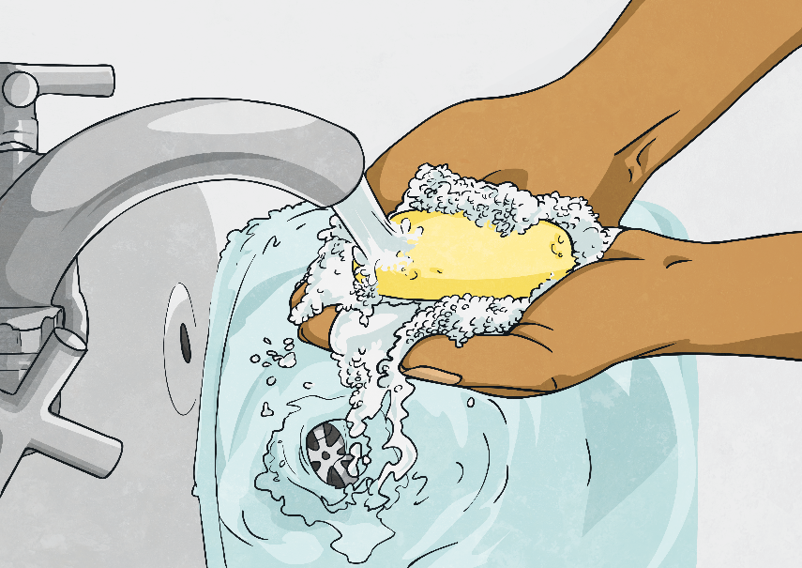
Cleaning Up
Food and Health - Safe, Clean and Hygienic
Always clean up after you’ve been preparing or cooking food.
Wash equipment in hot water using antibacterial soap and wipe down surfaces you have been working on using an antibacterial spray and clean cloth.
A clean and tidy kitchen helps prevents illness and accidents.

Slide 24
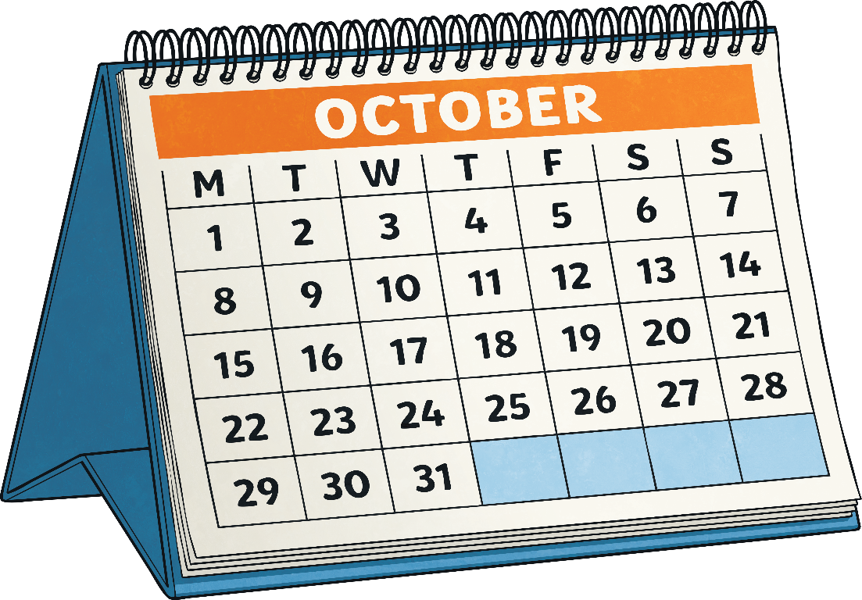
Check Dates
Food and Health - Safe, Clean and Hygienic
Best Before and Use By dates are shown on food packaging.
Best Before dates mean food used after that date may not be at its best but it is still safe to eat if it has been kept according to the conditions stated.
The Use By date is very important. After the Use By date, don’t cook, eat or freeze that food. It may look fine but it could make you ill.

Slide 25
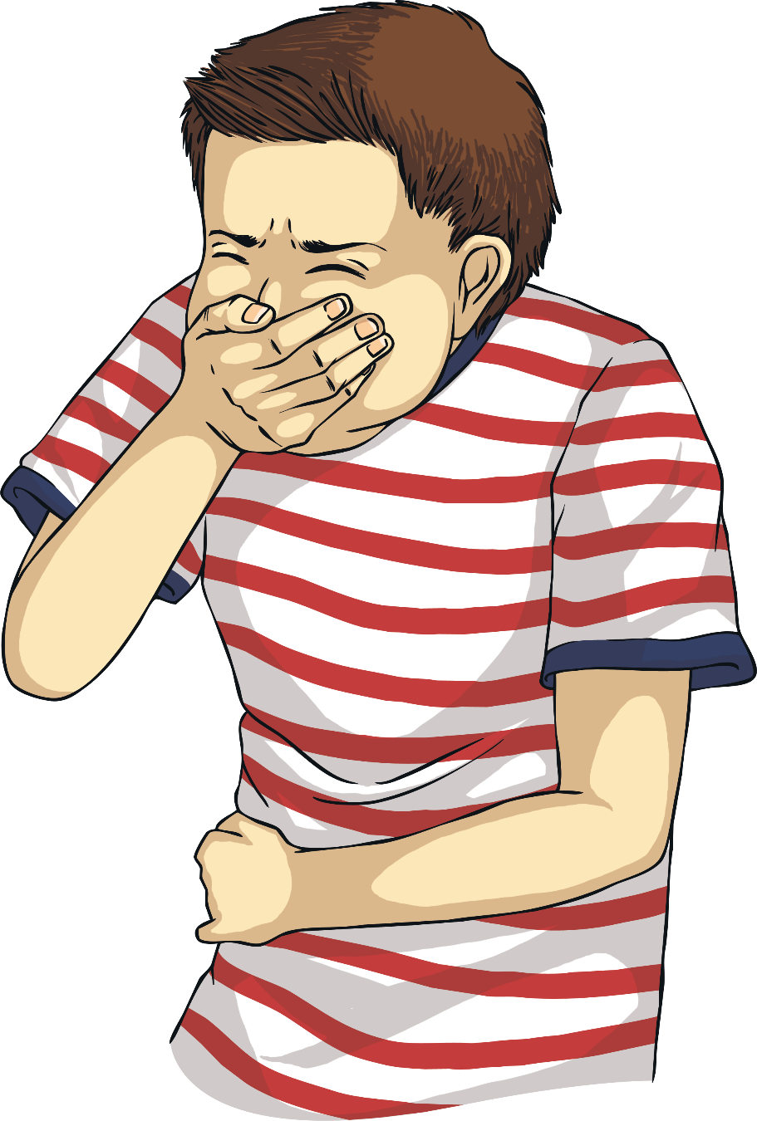
Check Allergies
Food and Health - Safe, Clean and Hygienic
Being safe with food means that we also must think about allergies. Food allergies can make some people very ill.
When preparing, cooking or serving food, always be aware of the allergies that people may have. It is always best to ask them.
Ingredients like nuts, which can cause serious reactions, are usually listed and warned about on food packaging and in restaurants.

