Slide 1
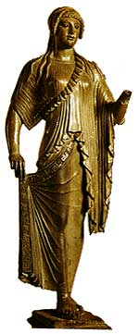
The greeks having an impact on the world
This Photo by Unknown author is licensed under CC BY.

Slide 2
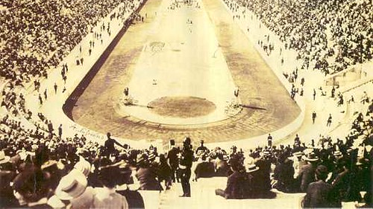
Sport t
-
The Greeks were the first to invent sport even things we have today like the Olympics.

Slide 3
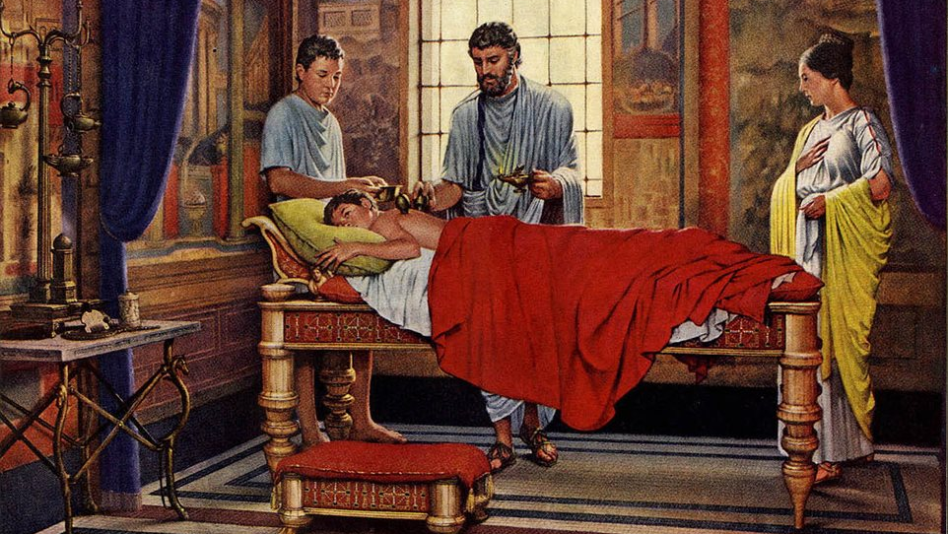
medicine
The ancient Greeks since they believed in gods they thought if they were healed it was a gift from the gods.

Slide 4
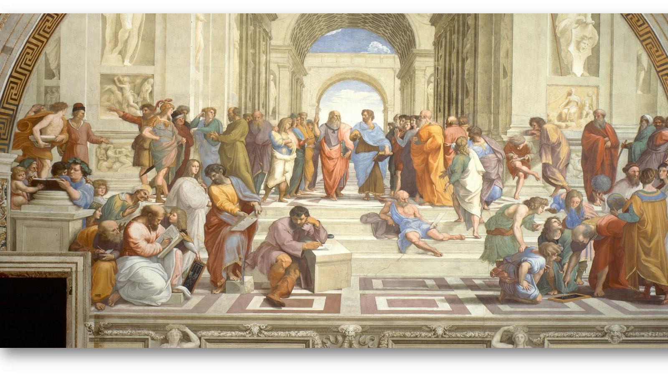
democracy
Women can’t vote but if you were a rich men you can make a rule but if you were a rich women you still can’t vote.

Slide 5
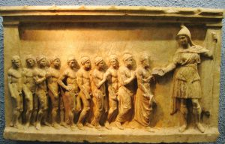
school
They were the ones who made schools what we have today what we learn from.

Slide 6
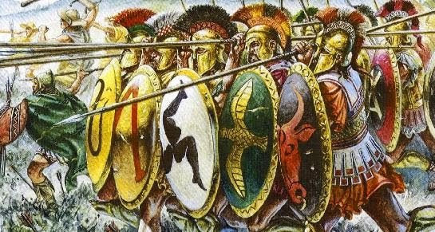
warfare
They had a plan they were learning from more about their enemies.

Slide 7
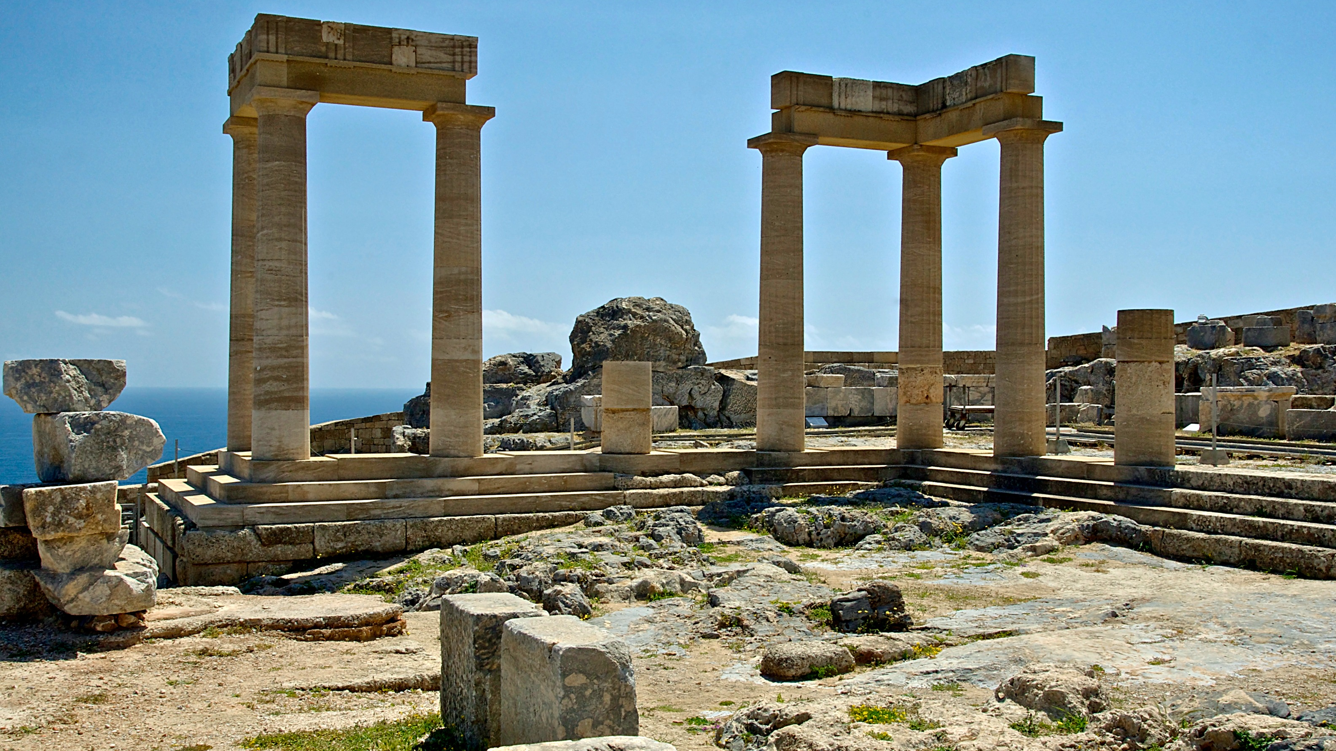
Answer and explain
The Greeks made useful things for us like sports, Olympics, university.

