Slide 1

All about the ancient Greeks

Slide 2
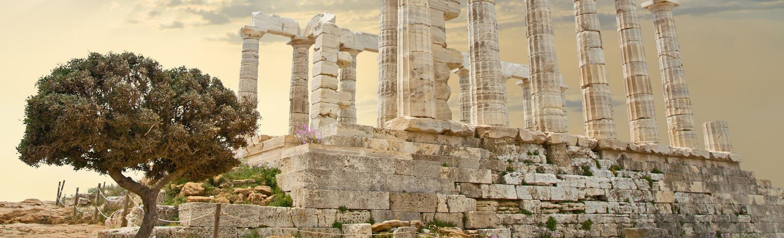
Hello and welcome to my presentation
My presentation is all about the ancient Greeks and what impact they have on the world.
Let's see what we can learn!

Slide 3

Sport
Sport was originated from Ancient Greeks.
The marathon started during the battle of marathon when a cook called Phidippides ran 25 miles from marathon to Sparta. They also invented the Olympics and left gymnastics, acrobatics, running and wrestling.

Slide 4
Medicine
Doctors had to do an oath that they would treat their patients fairly. Hippocrates believed that illnesses are caused by the imbalance of elements in the body. Doctors had strict ideas of how to treat their patients.

Slide 5

During Ancient Greek times women weren't allowed to vote, but nowadays everyone is allowed to vote, because of human rights.

Slide 6

Schools
In Ancient Greek times In Sparta boys and girls did not go to school. Instead, they were trained to be warriors!
But in Athens boys went to school and girls were taught at home by their maids.

Slide 7
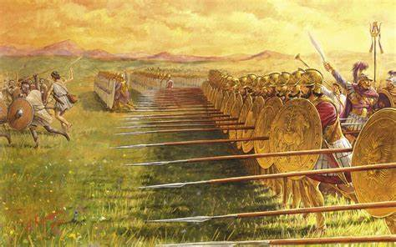
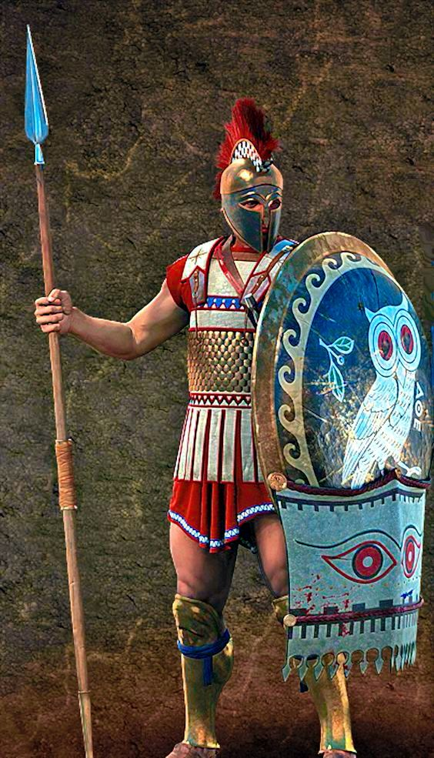
Warfare
In Ancient Greek times, Sparta was very vigilant because a long time ago they were attacked a LOT! So, they trained everyone to fight to become warriors.
In Sparta boys were trained by a very young age just so they can become strong and powerful.
Did you know that in Ancient Greek times they thought that if they taught children harshly, they would become better warriors.

Slide 8
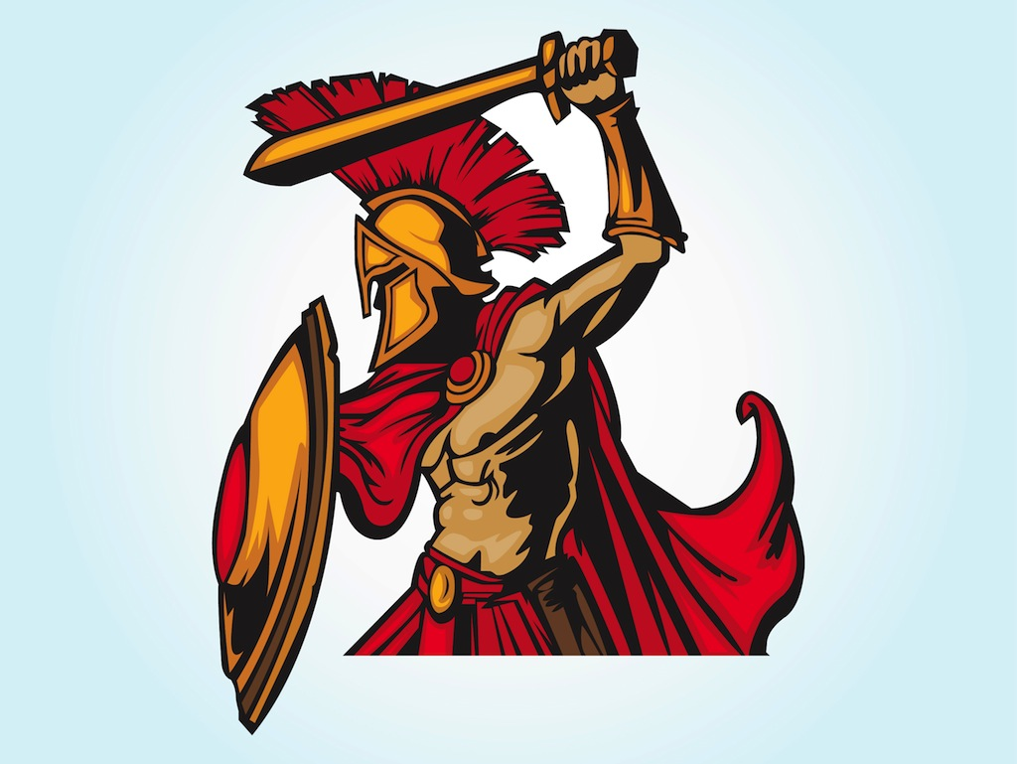
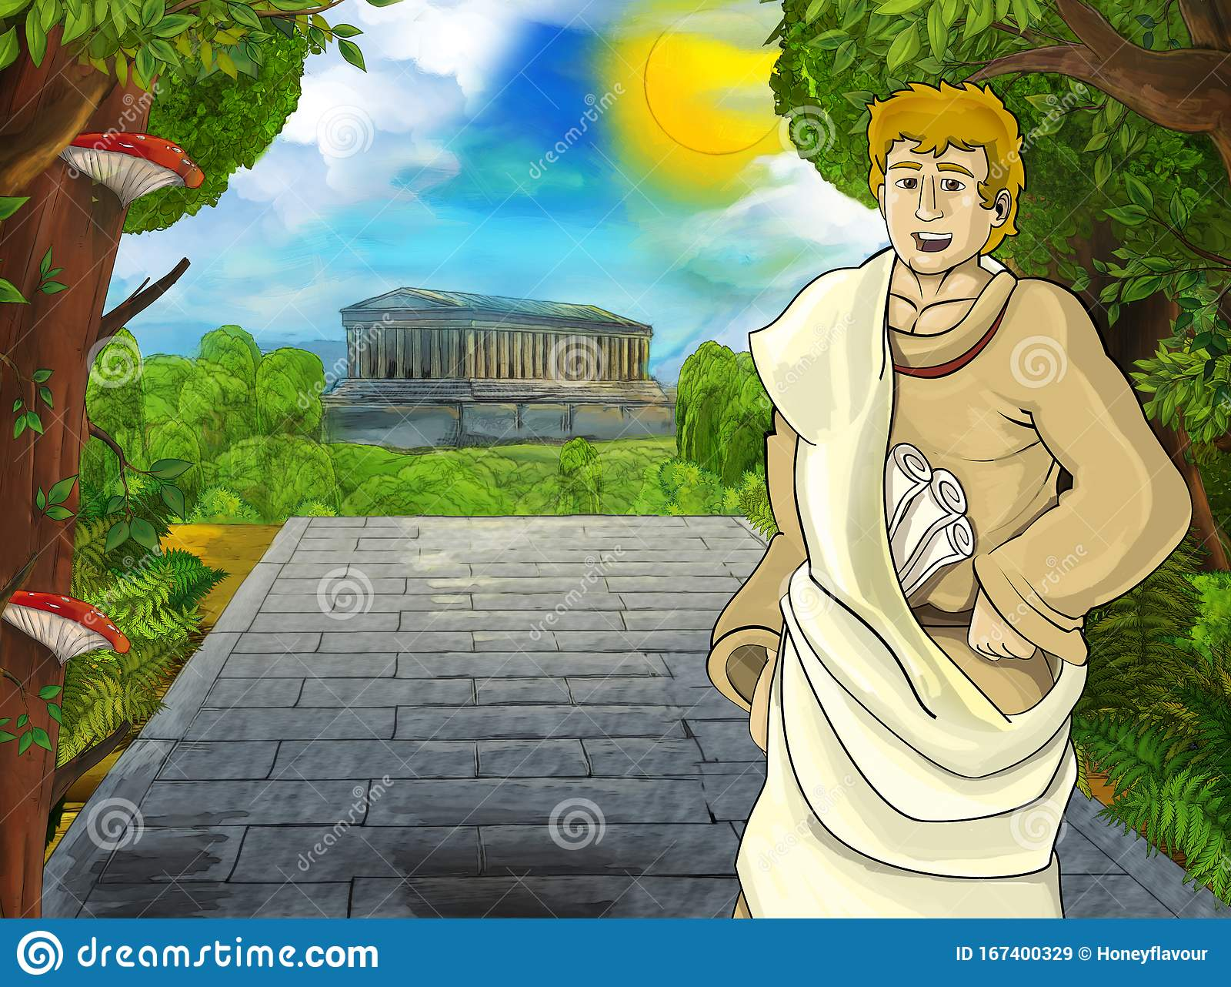
Conclusion
In conclusion, the Ancient changed how we live today.

