Slide 1
The Ancient Greek legacy
Are you ready to discover what the Ancient Greeks gave to us? From Education to Warfare, this amazing presentation will explain history! =)

Slide 2
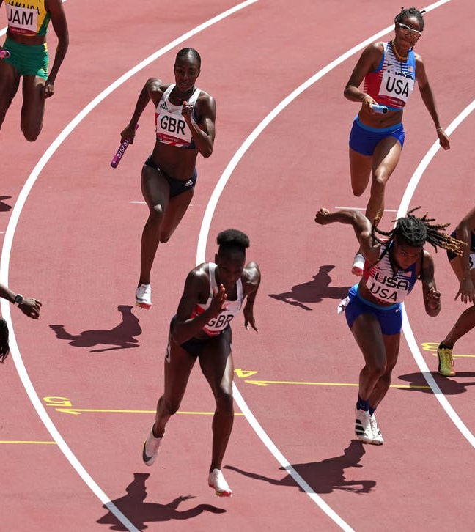
Sport
In Ancient Greece, there were many sports. Spartan children would train everyday, even women, so that they will become Warriors. The Olympics was first held in Olympia as an event for the god, Zeus.The marathon (a type of run) actually started in a battle, when a man ran 26.2 miles to ask for help. 26.2 miles is the distance a marathon is in the modern day.

Slide 3
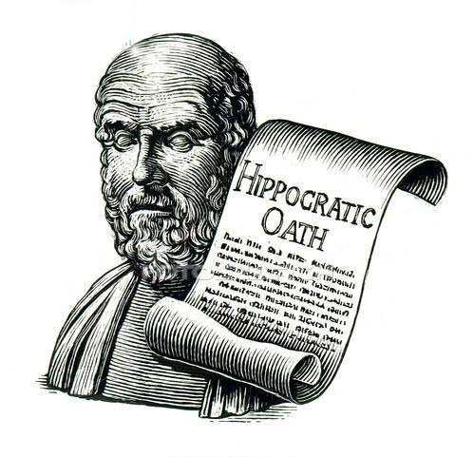
Medicine
Citizens believe that disease was caused by frustrated gods. Hippocrates was known as ‘the father of medicine’. He believed diseases were caused by scientific reasons. Hippocrates created an oath called the Hippocratic oath and whoever swore it would mean that they have to to cause no harm to their patients. Doctors still use the Hippocratic oath today.

Slide 4
Democracy
Athens was the first democratic city, as the Athenians created Democracy. Democracy is where everyone’s ideas are thought about. In Greek, dēmos means ‘the people’, and kratia means ‘rule’.
Democratic society | Non-democratic society
Everyone can speak for themselves | Only certain people are allowed to be part in a large speech
Leaders are chosen by people | Leaders are chosen by someone else

Slide 5
Education
In school children had wooden tablets to scratch on. Reading and writing were very important in Athens. Play take me to the first university called Plato’s Academy.Girls didn’t go to school but they had a tutor at home. If they weren’t wealthy enough, then they would have to do housework.

Slide 6
Warfare
Modern warfare | Greek warfare
Guns and bombs 💣 | Spears and swords
Planes and jets | Chariots and boats
Greek warriors were called hoplites. Phalanx was a formation of tightly pressed shields,even at the top. Many people created pots that show various battles on them.

Slide 7
The impact Ancient Greeks had on the world
Ancient Greeks have made a huge impact, because many of their ideas, we use today!
Amazing!

