Slide 1
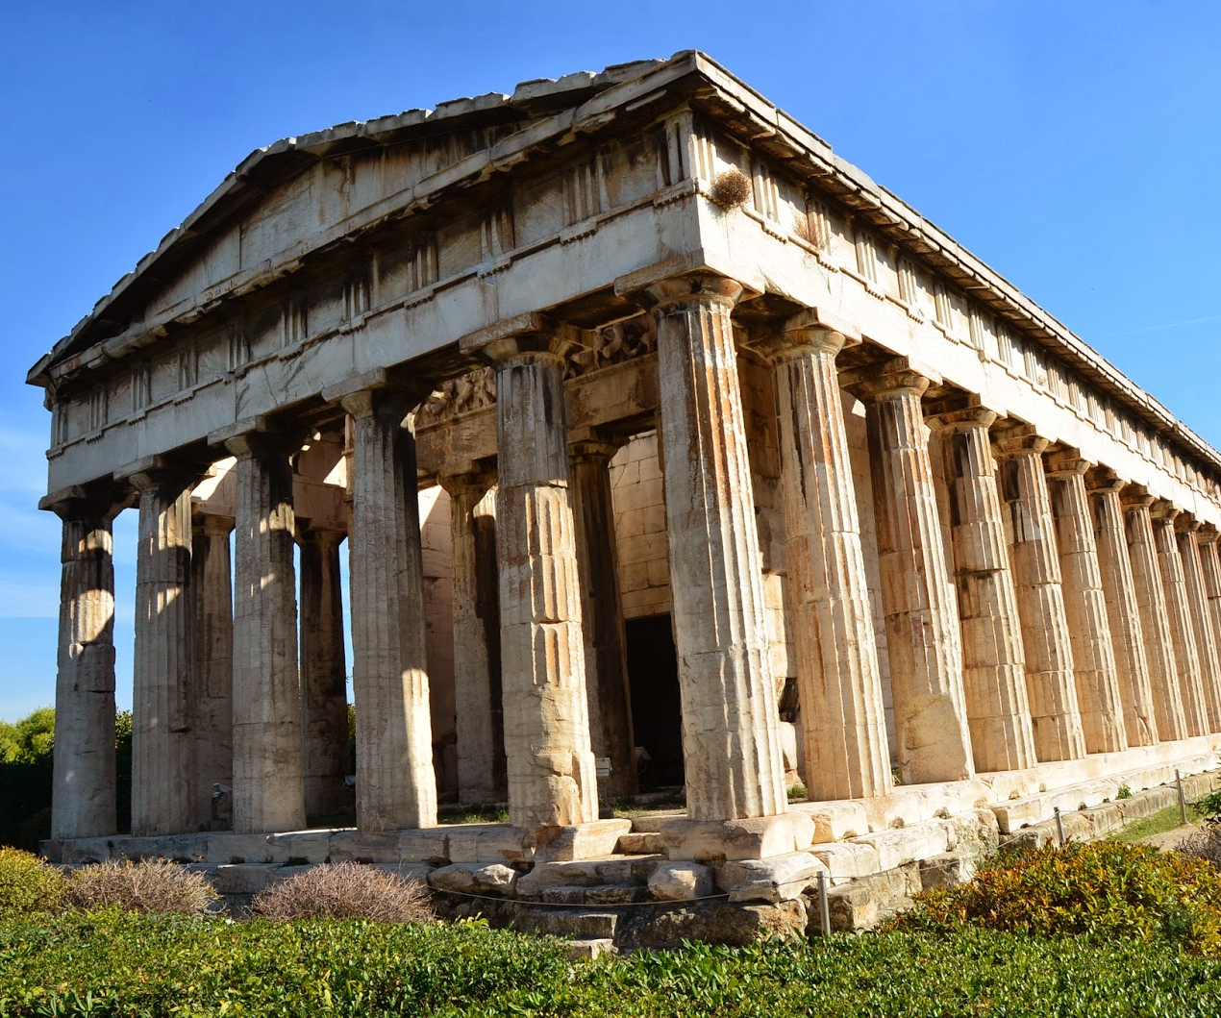
THE ANCIENT GREEKs
The impact on the world started in their hands
This Photo by Unknown author is licensed under CC BY-NC-ND.

Slide 2
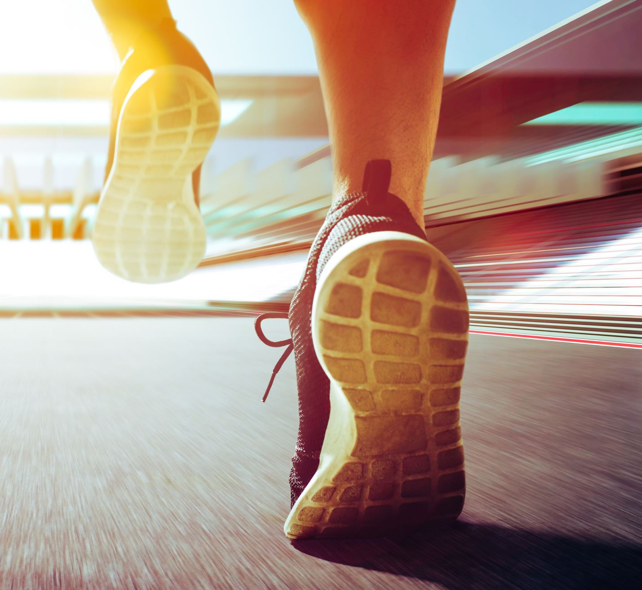
Sport from then to now

Slide 3
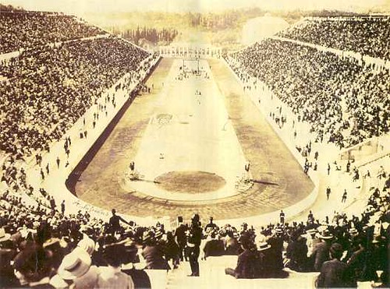
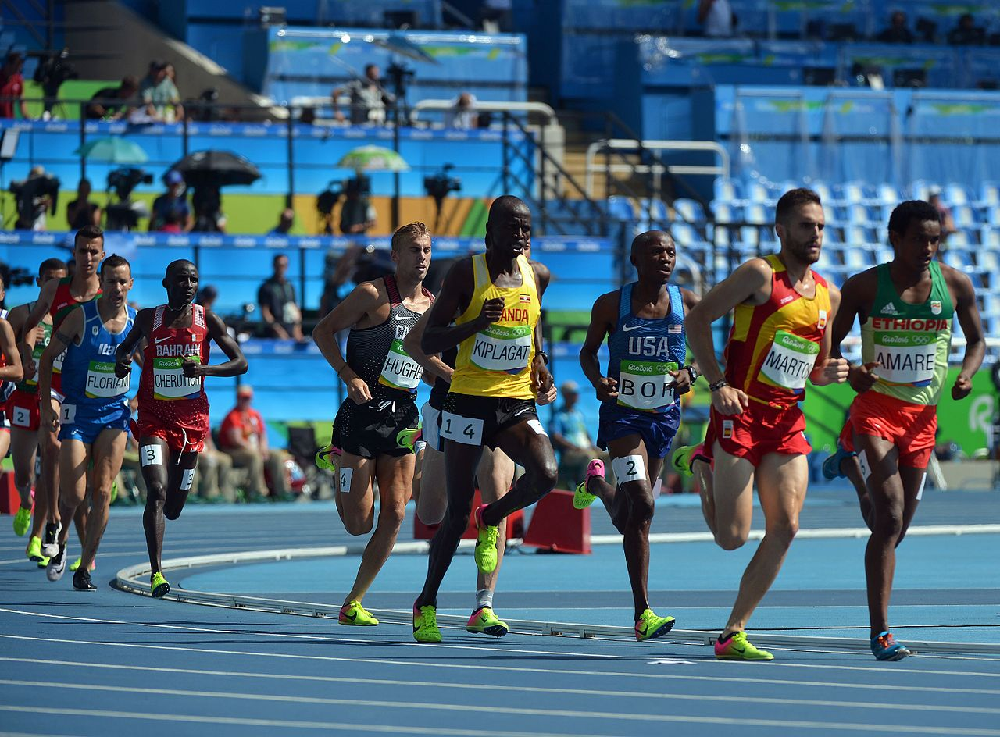
sport
The Ancient Greeks loved to be competitive. They were held in honour of the gods, especially Zeus . Each year a city state was chosen to hold the games. Unlike today, they only sent trained athletes to the Olympics.
Athens

Slide 4

Medicine

Slide 5

medicine
HIPOCRATES was a Greek scholar who had made many helpful contributions to medicine and science. He also founded the first school which taught medicine . SOCRATES was also a noble medic. He also created the hipocratic oath.

Slide 6
Ancient democracy

Slide 7
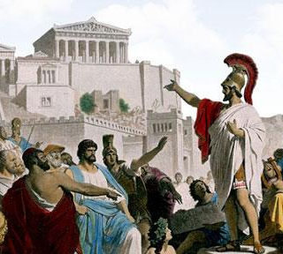
democracy
In Athens all citizens were expected to vote. You were only allowed to vote if you were a male. All men were treated equally and had an equal political right. Athens liked to read and write. They thought teaching and learning was a key to sucess.
Sparta, however, were more into agriculture and conquering.
Democracy

Slide 8
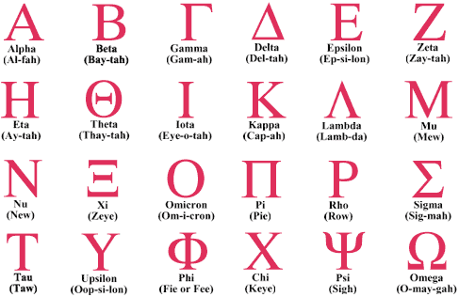

Schools

Slide 9
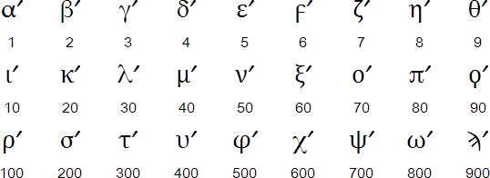
School
In Athens, they particularly liked schools. Ancient Greek schools were usually minute. They only accepted boys from a wealthy background and aged 7-14. they had hardly any equipment and only one teacher!
Sparta liked to put things like fighting ahead of knowlage. This is why they always won battles.

Slide 10
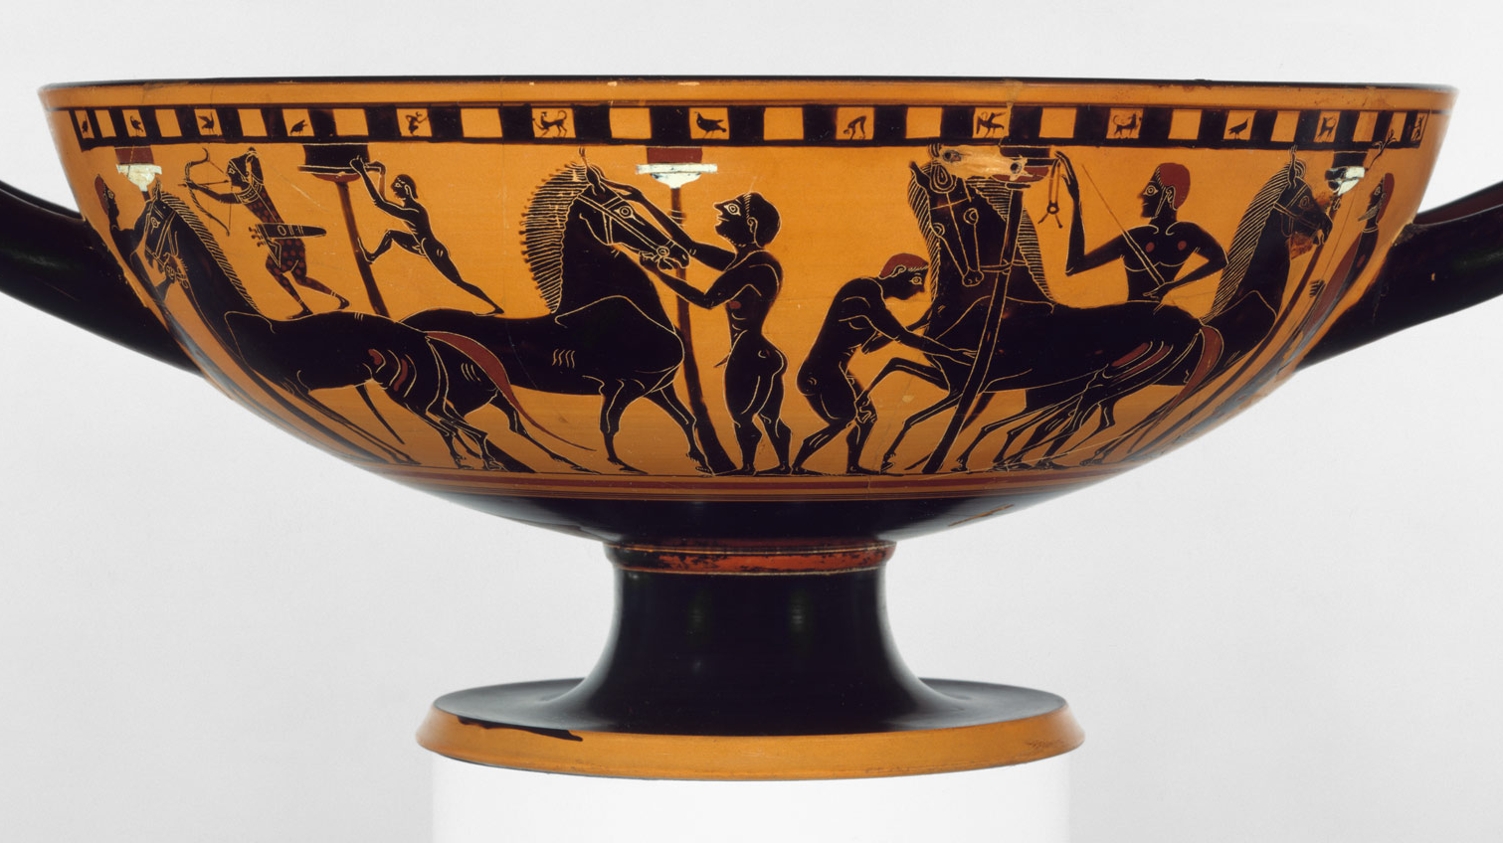
Warfare

Slide 11
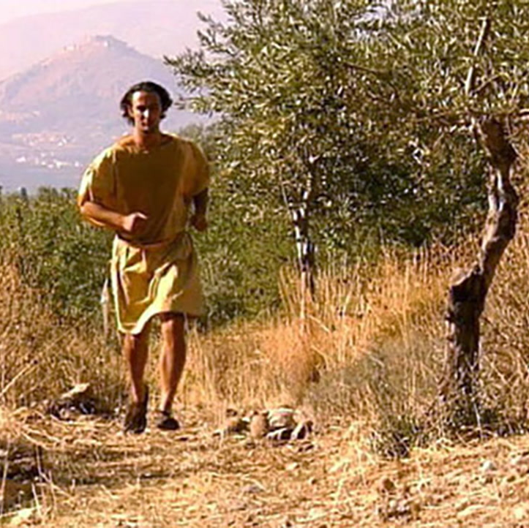
WAR
During 490bc, the battle of Marathon, a man named Herodotus ran to Sparta to ask for help. He ran 25 miles to get help while Athens was under attack.
This is why we have the London marathon.
FUN FACT
Once in 431-405 BC there was a ferocious war. This war was between Athens and Sparta .It was named the Peloponnesian war
This Photo by Unknown Author is licensed under CC BY-SA-NC

Slide 12
The big difference
now
then
Everyone has a say
Girls go to school
You don’t always have to pay for school
We don’t own slaves
Only boys at school
Men only in democracy
All citizens expected to vote

Slide 13
The Great Impact

Slide 14
If the Greeks had not ever lived, we would not have:
Schools
Medicine
The Olympics
the marathon
And finally Democracy

Slide 15





You see the Greeks had a lot of impact on the modern world

