Slide 1
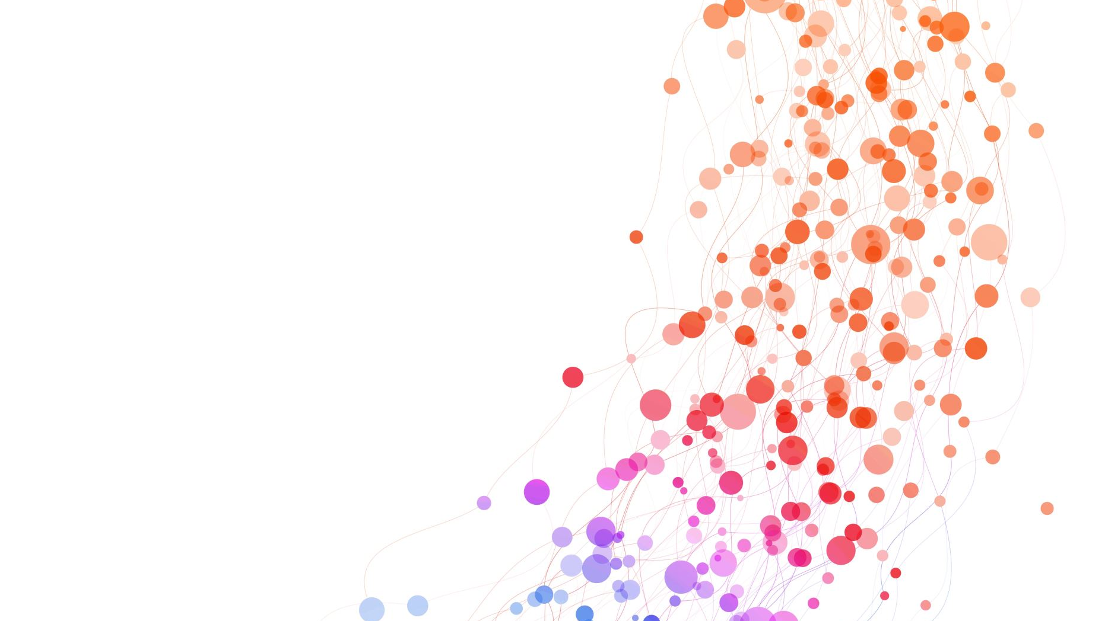
What impact did the Greeks have on the world?
Let's explore what the Greeks left behind...

Slide 2
Sport
The Greeks gave us the Olympics the name comes from Olympia in Greece it is where the first Olympics took place.
During the battle of the marathon in 776 BC a man called Pheidippides ran 25 miles from Marathon to Athens and then to Sparta to gather up troops about this big war that was being attacked.
The sports they did were running, jumping, and discus throwing. However, in 708 BC wrestling was also added.

Slide 3

Health
In honour of Hippocrates, doctors HAD to swear an oath that they would protect all their patients and to keep them healthy.
"Treat the sick to best of ones, ability, persevere patient privacy, teach secrets of medicine to the next generation."

Slide 4

Education
In Sparta boys could go to school but it was more like training than school. They had to hunt their own food like it was survival camp. Girls, on the other hand, trained too and were treated equally to other genders.
However, in Athens, boys went to school and did Grammata ( reading, writing and arithmetic) Music, and Physical education. Girls helped at home

Slide 5
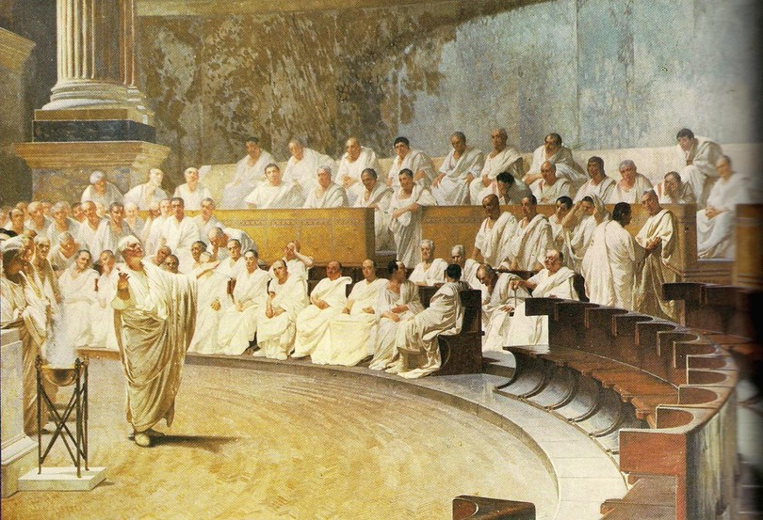
Democracy
Democracy means people-power.
They gave us democracy which we use today. To decide who runs the country. In ancient Athens, they met quite often to vote on the laws that change their lives day to day, using an array of hands. Women, slaves and foreigners were not allowed to voted according to rules and regulations so basically only men from Greece were allowed to vote.

Slide 6

Conclusion
THANKYOU FOR VEIWING LYDIA'S PRESENTATION!

