Slide 1
WHAT IMPACT DID THE GREEKS HAVE?
IN THIS INFORMATIVE PRESENTATION, YOU WILL FIND OUT WHAT IMPACT THE ANCIENT GREEKS HAD ON THE WORLD.

Slide 2
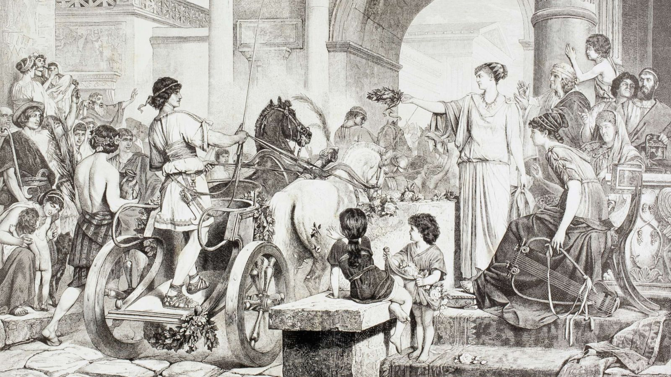
SPORT
The Greeks invented the Olympicswhich still exists today. Without the Greeks, certain sports, such as running, wouldn’t have existed. In Greek times, if you won a event, you were given only a laurel crown. The Olympics were named after Mount Olympus, the home of the Greek gods. Only men were allowed to take part.

Slide 3
Medicine
Greek doctors had to swear a oath called the Hippocratic Oath, named after Hippocrates, a Greek doctor. He was known as the Father of Modern Medicine. The Greek god of medicine is Asclepius.

Slide 4
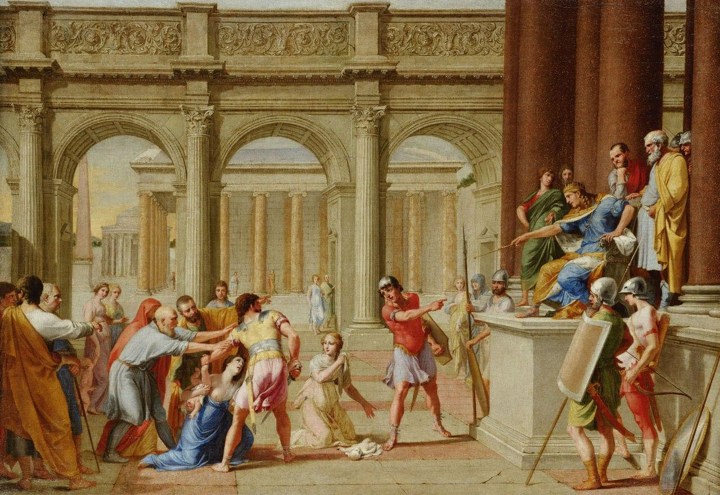
DEMOCRACY
Only Greek men over the age of 20 were allowed to vote. Women, children and slaves were not allowed to vote. In Athens, voting took place in the Parthenon, a sacred temple to all the gods.
Democracy means the citizens of a country are
allowed to vote for who shall rule the country.

Slide 5
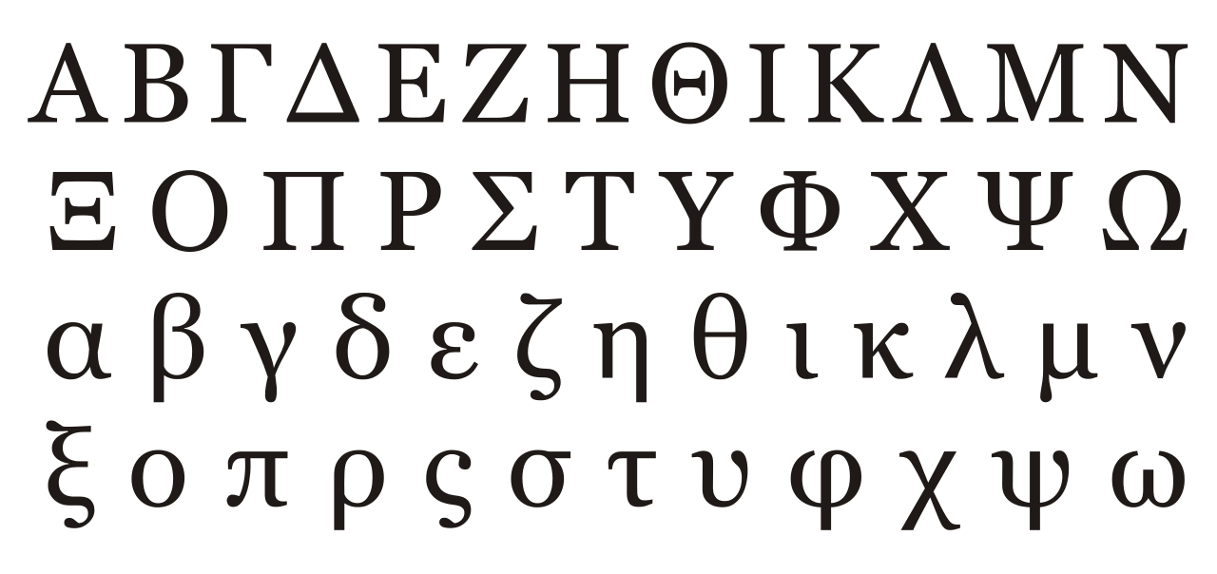
SCHOOL
In a school, students used wood tablets covered in wax and a carving tool called a stylus to write.They were taught sports, poetry, music, writing, maths and reading.
Plato, a Greek
scientist founded
the first university

Slide 6
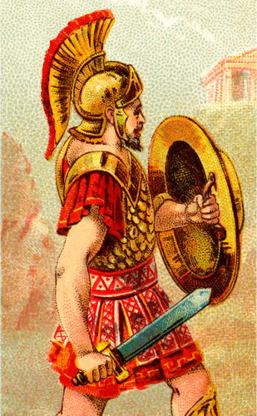
WARFARE
Greeks went to war in phalanxs,
which the romans called the testudo,
Latin for turtle.

Slide 7
THE IMPACT
Without the Greeks, we would have schools, universities, our alphabet, democracy, modern medicine and many things.

