Slide 1
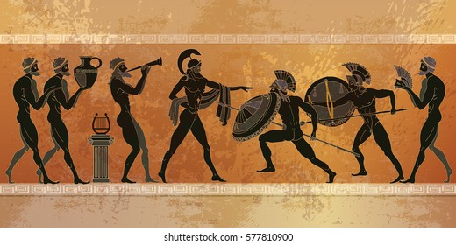
Ancient Greece

Slide 2

What impact did the ancient Greek have on the world?

Slide 3
Sport
Over 2,000 years ago, the first Olympic game was created. They only had one Olympic sport and that was the 200ft race and a chef won it!
The ancient Greeks gave us the marathon. It happened when someone was trying to destroy marathon [a city in Greece] a boy knew this, so he walked 25 miles to Athens to tell them. Now we have the marathon!
Every year, London sets up a marathon and LOTS of people compete in it. It is always 25 miles and now you know why it is 25 miles

Slide 4

Medicine
Docters HAD to swear an oath that they would treat there patients fairly and that they would try their best to heal them so they could go back to war.

Slide 5
Education
In Sparta boys and girls couldn't go to school ,because they would be trained to become warriors!
In Athens only boys could go to school while girls would be doing chores and learn how to do house work.
The ancient Greeks were VERY smart and they were so smart that the first university was named after a Greek philosopher!

Slide 6
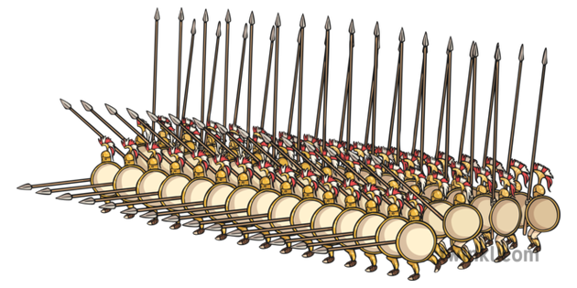
Warfare
Sparta were very vigilant, because a long long, LONG time ago Sparta used to get attacked a LOT so they decided that they would use all there citizens and turned them to soldiers! So, they are a very strong country but they are inland so they don't have a navy.
Athens are a VERY strong country and they have a navy. This makes them a very strong country.
Did you know?
A famous Greek position is called the phalanx!

Slide 7

Democracy
In Athens only boys could vote! I found this surprising, because back then girls couldn't really do anything if you think about it!
Girls didn't have the same rights which was incredibly unfair

Slide 8
Conclusion
I think that the Ancient Greeks have given us a lot , because they gave us the Olympics, the medicine and good Education so I think that the Ancient Greeks Gave us a lot.
Thank you for looking at Erian's presentation!

