Slide 1

LO: To Master Techniques
C: Colour mixing

Slide 2
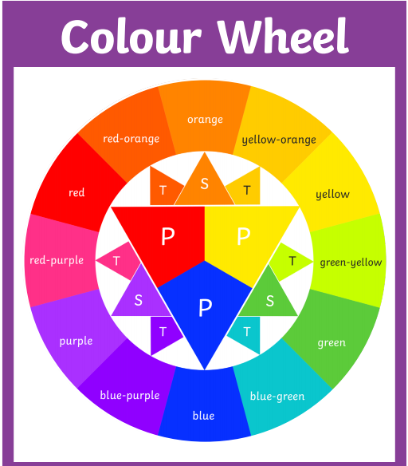

Slide 3
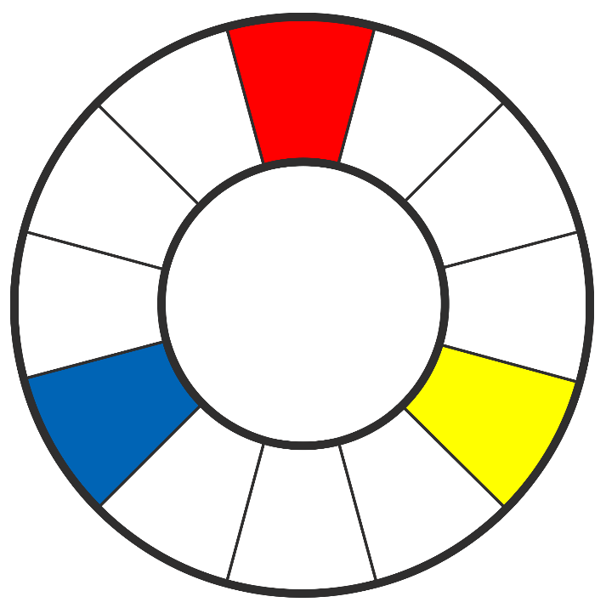
Primary Colours
Red, blue and yellow are known as primary colours.
These colours cannot mixed or made by mixing other colours.
All other colours are derived from the primary colours.

Slide 4
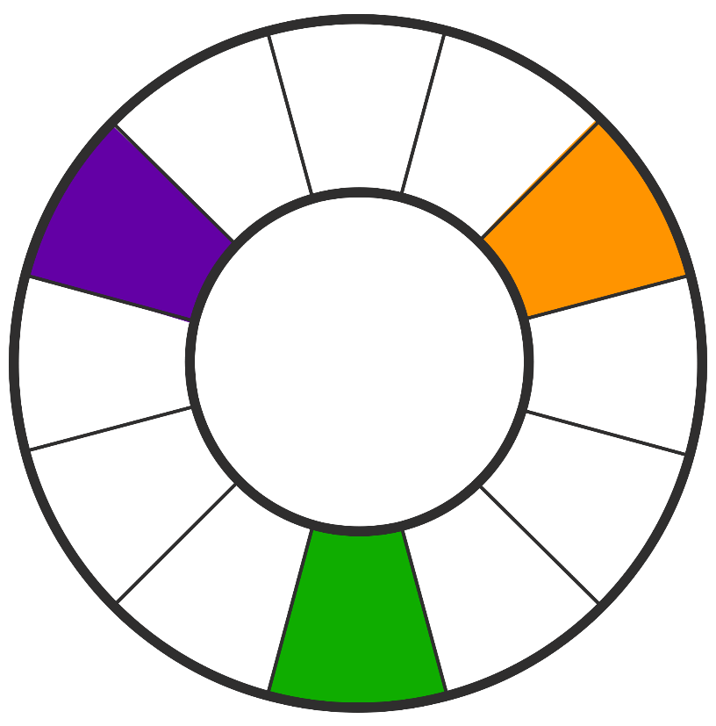
Secondary Colours
The secondary colours are green, orange and purple.
They are made by mixing primary colours.

Slide 5
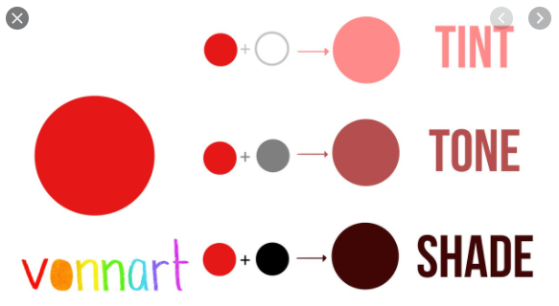

Slide 6
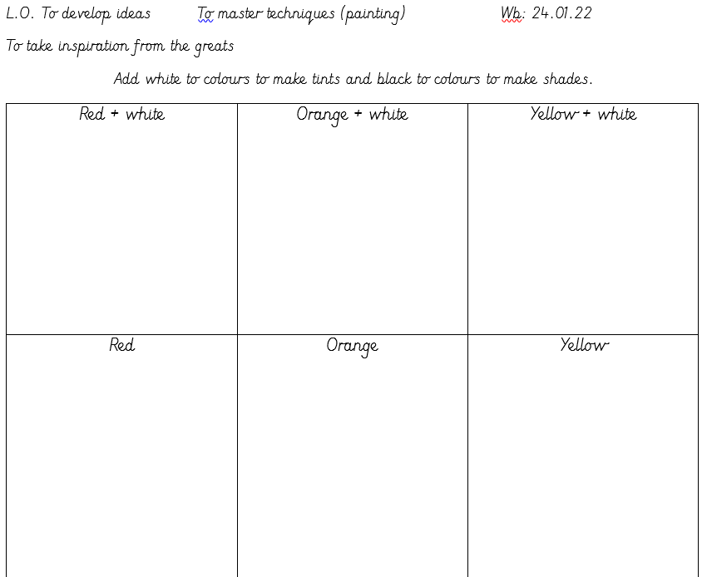

Slide 7
Red Pen Question
Which combination of tints and shades will you use for the fire in your picture? Why?

