Slide 2
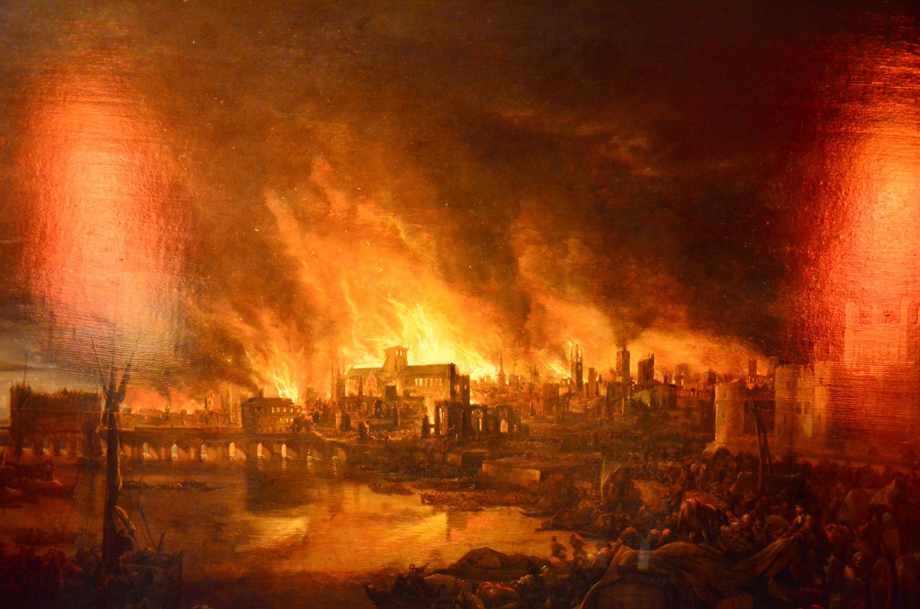
How do we know about the Great Fire?
What is an eyewitness?
Imagine you are there: How would you feel? What would you do?
Photo courtesy of Ben Sutherland(@flickr.com) - - granted under creative commons licence - attribution

Slide 3

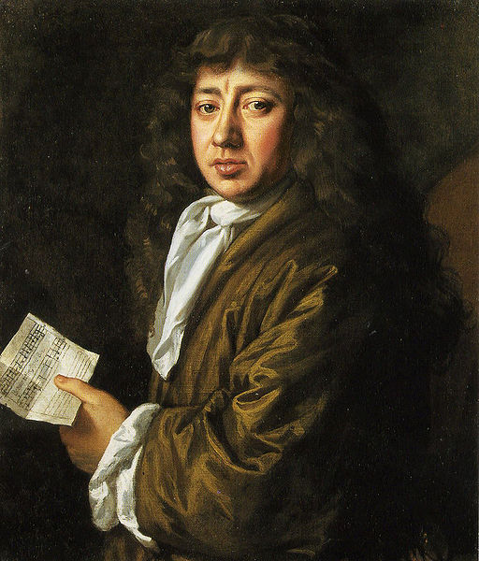
Samuel Pepys
Who is Samuel Pepys? What did he do?
What is a diary? What sort of information do people keep in diaries?
Why might diaries from the past be useful for us today?
Photo courtesy of Robert Hoffstutter(@flickr.com) - - granted under creative commons licence - attribution

Slide 4

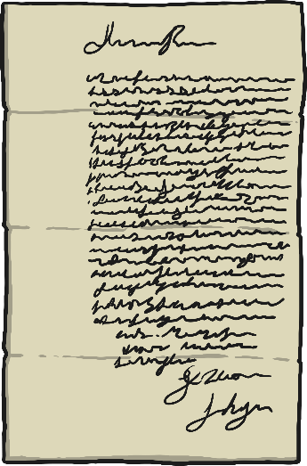
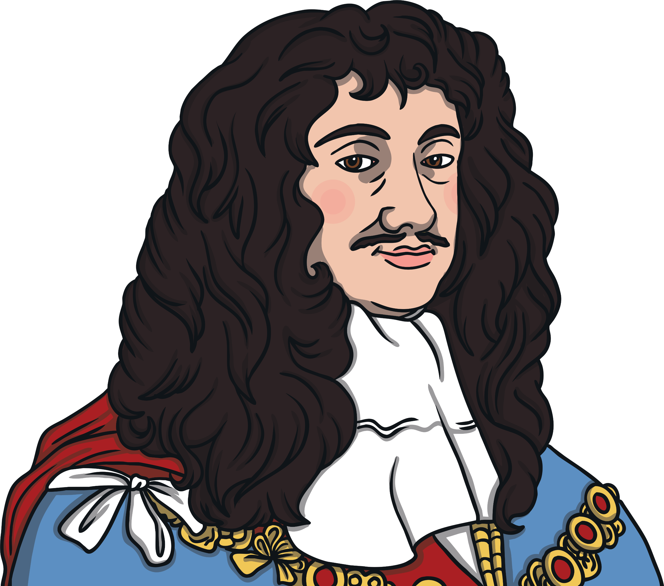
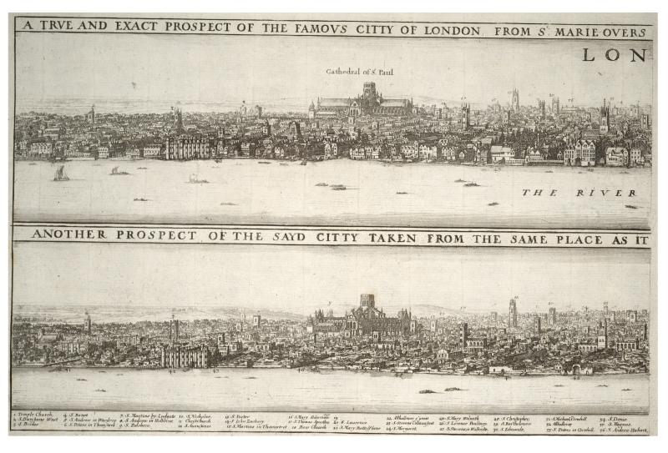
An object that helps historians to find out facts about the past is called a source.
Which of these sources help to let us know how the Great Fire started?
A detailed drawing of the London skyline, before and after.
An eyewitness statement detailing where the fire began, signed by John Morgan in 1668.
A portrait of King Charles II
Photo courtesy of Thomas Fisher Rare Book Library (@flickr.com) - - granted under creative commons licence - attribution

Slide 5


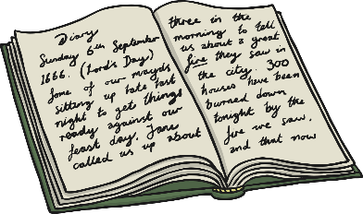


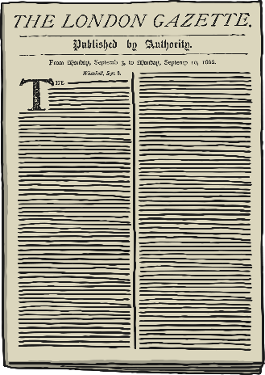

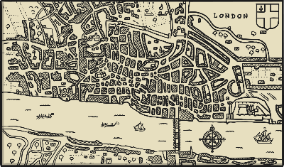
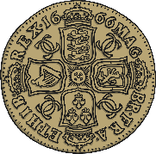
Great Fire Sources
Which of these sources help to let us knowhow the Great Fire started?
You are going to be history detectives!
Look at the pictures on your sheet. Which of these sources will help you to find out more about the Great Fire of London?

Slide 6
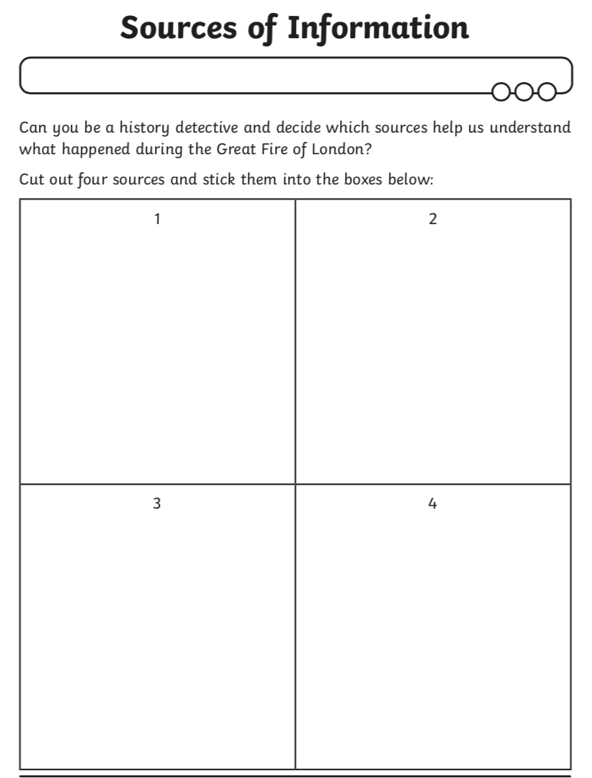
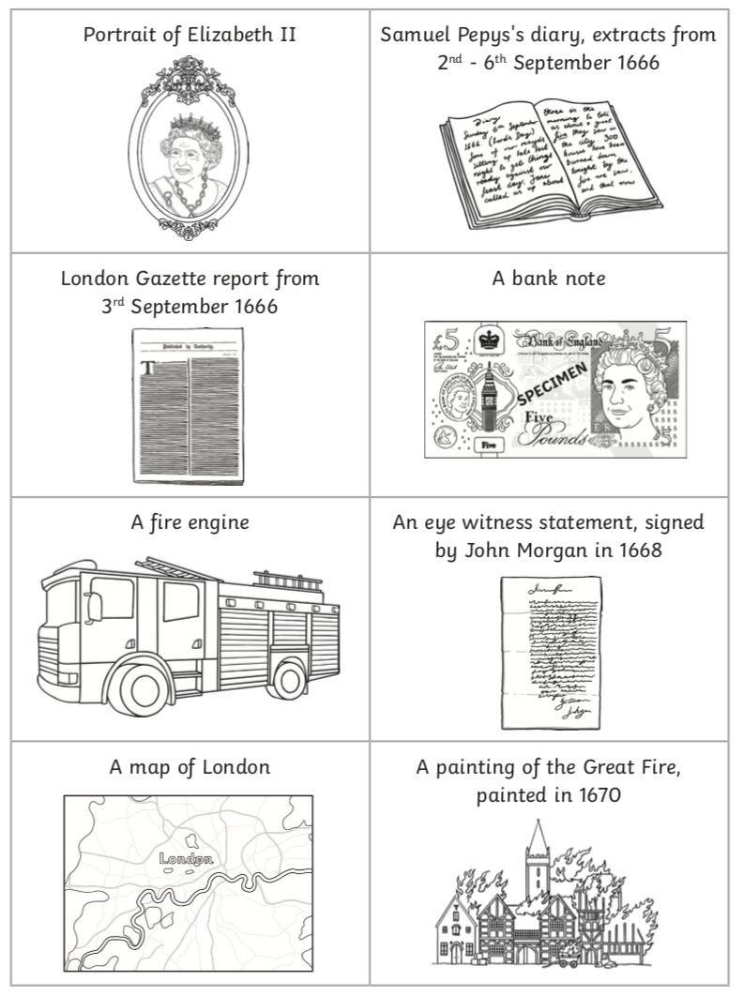
Challenge:
Can you explain why you chose each source?
Why were some sources not helpful?

