Slide 1
LO: I understand the rights and responsibilities of being a member of my class know how to make my class a safe place for everybody to learn
C: Being me in my world – Piece 3

Slide 2
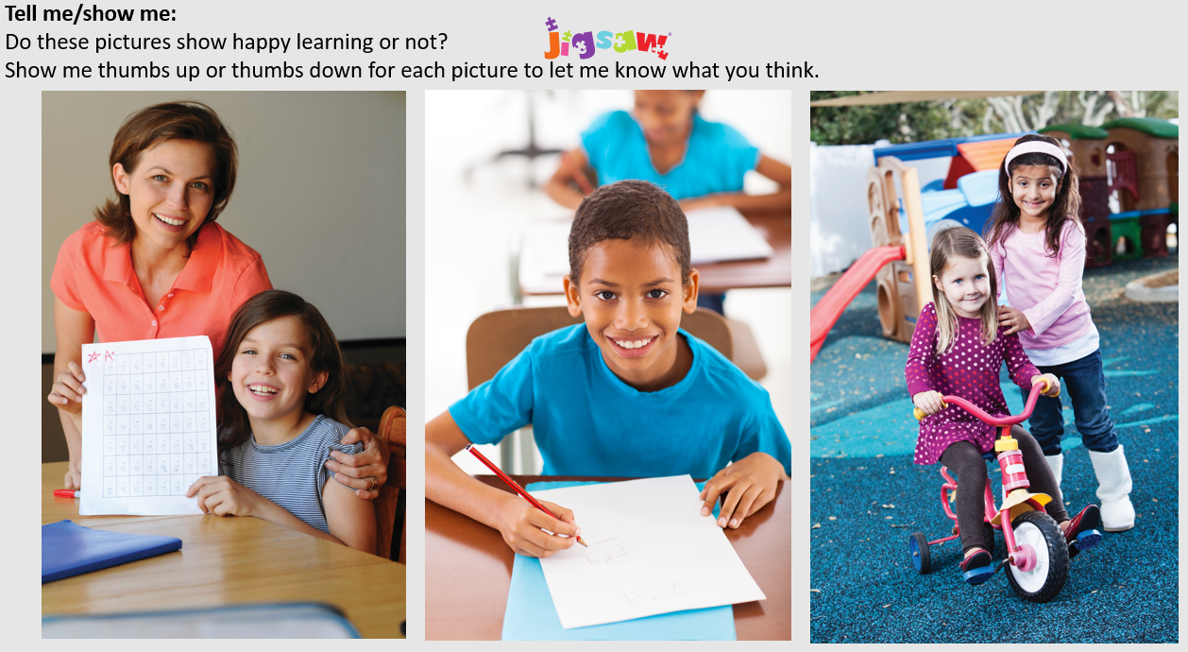

Slide 3
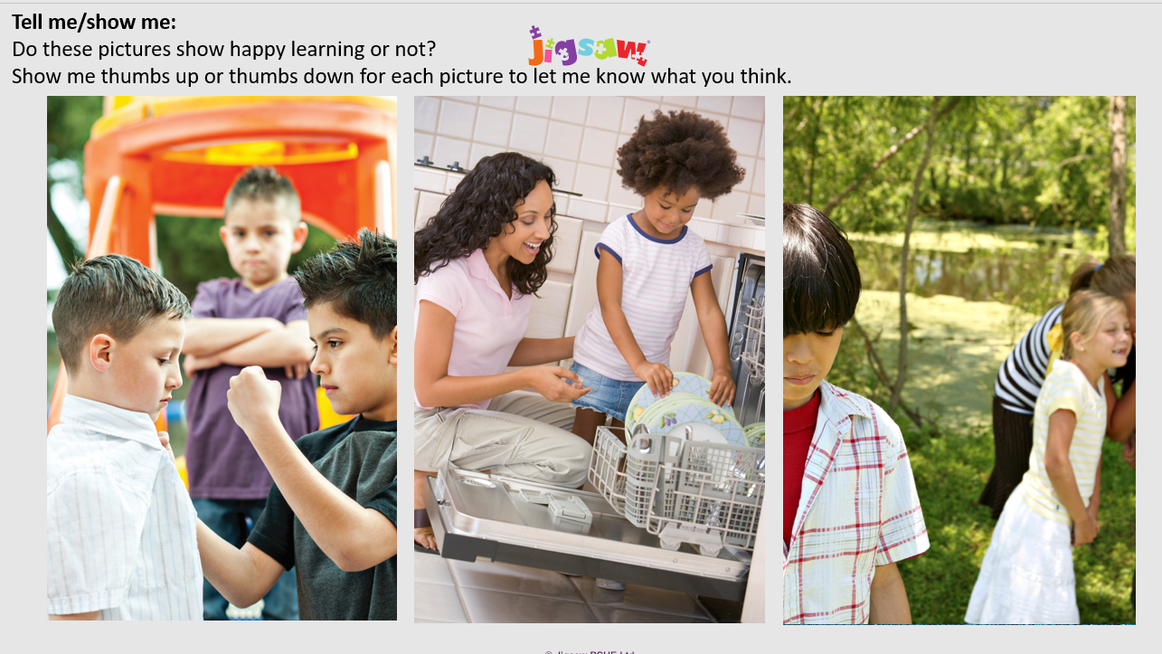

Slide 4
Let me learn: TTYP
What do you think is important for happy learning in school?
(Teacher write class ideas on whiteboard and take photo for childrens’ books. This learning charter will be needed for other lessons. )
Examples:
We are kind
We listen
We work hard

