Slide 1

Healthy Eating: bringing the Eatwell Guide to life
Year 3’s Sandwich Project!
9.2.2021
Designing!
Alex White
British Nutrition Foundation

Slide 2
Healthy Eating: bringing the Eatwell Guide to life
Year 3’s Sandwich Project!
Your first step is to draw and label your sandwich. Remember to think about your Eat Well chart you made yesterday, as well as the food you have at home.
Alex White
British Nutrition Foundation

Slide 3
Healthy Eating: bringing the Eatwell Guide to life
Year 3’s Sandwich Project!
Remember your sandwich should include:
Carbohydrate : Bread of some kind
A dairy product
Spread
Protein
2+ Fruit/Vegetables
Alex White
British Nutrition Foundation

Slide 4
Healthy Eating: bringing the Eatwell Guide to life
Year 3’s Sandwich Project!
Once you have completed the sandwich design, you need to think about the steps to build it.
Try to be as clear as possible- imagine an alien is trying to make it!
Alex White
British Nutrition Foundation

Slide 5
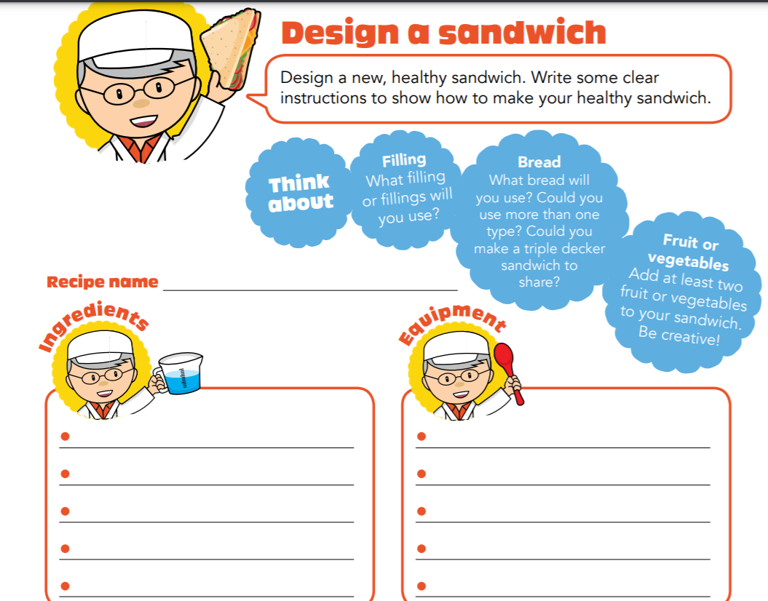
Healthy Eating: bringing the Eatwell Guide to life
Miss Watton’s Super Supreme Sandwich
Alex White
British Nutrition Foundation
Anti-bacterial spray
Butter knife
Chopping board
Cutting knife
2 slices of white bread
10g of low-fat sunflower spread
1 slice of lean chicken breast
Grated low-fat cheese
2 sliced plum tomatoes

Slide 6
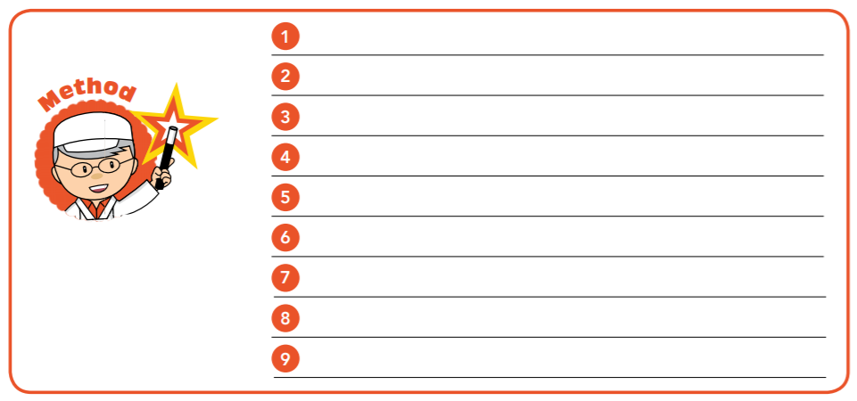
Healthy Eating: bringing the Eatwell Guide to life
Use the butter knife to evenly spread half the sunflower spread on each slice of bread.
Place the sliced chicken on top of one buttered piece of bread. Make sure it is in the middle.
Alex White
British Nutrition Foundation

