Slide 1
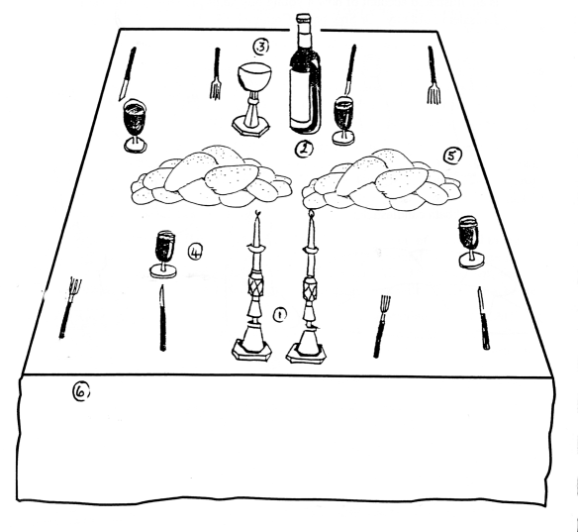
This special meals takes place every Friday
evening to celebrate the Shabbat starting.
The table is laid with special cutlery and a
table cloth as this is a celebration.
The Shabbat Candles are lit to welcome the
special day.
They drink wine called Kiddush from a
special cup called the Kiddush cup. They
do this to welcome the angels into their home
during the meal.
There are two loaves of bread on the table
called Challah. This reminds them of a story
in their special book (the Torah) when
God sent the Jews 2 portions of bread in the
desert.

