Slide 1

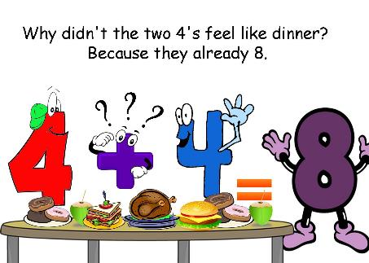
9.2.2021
L.O: Multiplication and Division
C: Consolidate 2, 4 and 8 times-tables.

Slide 3


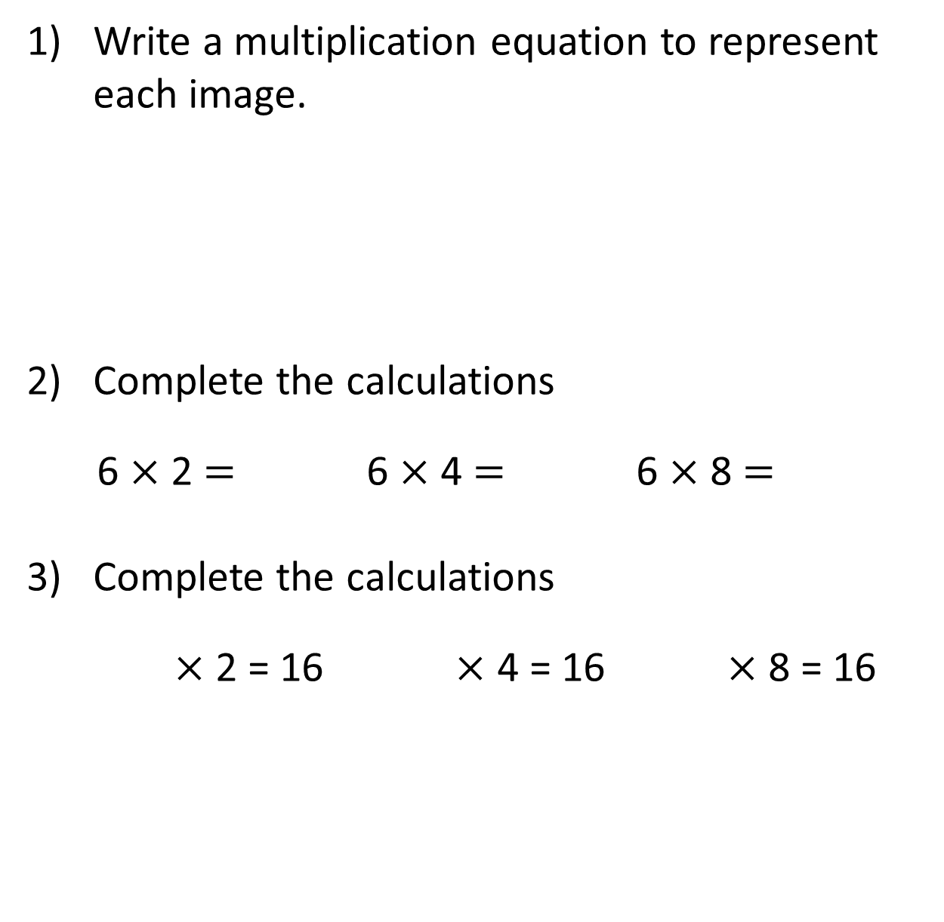
1) Write a multiplication equation to represent each image.
2) Complete the calculations
6 $×$ 2 $=$ 6 $×$ 4 $=$ 6 $×$ 8 $=$
3) Complete the calculations
$×$ 2 = 16 $×$ 4 = 16 $×$ 8 = 16

Slide 4
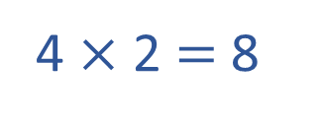
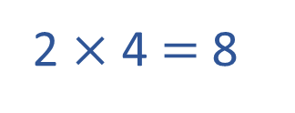
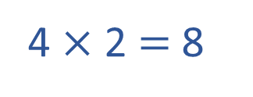

1) Write a multiplication equation to represent each image.
2) Complete the calculations
6 $×$ 2 $=$ 6 $×$ 4 $=$ 6 $×$ 8 $=$
3) Complete the calculations
$×$ 2 = 16 $×$ 4 = 16 $×$ 8 = 16
4 $×$ 2 $=$ 8
2 $×$ 4 $=$ 8
2 $×$ 4 $=$ 8
4 $×$ 2 $=$ 8
12
24
48
8
4
2

Slide 6


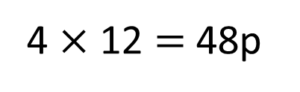
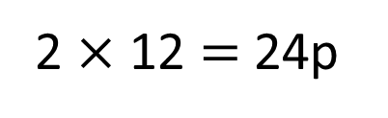
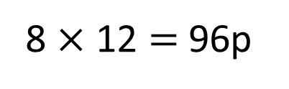
One lolly costs 12p
What is the total cost of
2 lollies?
4 lollies?
8 lollies?
12p
12
12
2 $×$ 12 $=$ 24p
12
12
12
12
4 $×$ 12 $=$ 48p
12
12
12
12
12
12
12
12
8 $×$ 12 $=$ 96p
Have a think

Slide 7


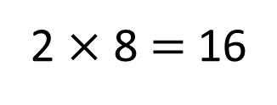
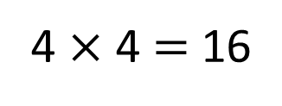

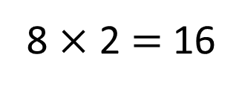


2 | 4 | 6 | 8 | 10 | 12 | 14 | 16 | 18 | 20 | 22 | 24
4 | 8 | 12 | 16 | 20 | 24 | 28 | 32 | 36 | 40 | 44 | 48
8 | 16 | 24 | 32 | 40 | 48 | 56 | 64 | 72 | 80 | 88 | 96
8 $×$ 2 $=$ 16
$÷$ 2
$×$ 2
4 $×$ 4 $=$ 16
$÷$ 2
$×$ 2
2 $×$ 8 $=$ 16

Slide 8



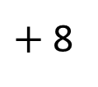
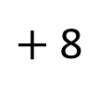

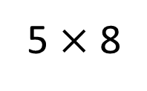
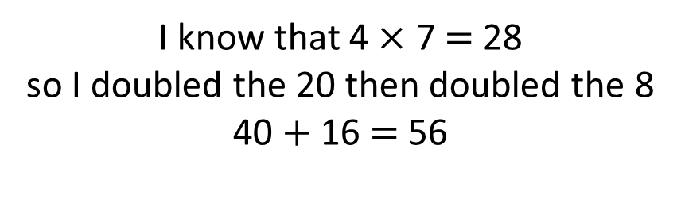
How could you calculate 7 $×$ 8?
0
8
16
24
32
40
48
56
I know that 4 $×$ 7 $=$ 28
so I doubled the 20 then doubled the 8
40 $+$ 16 $=$ 56
5 $×$ 8
$+$ 8
$+$ 8
Have a think
0
40
48
56

Slide 9


Alex and Rosie are playing a game.
4 | 36 | 16 | 28 | 12 | 8
24 | 48 | 16 | 8 | 56 | 40
88 | 24 | 40 | 48 | 32 | 16
20 | 72 | 24 | 16 | 24 | 64
40 | 32 | 80 | 44 | 96 | 48
First we fill the grid with any multiples of 2, 4 and 8

Slide 10




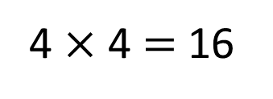
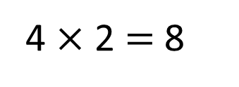
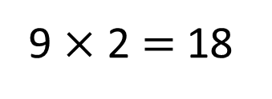
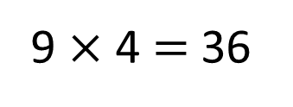
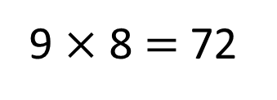
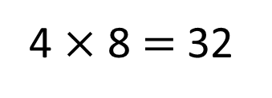
Alex and Rosie are playing a game.
4 | 36 | 16 | 28 | 12 | 8
24 | 48 | 16 | 8 | 56 | 40
88 | 24 | 40 | 48 | 32 | 16
20 | 72 | 24 | 16 | 24 | 64
40 | 32 | 80 | 44 | 96 | 48
4 $×$ 2 $=$ 8
9 $×$ 2 $=$ 18
4 $×$ 4 $=$ 16
9 $×$ 4 $=$ 36
4 $×$ 8 $=$ 32
9 $×$ 8 $=$ 72

Slide 11

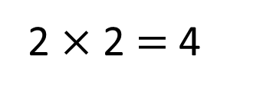
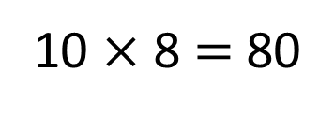
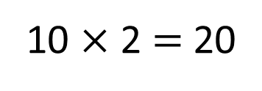
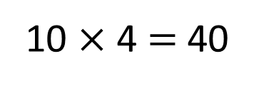
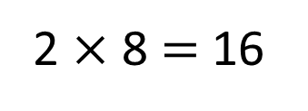
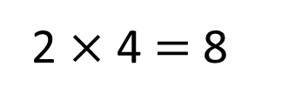
Alex and Rosie are playing a game.
4 | 36 | 16 | 28 | 12 | 8
24 | 48 | 16 | 8 | 56 | 40
88 | 24 | 40 | 48 | 32 | 16
20 | 72 | 24 | 16 | 24 | 64
40 | 32 | 80 | 44 | 96 | 48
2 $×$ 2 $=$ 4
10 $×$ 2 $=$ 20
2 $×$ 4 $=$ 8
10 $×$ 4 $=$ 40
2 $×$ 8 $=$ 16
10 $×$ 8 $=$ 80

Slide 12
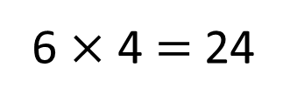
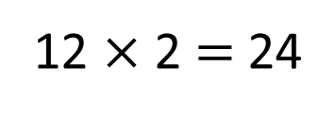
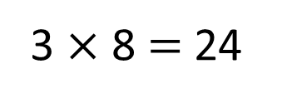
What number could Alex have rolled?
4 | 36 | 16 | 28 | 12 | 8
24 | 48 | 16 | 8 | 56 | 40
88 | 24 | 40 | 48 | 32 | 16
20 | 72 | 24 | 16 | 24 | 64
40 | 32 | 80 | 44 | 96 | 48
12 $×$ 2 $=$ 24
6 $×$ 4 $=$ 24
3 $×$ 8 $=$ 24
Alex could have rolled 12, 6 or 3

Slide 13


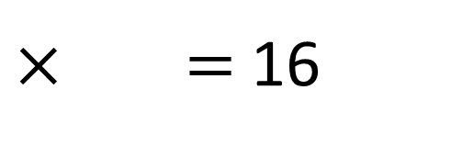

Work out the value of each shape and then calculate the missing numbers.
4
$× =$ 8
Have a think
2
4
$× =$ 16
4
$× × =$
32
$× × =$
16

Slide 14
Have a go at the rest of the questions on the worksheet

