Slide 1
Creation

Slide 2
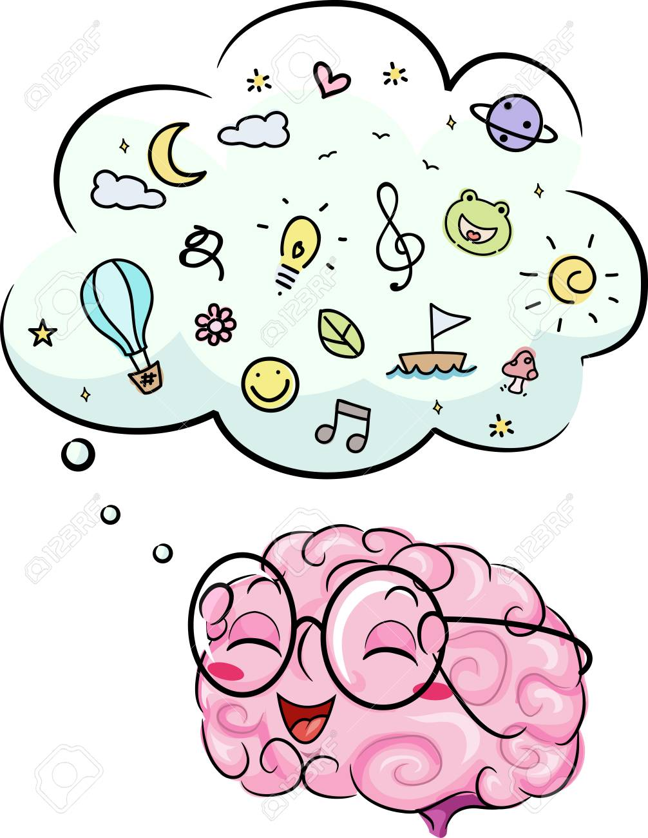
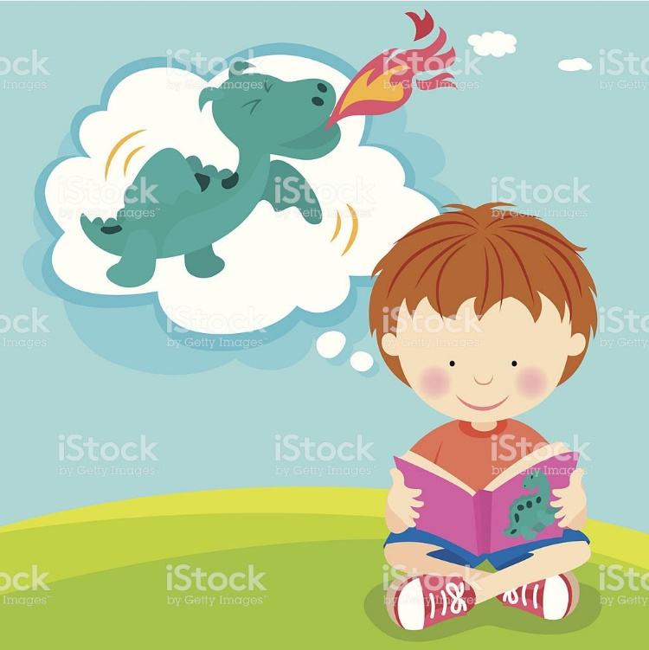
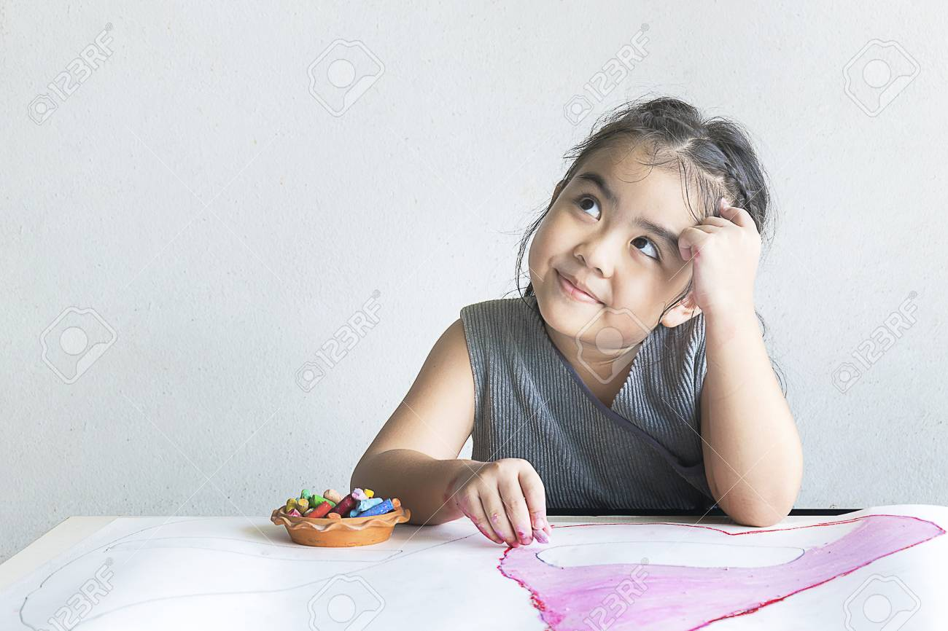

God created the world and everything on it 6 days. What would you create if you could?
Flex your imagining muscles…

Slide 3
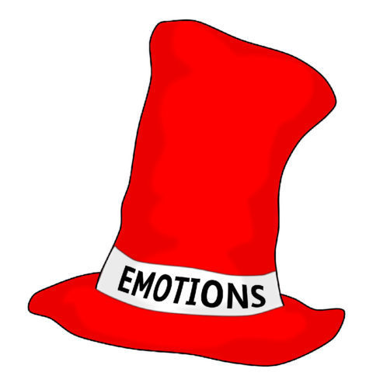
It’s time to put our red hats on!
Our red hats help us think about our feelings.
How did you feel when you made your creation?
How would you feel if someone wanted to look after it for you?
How would you feel if someone or some people destroyed it?

Slide 4
Tasks
Paddling: (Describe)
Write about what you made and how it made you feel.
Snorkeling: (Describe)
Write about your creation and how it made you feel. How would you feel if someone wanted to look after it?
Diving:(Predict)
Write about your creation and how it made you feel. How do you think you would feel if someone wanted to look after it?
How do you think you would feel if someone destroyed it?
Red pen – How do you feel about things you have created?

