Slide 1

LO: To Master Techniques
To Develop Ideas
C: Respond to ideas and starting points.
Explore ideas and collect visual information.
Use thick and thin brushes.

Slide 2
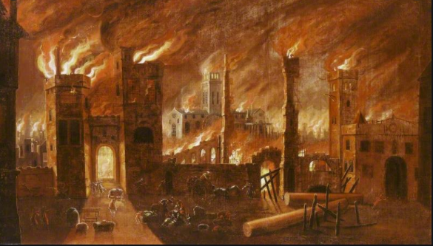
How were these painting created?
What tools may have been used?

Slide 3
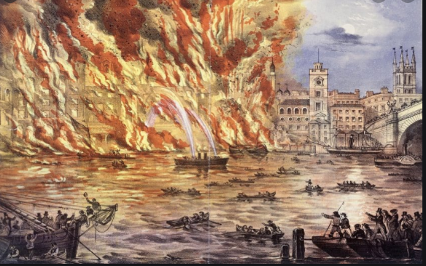

Slide 4
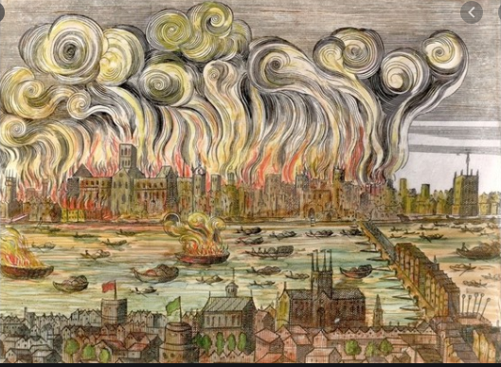

Slide 5
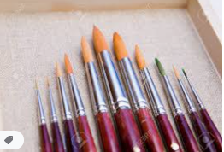
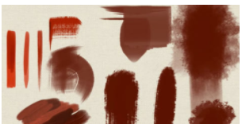
Using different sized brushes can help us create different effects.

Slide 6
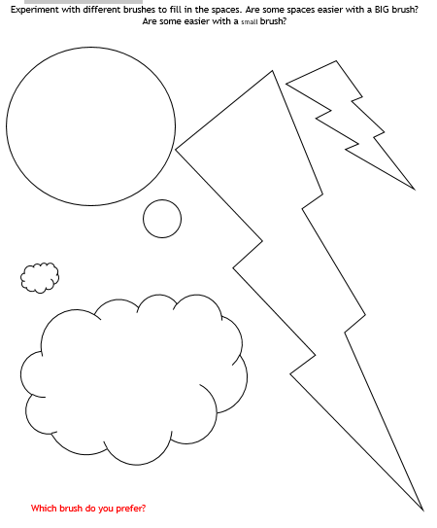
Task
(Available as a word document on class pages)
I prefer the thick/thin brush because…

Slide 7
Resourcing art supplies at home…
Be creative!

