Slide 1
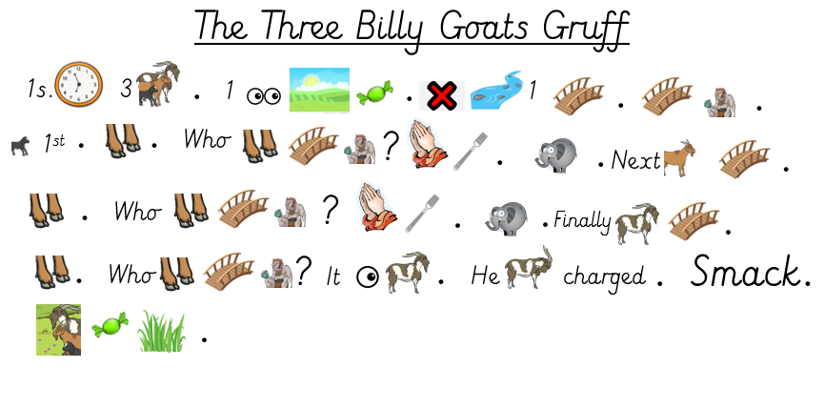

Slide 2
Once upon a time there were three Billy Goats Gruff. One day they saw a field of sweet green grass. They had to cross a river but there was only one bridge. Under the bridge lived a terrible, grumpy troll. The smallest Billy Goat Gruff was the first to try. Trip-trap, trip-trap. “Who goes trip-trap over my bridge?” growled the troll. “Please don’t eat me. My brother is much bigger than me.” Next, the medium sized Billy Goat Gruff went over the bridge. Trip-trap, trip-trap. “Who goes trip-trap over my bridge?” growled the troll. “Please don’t eat me. My brother is much bigger than me.” Finally, the biggest Billy Goat Gruff went over the bridge. Trip-trap, trip-trap. “Who goes trip-trap over my bridge?” growled the troll from under the bridge. “It is I, big Billy Goat Gruff.” He lowered his horns and charged. Smack! He joined his brothers and they ate sweet green grass.

