Slide 2
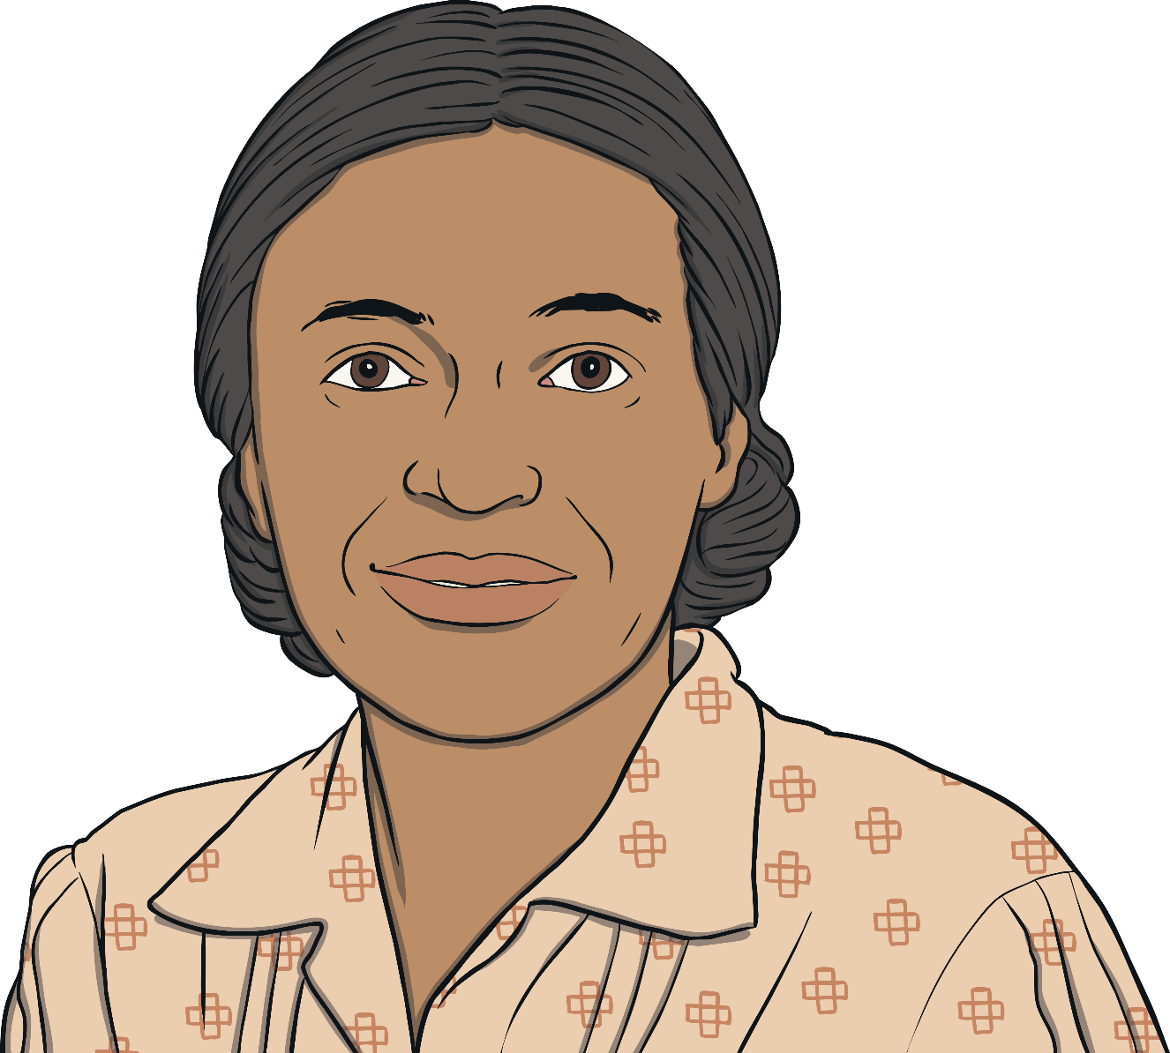
Early Life
Rosa Parks was born on February 4, 1913.
She grew up in Tuskegee, Alabama.
Rosa lived on her grandparents’ farm.
Her mother was a teacher and homeschooled her.

Slide 3
Segregation
Rosa experienced racism as a child.
She saw how laws separated people based on the color of their skin.
During this time in history, many things were segregated.
Black and white people had separate restaurants, parks, and even bathrooms.
Black children were not allowed to go to the same schools as white children.
To segregate means to separate people from each other. At this time, segregation was based on skin color.
What does segregated mean?

Slide 4
Who Was Rosa Parks?
Rosa married Raymond Parks in 1932.
They lived in Montgomery, Alabama.
Rosa worked as a seamstress.
She was a civil rights activist.
She was a member of the NAACP.

Slide 5
Bus Segregation
Buses were segregated in Montgomery.
The rule was that Black people had to sit at the back of the bus.
They also had to give up their seat to white passengers.
Black passengers that did not obey the rules could be fined or arrested.

Slide 6
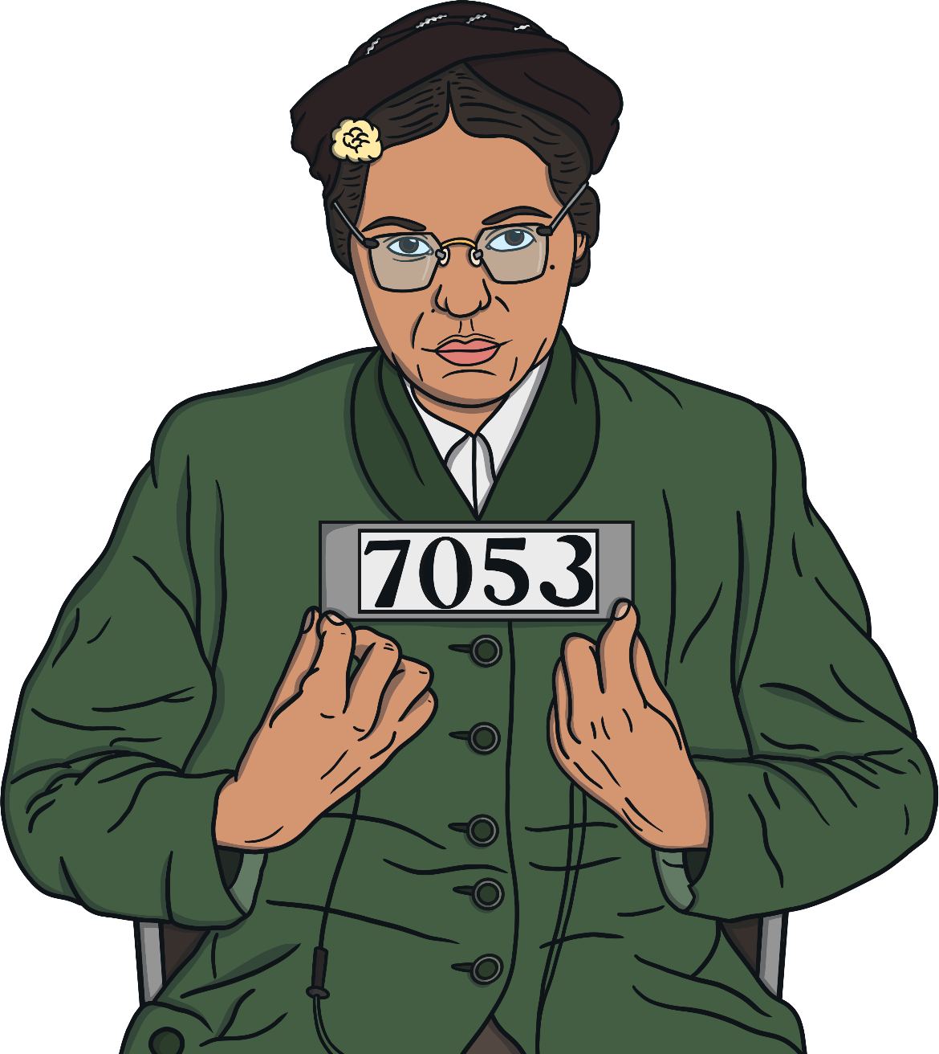
December 1, 1955
Rosa Parks rode the bus to work each day.
On December 1, 1955, Rosa refused to give her seat up to a white passenger.
The bus driver told her she had to move to the Black section of seats.
She refused to move.
Rosa Parks was arrested and went to jail.

Slide 7
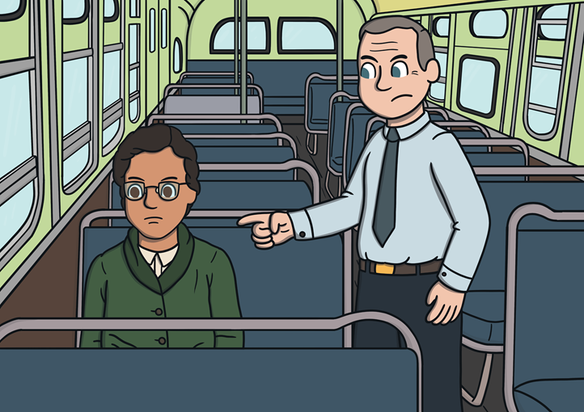
Why Didn’t She Move?
Why do you think Rosa Parks did not move?
Rosa did not feel she should have to move. She was feeling angry about the unfair segregation that had been happening. Rosa felt that Black people in society were being treated differently than white people.
click for answer

Slide 8
Montgomery Bus Boycott
People were angry about the arrest of Rosa Parks.
They organized a bus boycott.
Black people would refuse to use any buses until the bus segregation ended.
Martin Luther King Jr. led the bus boycott.
For 381 days, 40,000 people did not ride the buses.

Slide 9
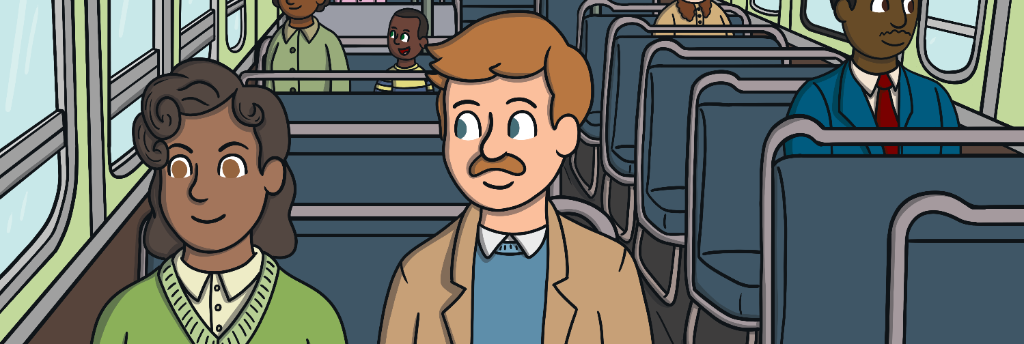
End of Bus Segregation
The boycott officially ended on December 20, 1956.
The Supreme Court declared that the Alabama and Montgomery laws
that segregated buses were unconstitutional.
Rosa Parks’ bravery had led to the end of bus segregation.
Turn and talk with a partner about that word.
What do you think unconstitutional means?

Slide 10
Legacy of Rosa Parks
Rosa Parks is remembered for her civil rights activism.
She is called “the first lady of civil rights.”
Rosa Parks received the Presidential Medal of Freedom and the Congressional Gold Medal for her role in the civil rights movement.
Rosa Parks Day is celebrated each year on February 4.

Slide 11
Check Your Knowledge
1. What year was Rosa Parks arrested?
a
b
c
1913
1956
1955
2. Who led the bus boycott in Montgomery?
a
b
b
c
Malcolm X
Martin Luther King Jr.
Rosa Parks
3. What did Rosa Parks refuse to do?
a
give her seat to a white passenger
b
c
pay bus fare
get off the bus

Slide 12
Check Your Knowledge
4. Black and white children could attend school together during segregation.
a
b
true
false
5. Rosa Parks lived in the city as a child.
a
c
a
b
b
b
true
false
6. Rosa Parks received the Presidential Medal of Freedom for her role in the civil rights movement.
a
c
a
a
b
b
true
false

Slide 13
Check Your Answers
c. 1955
b. Martin Luther King Jr.
a. give her seat to a white passenger
b. False-White and black children were not allowed to attend school together during segregation.
b. False-Rosa lived on her grandparents’ farm as a child.
a. True-Rosa received the Presidential Medal of Freedom in 1996 from President Clinton.

Slide 14
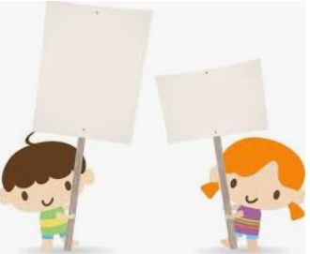
Task
Create a placard to remind people that it’s important to treat other people fairly.

