Slide 1
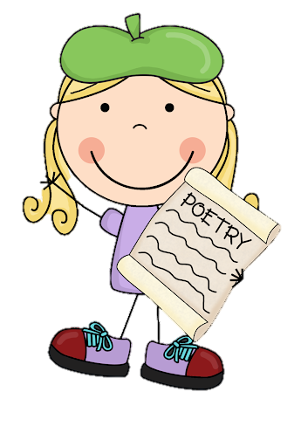

Tuesday 2nd March 2021
L.O: To investigate the main features of a type of writing.
C: Cinquain Poems

Slide 2

Quick reminder:
A cinquain is a special kind of poem. Over the next two weeks, we are going to investigate the features and create our own!

Slide 3

Today it is your turn to spot the features!

Slide 4
Let’s remind ourselves of the features!
Cinquains have five lines;
The syllables follow a pattern in each line (2, 4, 6, 8, 2);
They form a diamond shape;
The lines are centered in the middle
The lines follow a theme pattern.

Slide 5

Your task!
Please label the features on a cinquain of your choice!
I do! You do!
Don’t worry, I’m going to show you an example!

Slide 6

My Turn!
Flowers
Pretty, fragrant
Swaying, growing, blooming
They make me feel very happy
Blossoms
WATCH VIDEO

Slide 7
Your turn!
Choose one of these three poems to label!
Use the features as a checklist!

Slide 8
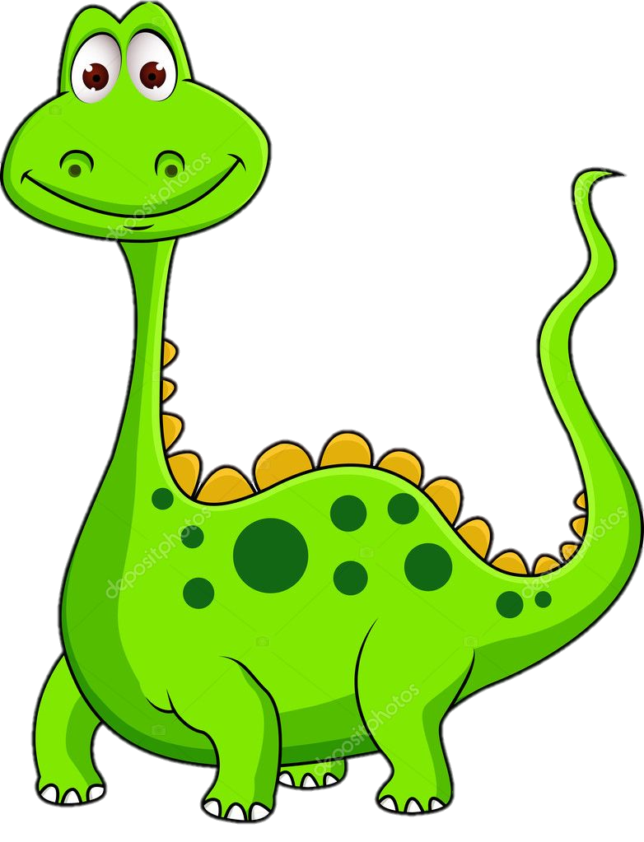
Option 1:
Dino
Enormous, fierce
Roaming, fighting, screeching,
Sadly, dinosaurs are extinct,
Reptiles

Slide 9

Option 2:
Nature
Beautiful, green
Refreshing, relaxing
Nature is very important
Outside

Slide 10
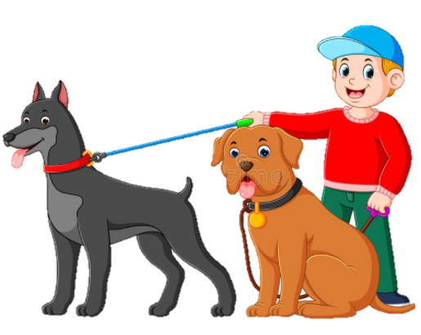
Option 3:
Big Dogs
Furry, friendly
Barking, fetching, playing
Always there to play fetch with you
My pets

Slide 11

RED PEN CHALLENGE!
ABC
A: Achievement- What do you like about this poem? What is successful?
B: Build On- How could you improve this poem?
C: Challenge: How will you use this activity to challenge yourself when writing your own poem?

