Slide 1

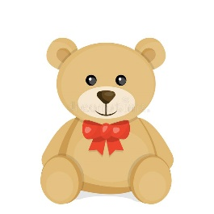
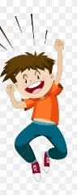
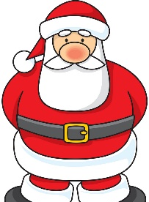




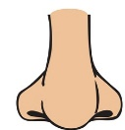
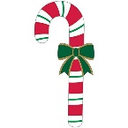

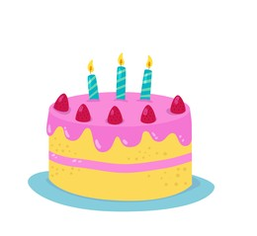
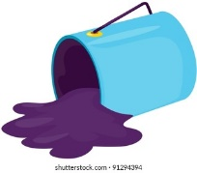

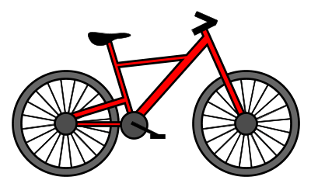



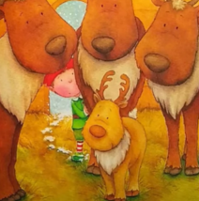

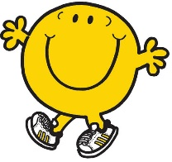


The Littlest Elf
.
.
.
.
.
.
.
Finally
.
.
.
.
He met

Slide 2
Oliver was the littlest elf. Oliver was excited because this year he would discover his job at Santa’s workshops. Santa’s workshops always smelt of peppermint candy canes and there was always jolly Christmas music playing. Oliver went to the toy workshop but he got lost in the stuffing. He went to the bike workshop but the tools were too heavy. Then, tried the bakery but he fell in the mixing bowl. Finally he went to the book makers but he spilt the ink. Oliver was sad. He met dot, a reindeer, who was also too little. They made presents for the other elfs which made them very happy. Santa was pleased with Dot and Oliver.

