Slide 1

LO: To Reflect
C: Does Chanukah make Jewish children feel closer to God?

Slide 2
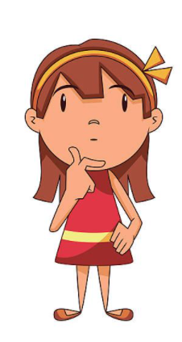
Chanukah is a time when Jewish children reflect on what is important to them.

Slide 3

What are you thankful for?
It could be something very big or something very small and personal.

Slide 4
Here is my prayer of thanks.
Dear God,
Thank you for the technology that is allowing us to still stay in touch and continue our learning during this pandemic.
Thank you for my fantastic Year 1 students who are all working so hard both at school and at home.
Thank you for all the people that help look after me and help keep me safe
Amen.

Slide 5
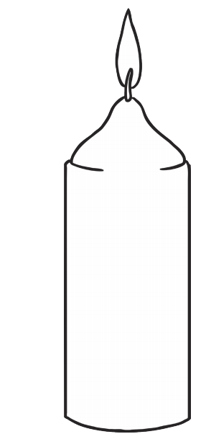
Task: On the candle template provided, write your own prayer of thanks.
You may decorate the candle after you have written your prayer.
You could roll it up and stick it with glue if you wanted to make it look more realistic. Or you could stick it up in your window after you are done. Or use it as a book mark!
Please take a picture of your prayer candle when it is complete. We would love to see them.

Slide 6

Red Pen Question

