Slide 2
With your talking partner...
Where should we use capital
letters in our writing?
Be ready to give your ideas!

Slide 3
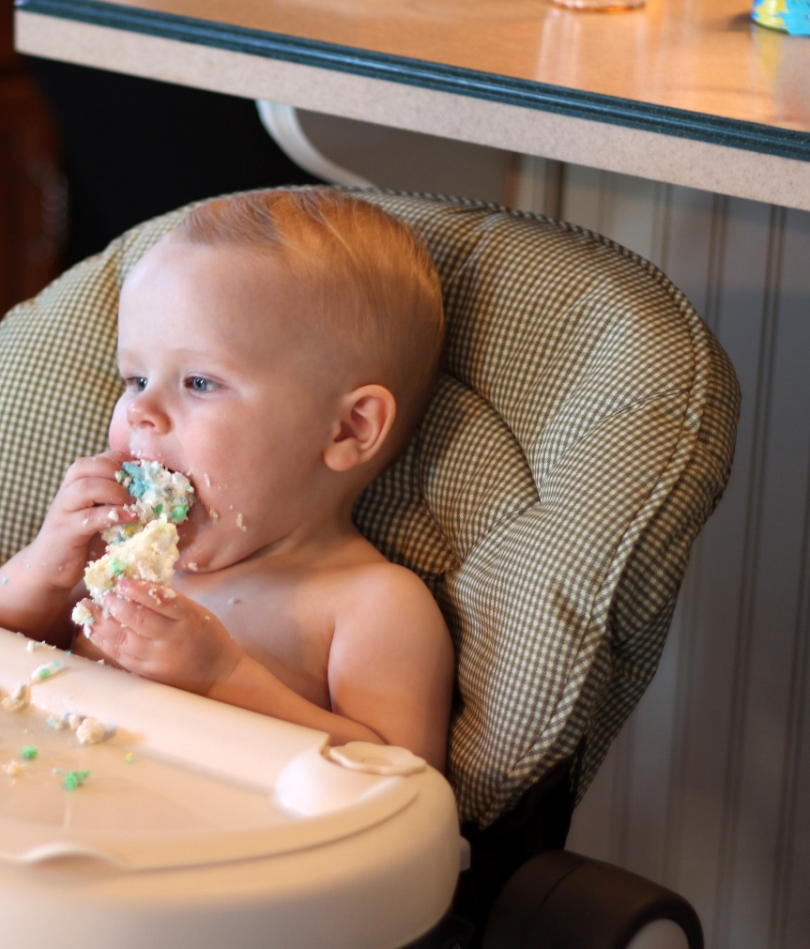
Starting Sentences
Capital letters are always
used to start sentences
He loves to eat cake!
Photo courtesy of viviannguyen(@flickr.com) - granted under creative commons licence – attribution

Slide 4
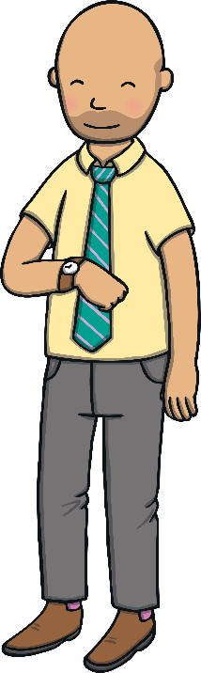
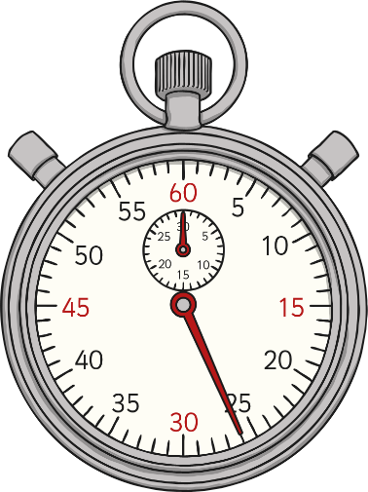
I
When we are writing about ourselves we use the
personal pronoun ‘I’
I can tell the time.
The personal pronoun ‘I’ always needs a capital letter.

Slide 5
Names
Naming words for individual people, places, days of the week and months of the year all need capital letters.
England
Spain
Binfield
Helen
James
Monday
Tuesday
Wednesday
January
September
December

Slide 6
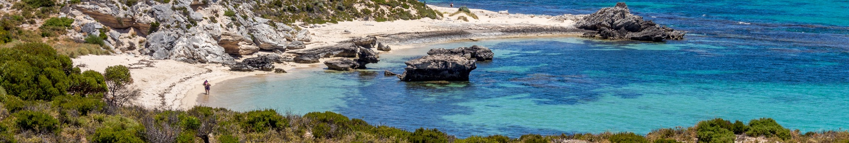
Activity
Can you add capital letters to the correct places in these sentences. Have a go on your whiteboard.
ben and susan went to australia for their holidays.
Ben and Susan went to Australia for their holidays.
on tuesday, i went to the park.
On Tuesday, I went to the park.

Slide 7
Now it’s your turn …
Work in your table groups to edit the sentences to add capital letters in the right places. Remember, the beginnings of sentences, names
and ‘I’ need capital letters!
it is always snowing in iceland.
i like going to london.
tom and sophia went to the shops in bracknell.
when i was a baby i didn’t have any teeth.
my brother zach and i watch football every saturday night.

