Slide 1
LO: I understand the rights and responsibilities as a member of my class.
C: Being me in my world. Lesson 2

Slide 2
Open my mind
Teach the ‘I am special’ song (to the tune of Frère Jacques):
I am special, I am special,
I belong, I belong,
with my friends and family, with my friends and family,
and my class, and my class.
Sing it several times with the children

Slide 3
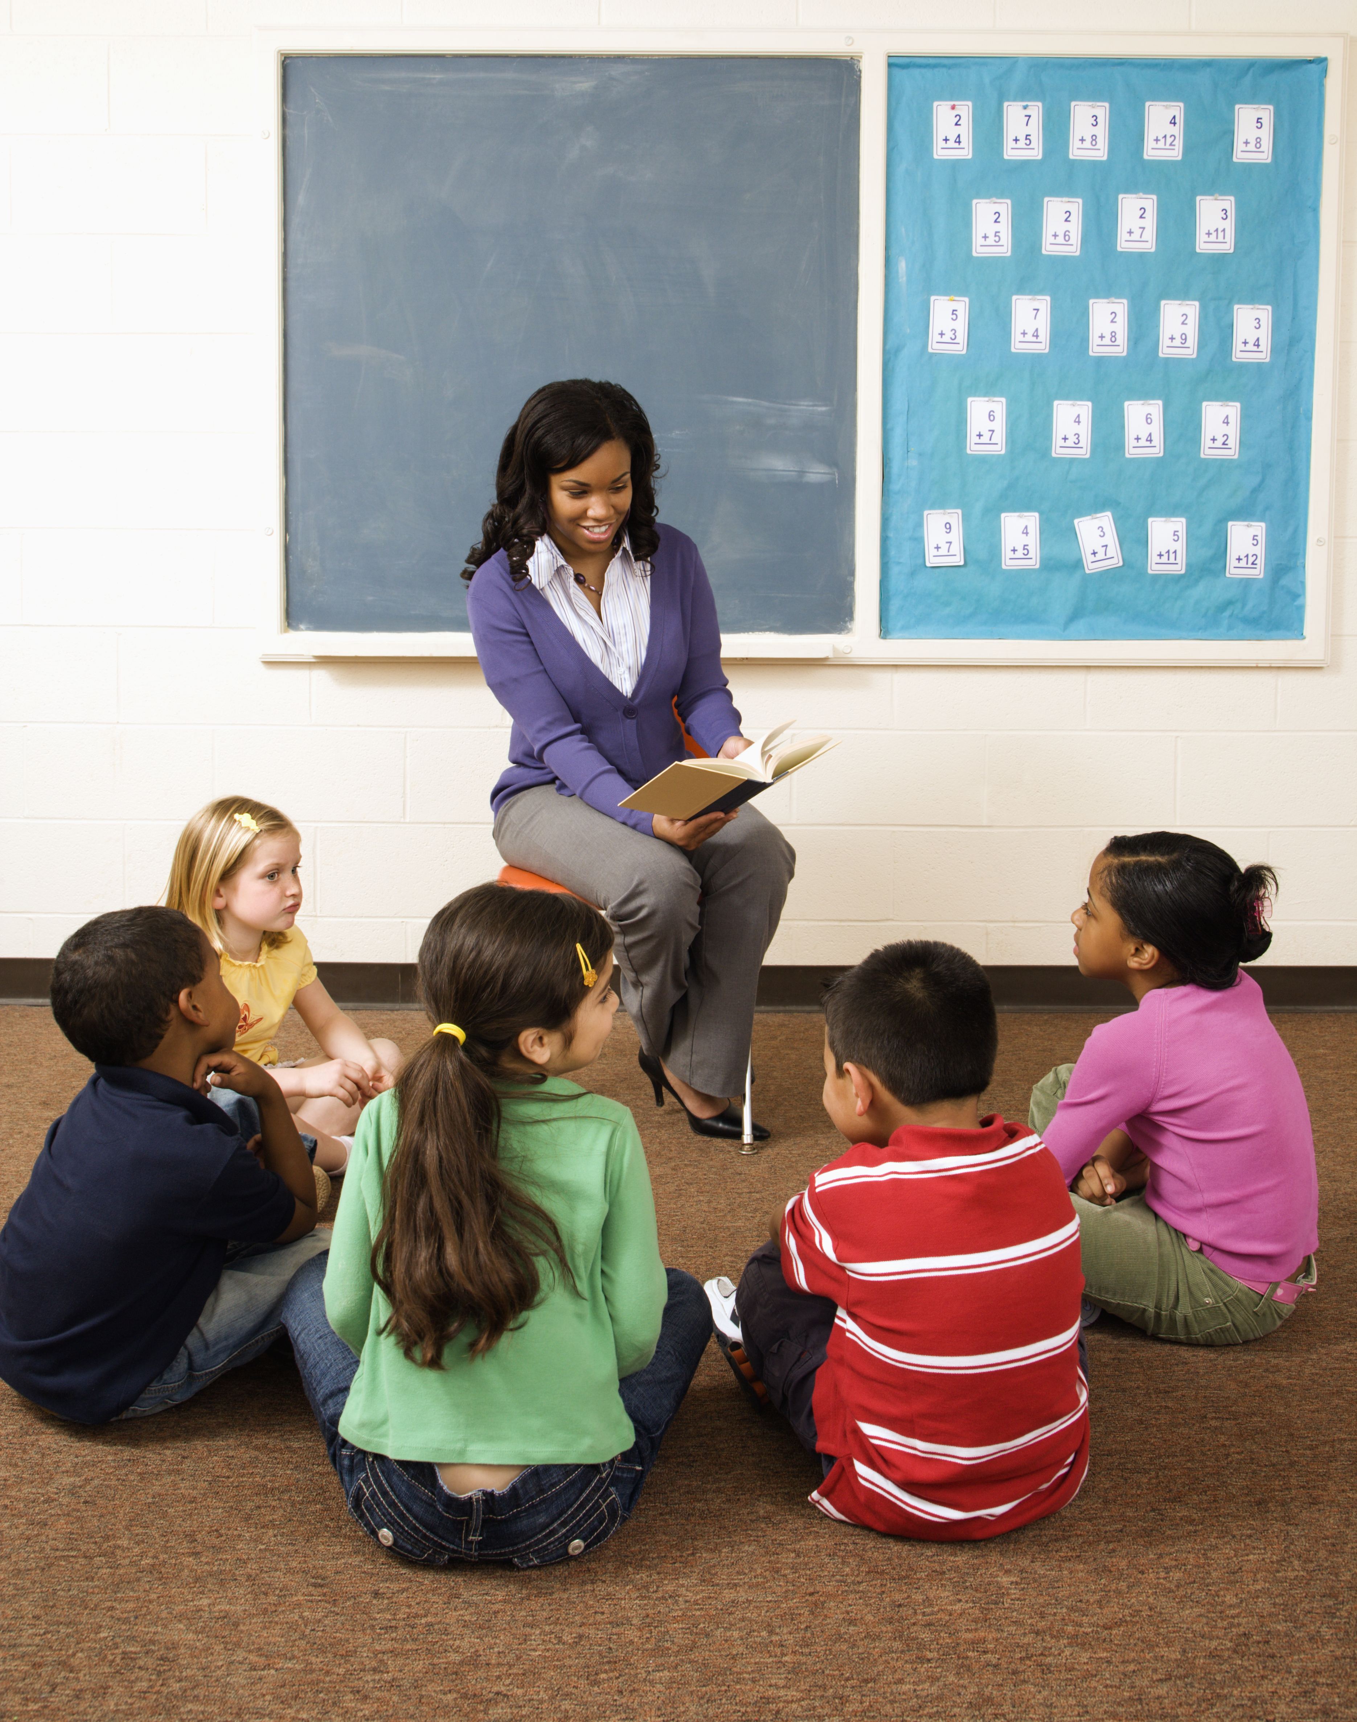
How can we help each other learn?
Summarise the ideas and introduces the language of rights and responsibilities, e.g. we all have the right to belong to this class, we all have the right to ask questions, we all have the right to learn and we all have the responsibility to help each other to learn.

Slide 4
Let me learn.
Task: Draw a picture of you learning well with your friends.
Children then share with their learning partners what they have drawn and explain how this helps them to learn. Some children share this with the whole class, the teacher summarises the rights and responsibilities for their classroom using the children’s ideas.
(This will form the basis of the learning charter)

