Slide 1
LO: I know how to make new friends
C: celebrating difference
Notes:
To make new

Slide 2
First: Binfield Golden and extra golden rules.
Next: Connect us – Chn stand and pass on a hello. They must wave and give eye contact to the person they are waving to. Say ‘hello….’ then that person passes it on to someone else. Chn to sit down once they have said hello to someone so the chn who are left know who to say hello to.
Then: Calm me.

Slide 3
Listen to the song: There’s a place
What is it about?
Notes:
What’s it about: Friendship – It’s ok to be different

Slide 4
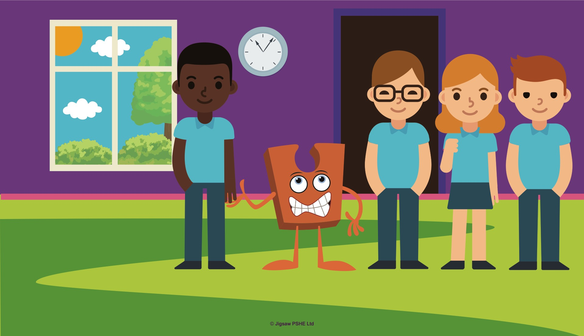
Listen carefully to the story
Notes:
Note to teacher: Your children may have chosen whether their Jigsaw Jack is a particular gender. In some places in this story you will need to use the correct pronoun for your Jack. This story also uses Abbey Owl (from Discovery RE) which you may also have in your classroom if you use this resource for your R.E. (https://discoveryschemeofwork.com)
One playtime Jigsaw Jack wanted to go out to play with all the children. It was a lovely sunny day, not too hot, and not too cold, but just right.
Jigsaw Jack didn’t go onto the playground very much so it was exciting to be going outside.
When it was time for playtime to begin all the children stopped their work and lined up at the classroom door. Does your teacher ask you to do this too, or do you do something different?
Jack proudly stood in the line holding one of the children’s hands. Jack started to feel a little bit nervous, so practised Calm me and took some deep breaths to calm down. Jack knew all about Calm me time because the children did it in their Jigsaw lessons.

Slide 5
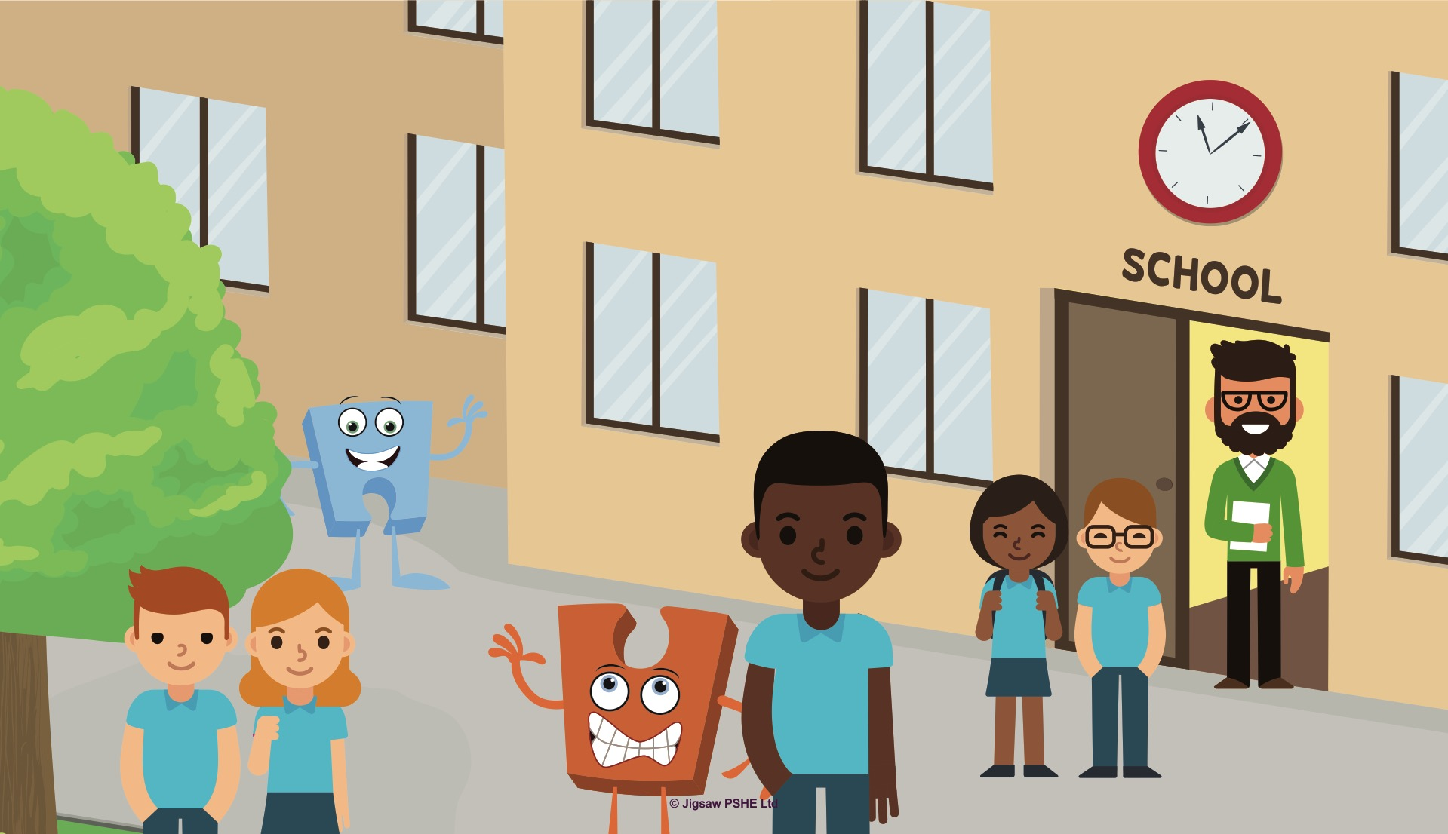
Notes:
Jack started to feel less worried and then when the teacher opened the classroom door, all the children ran outside onto the playground. Jack went too holding on tightly to the one of the children.
Soon all the children were playing their games but because Jack didn’t go outside very much, (he/she) didn’t know how to join in. Some of the children from Jigsaw Jack’s class went over and tried to encourage (him/her) to play, but Jack wanted to be quiet and just watch for a while. Because the children were so good at being Jack’s friend they were happy to let (him/her) do that.
Suddenly Jack noticed another person just like (him/her), except instead of being bright orange they were a pale blue. Jack was curious and went over to ask the person’s name.

Slide 6
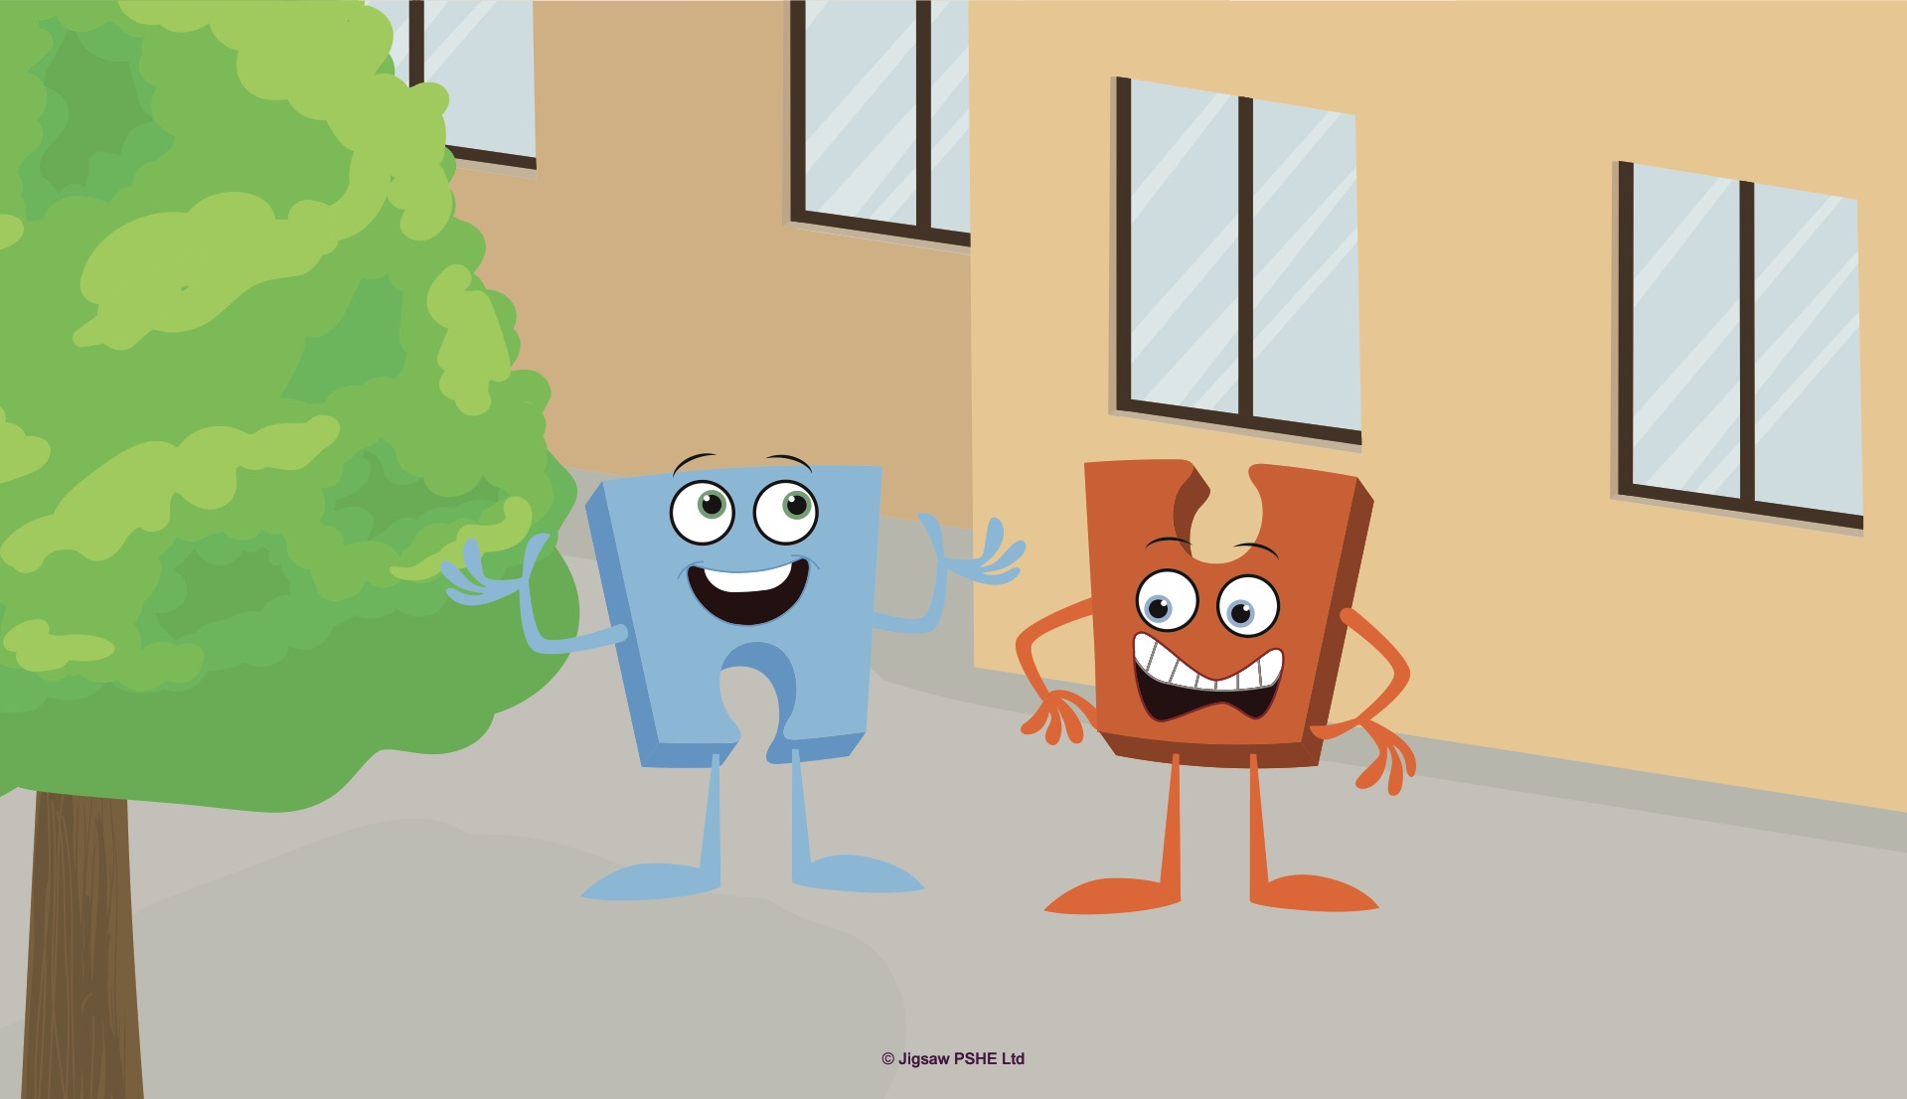
Notes:
“Hello I’m Jack” (he/she) said. “Who are you?”
The little blue character said, “I’m called Jigsaw Jenie, and I help all the children in the Nursery and Early Years classes. Which children do you help?”
Jack told Jenie about the class and all of the children he worked with.
“Oh, it sounds like we have a lot in common,” Jenie said, “apart from that you are orange, and I am blue. Do you think that means we can’t be friends?”
Jack wondered for a little while. (He/She) had heard the children in class talking a lot about being the same or different and (he/she) didn’t think that it mattered.
“No, I don’t think that matters at all Jenie.” Jack said. “Would you like to be my friend?”
Jenie looked really pleased but also a little muddled. “Yes, I would love to be your friend Jack, but I heard one of the Nursery children saying they wouldn’t be friends with someone else because they liked doing different things. I’m a little muddled.”
Jack thought again. (He/She) knew that it didn’t matter at all if people were different, they could still be friends, but Jenie didn’t seem to understand this so Jack had an idea to help.

Slide 7
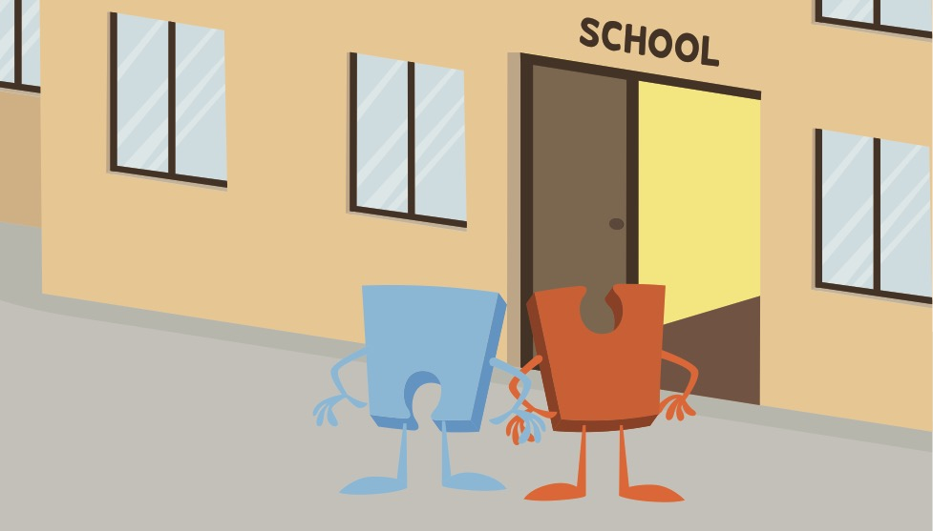
Notes:
“Hey Jenie,” Jack said, “I know a really clever and wise person we could ask about this inside my classroom. Shall we go inside?”
Jenie took Jack’s hand. It felt nice and friendly, not hurtful or unkind. Jenie thought, “I like Jack, (he/she) is very caring. That’s a good friend.”

Slide 8
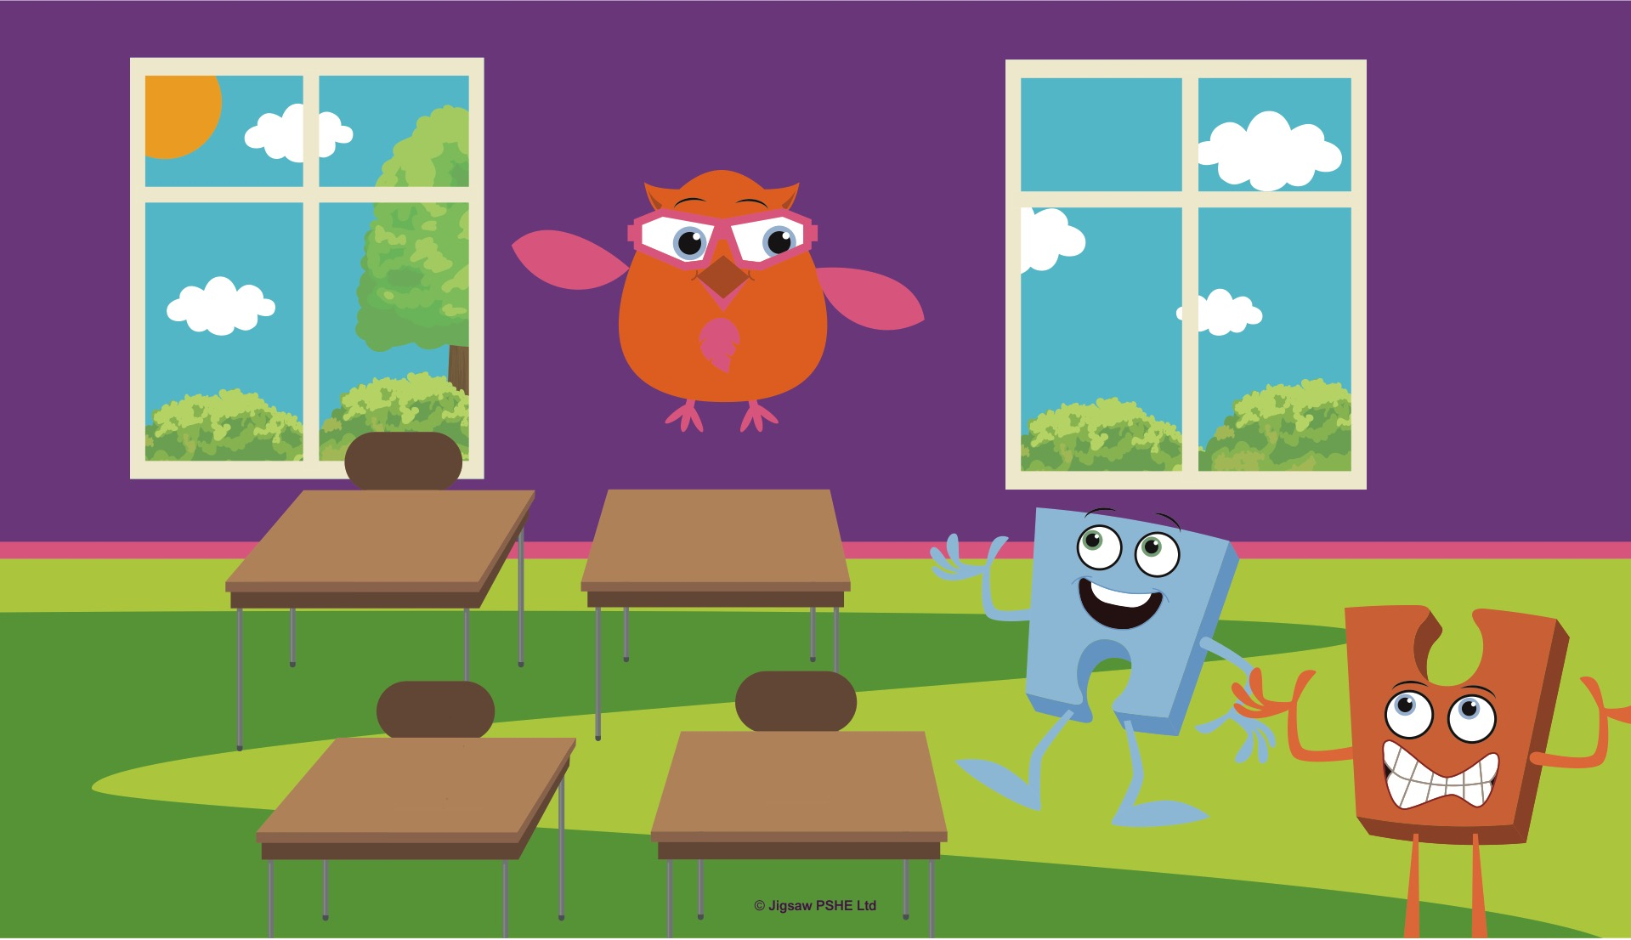
Notes:
When they were inside, Jack introduced Abbey Owl. Abbey also helped with the children in their lessons and Jack knew she was VERY clever.
“Hello Abbey,” said Jack. “This is Jigsaw Jenie and we have a question for you, because we know you will have the right answer!”
Abbey Owl hooted, she was pleased to be asked. Abbey liked helping too.
Jenie asked Abbey if it was OK to be friends with someone even if they were different from each other.
Abbey Owl hooted, “Of course it’s OK to be friends. We don’t all have to look the same way, or like doing the same things to be friends. Wouldn’t it be boring if everyone was the same? Now Jenie, I think you need to go back to the child in Nursery and explain this so they understand.”
Jenie nodded and thanked Abbey Owl for her wise words.

Slide 9
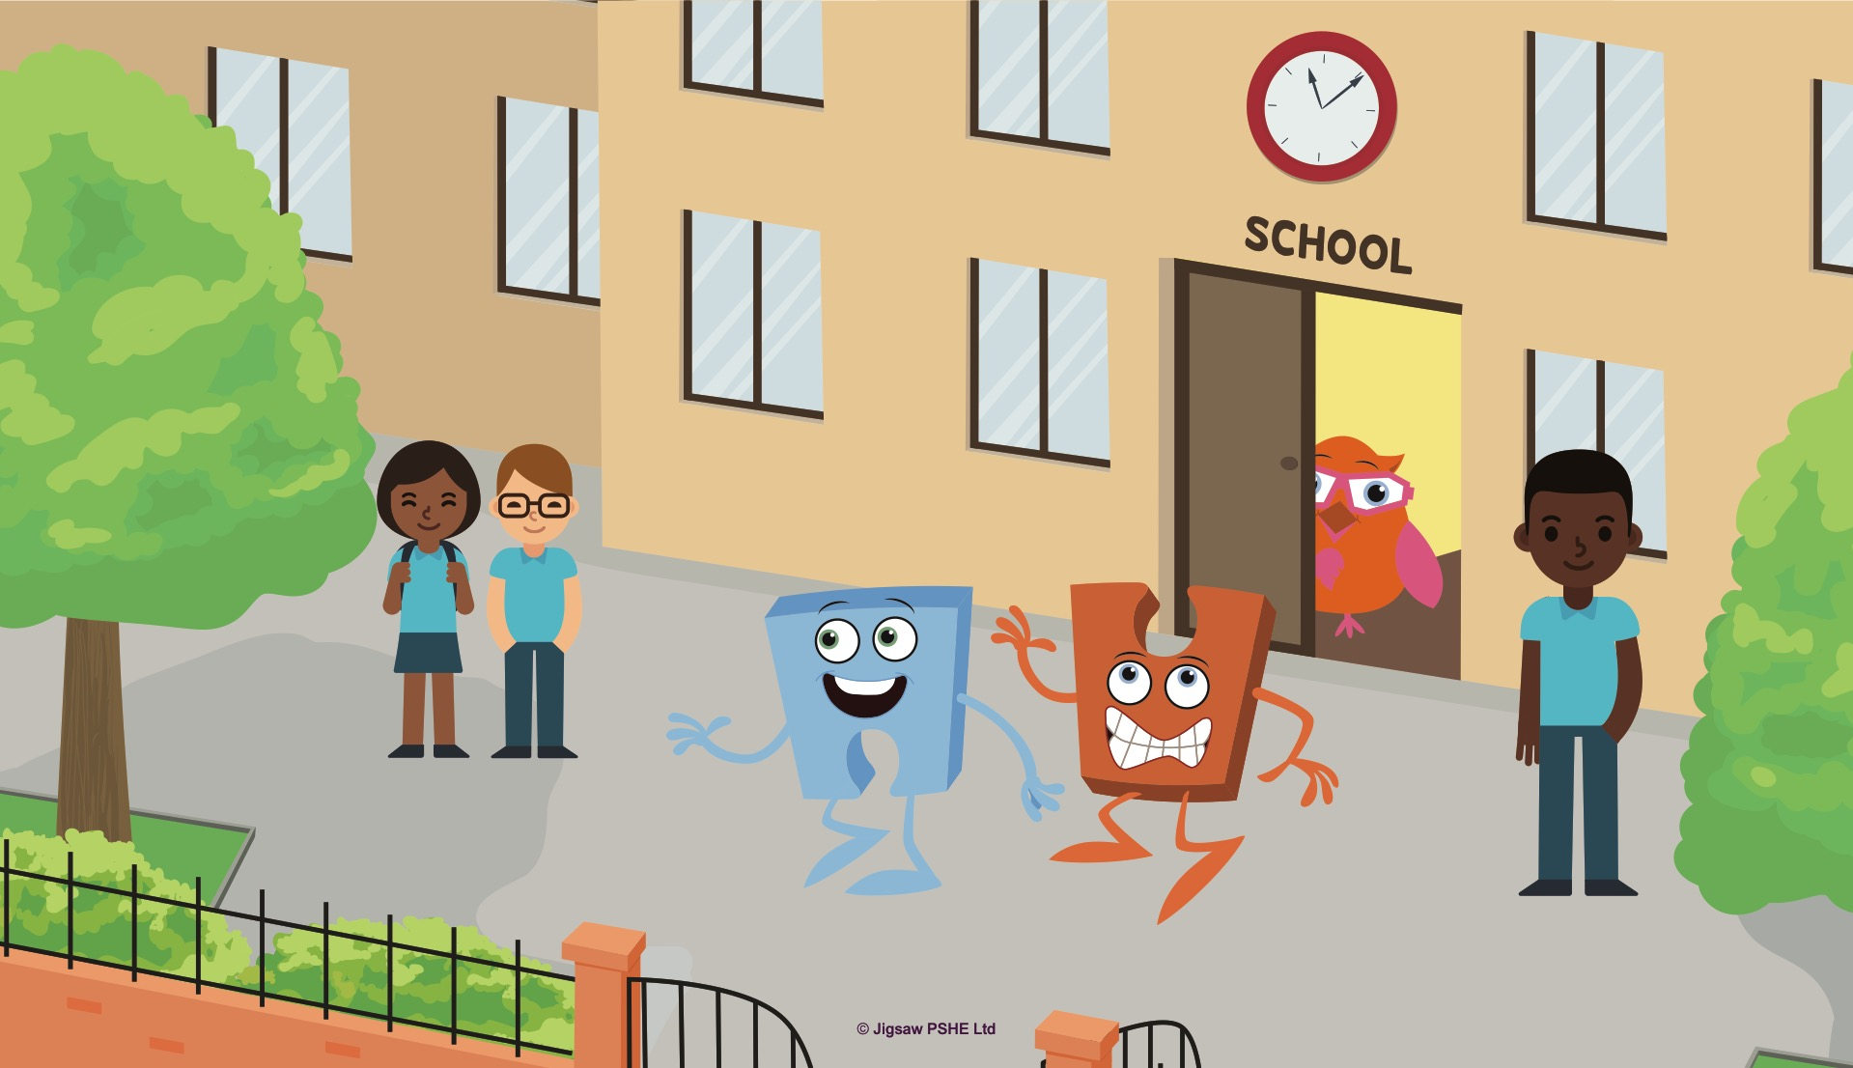
Notes:
Outside on the playground Jenie said, “Thank you Jack, now I know we can be friends. In fact, I think we are going to be best friends.”
Jack smiled back, (he/she) thought that Jigsaw Jenie was right.

Slide 10
What makes a good friend?

Slide 11
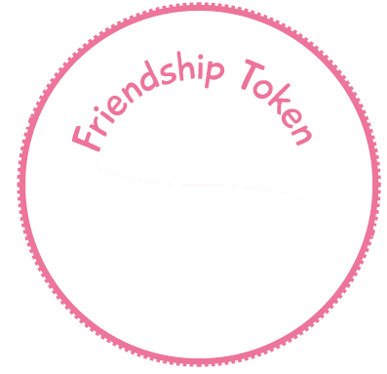
Task
Draw or write something on the friendship token that you could say or do to show someone you are a good friend.
Stick one in your book.
Give one to someone else
and see if you can make a new friend
this week!

