Slide 1
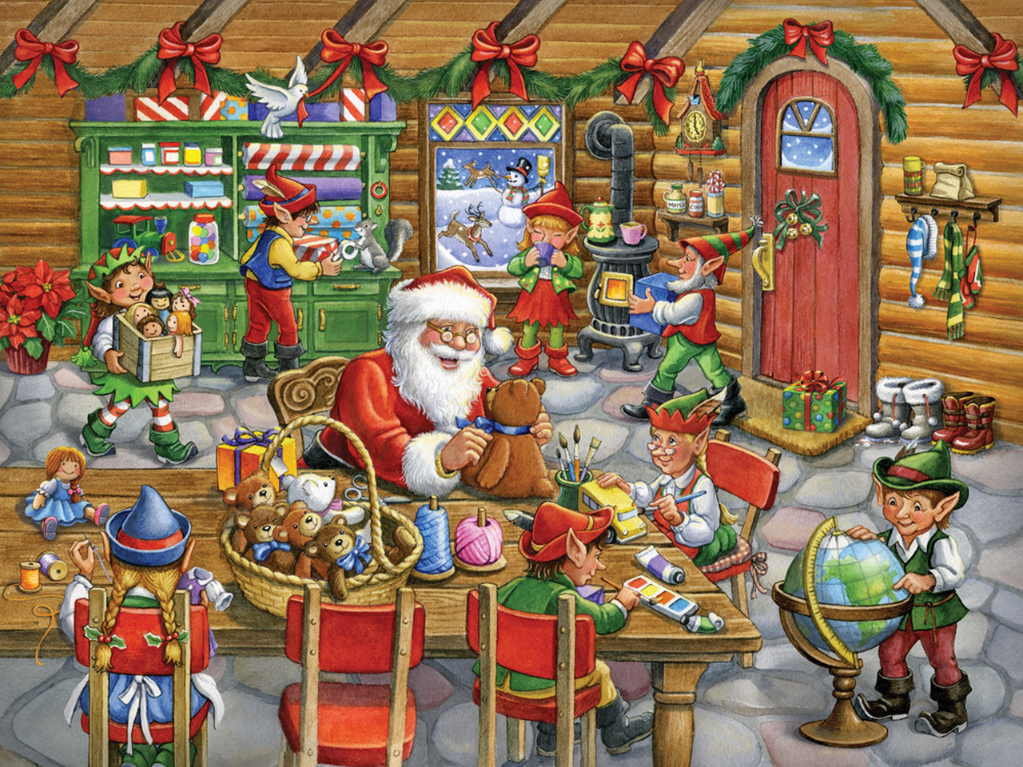
ELVES NEEDED URGENTLY!
Please call
01234 56789
to apply

Slide 3
https://www.youtube.com/watch?v=zb9Gcpo1Cu4

