Slide 1
My Day at the Beach

Slide 2
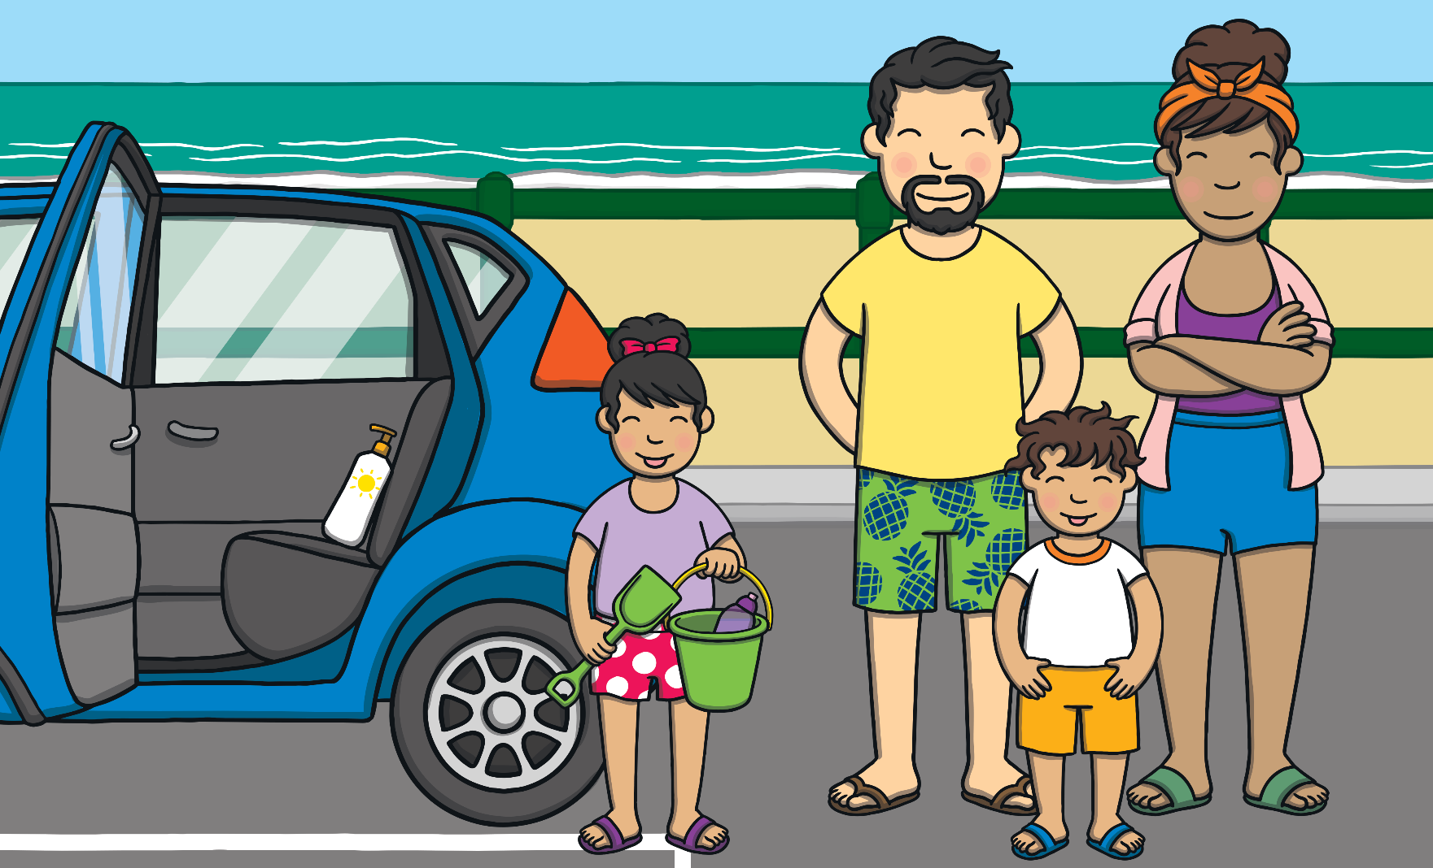
Last weekend, I went to the beach with my family.

Slide 3
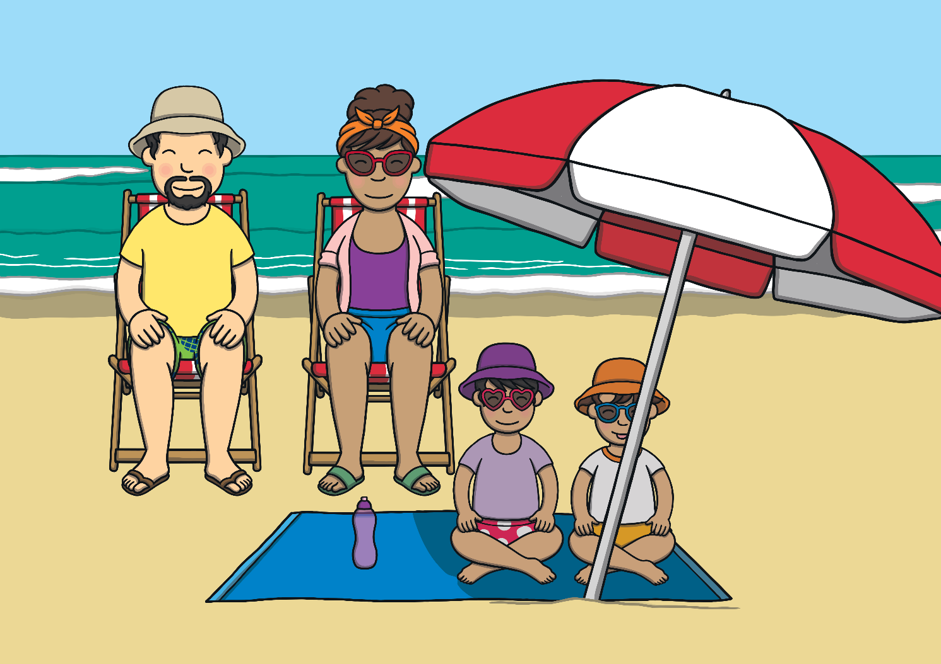
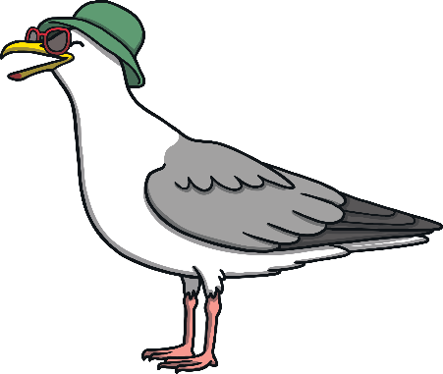
The sea was bright blue. There were lots of noisy seagulls and I could smell fish and chips.

Slide 4
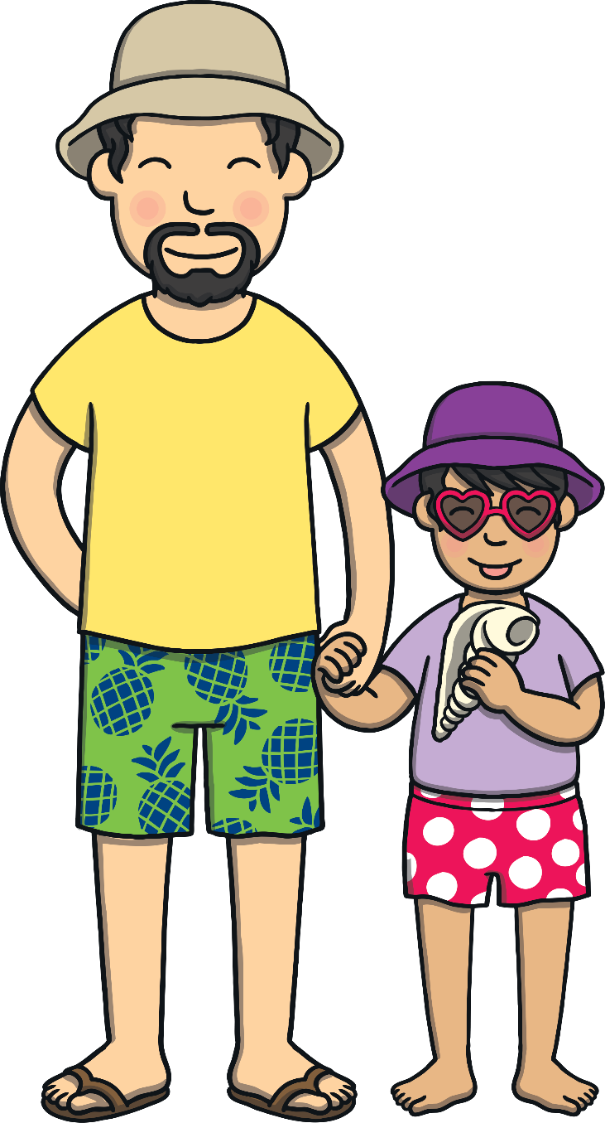
My dad helped me find a shiny shell.

Slide 5
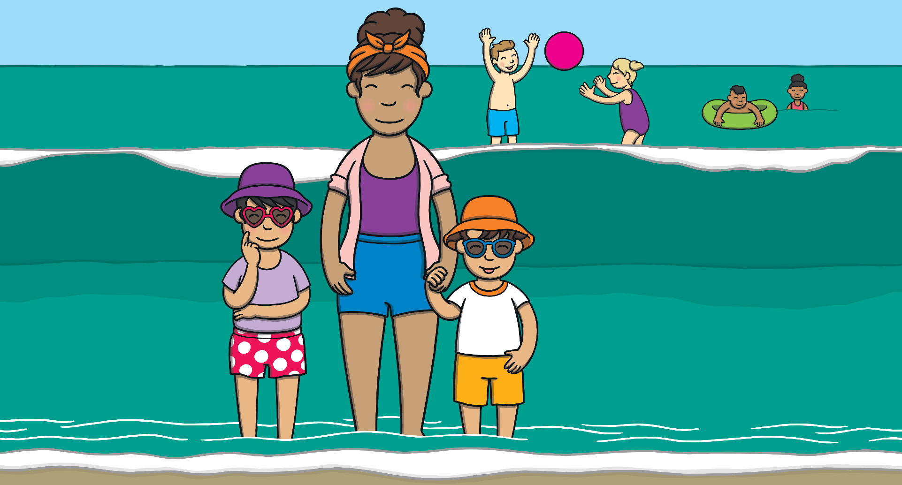
We paddled in the water. It felt very cold.

Slide 6
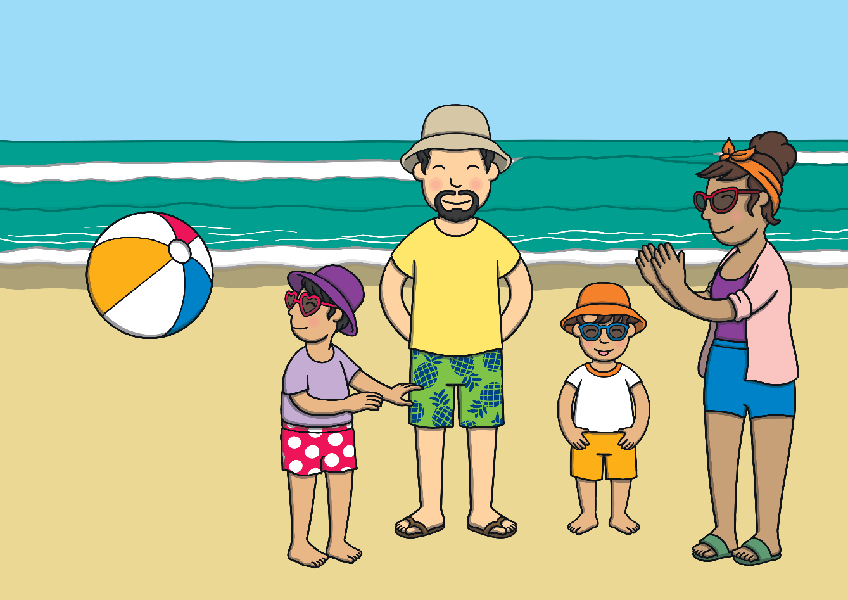
Then we played catch with a stripy beach ball.

Slide 7
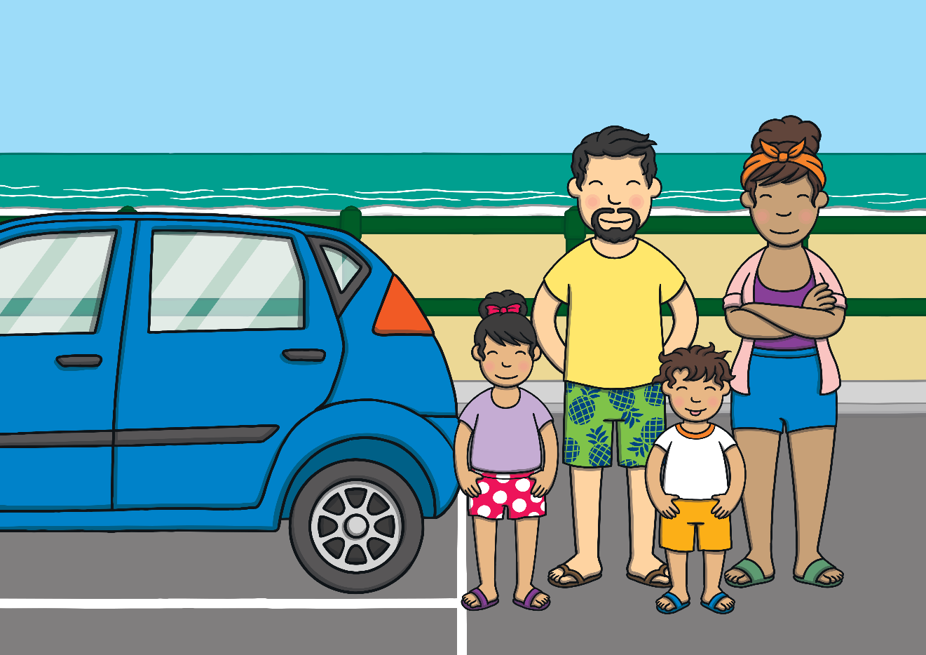
I had a fantastic day. I can’t wait to go again soon.

