Slide 1
Open my mind
With the children seated in a circle, start off a round by saying, “I’m … and someone in my family is my…….” (mum, sister, brother, dad, step brother etc.) Ask the children in turn round the circle to follow suit and see how many different family members the class as a whole can refer to. They can include close family, extended family, step family, etc.

Slide 2
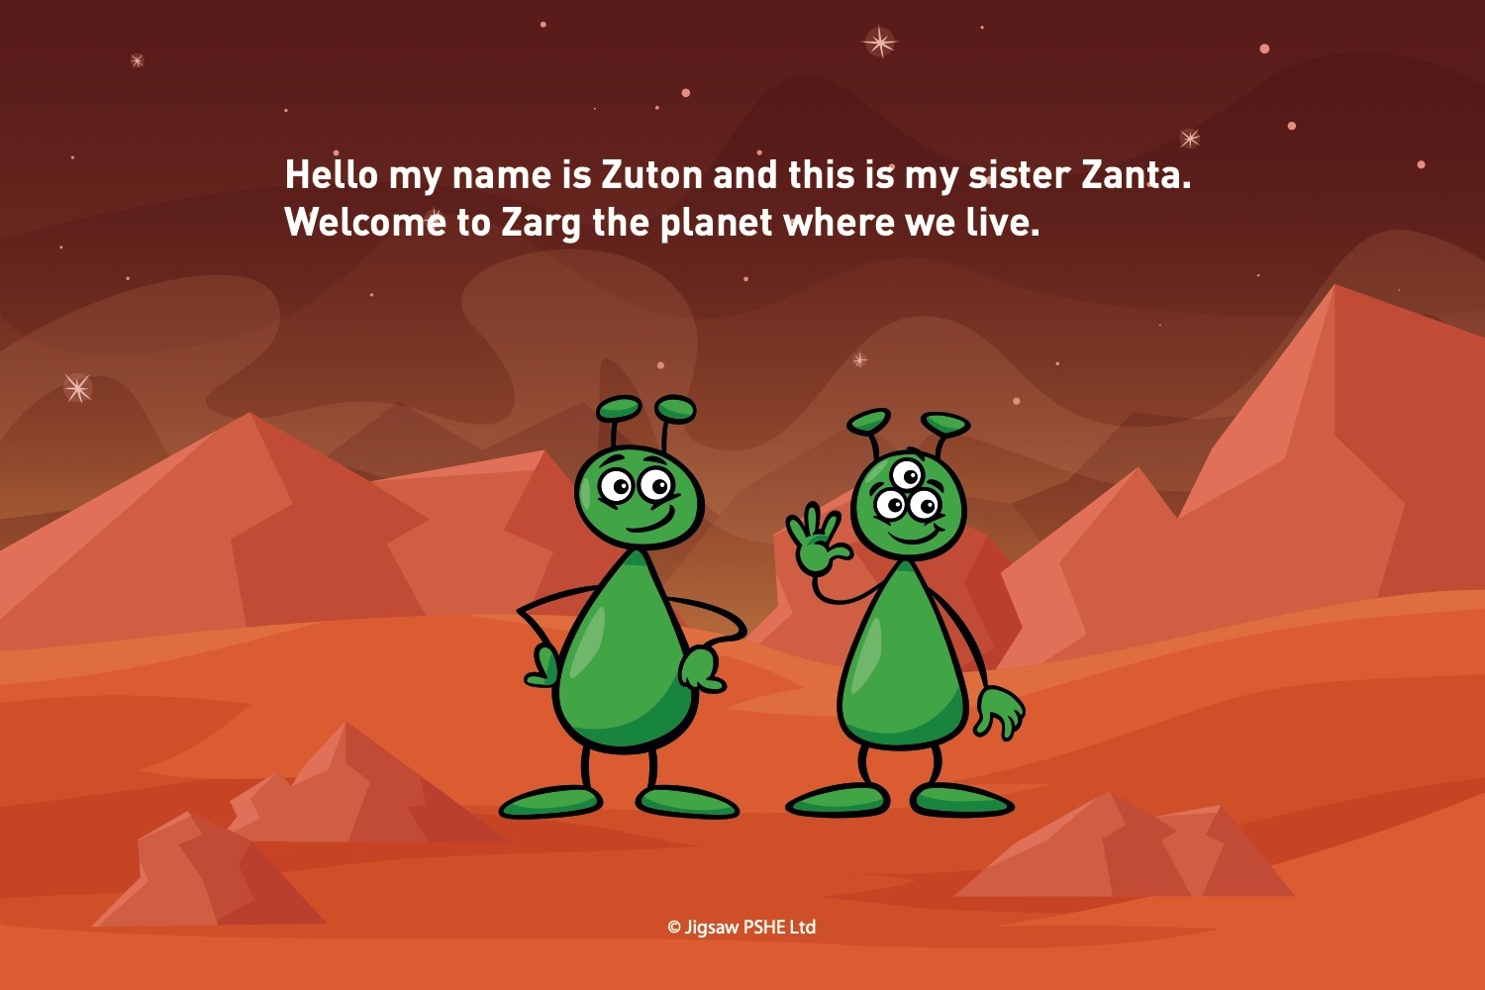

Slide 3
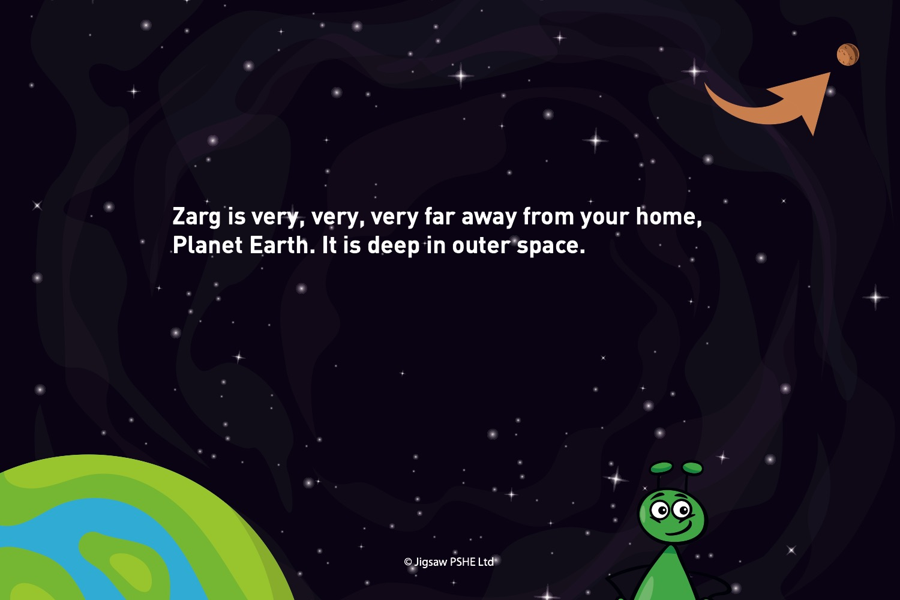

Slide 4
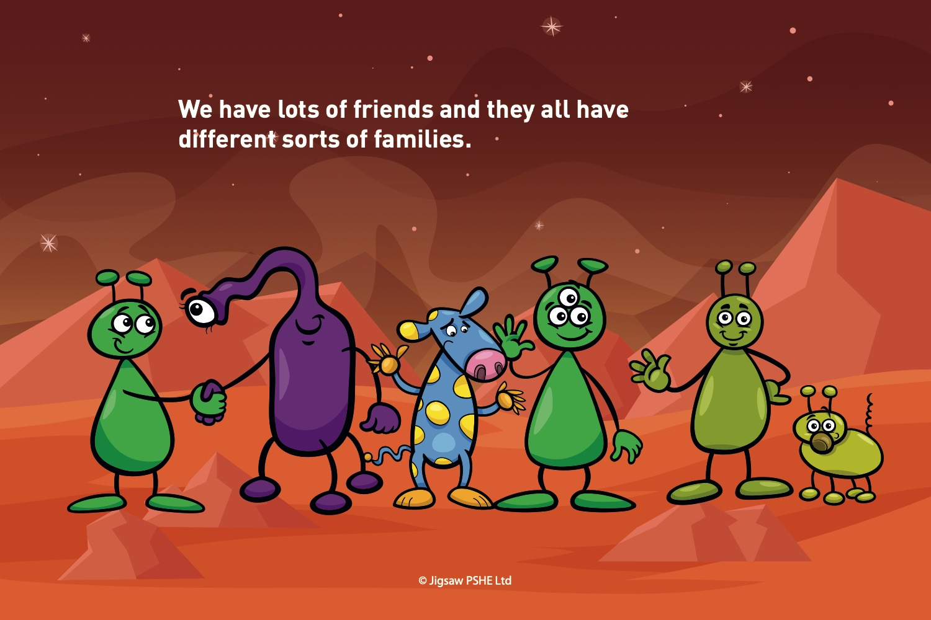

Slide 5
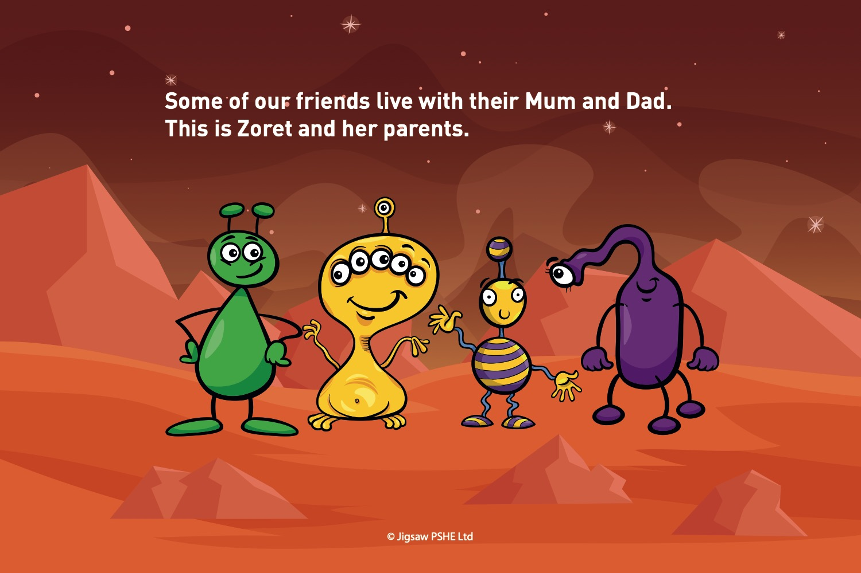

Slide 6
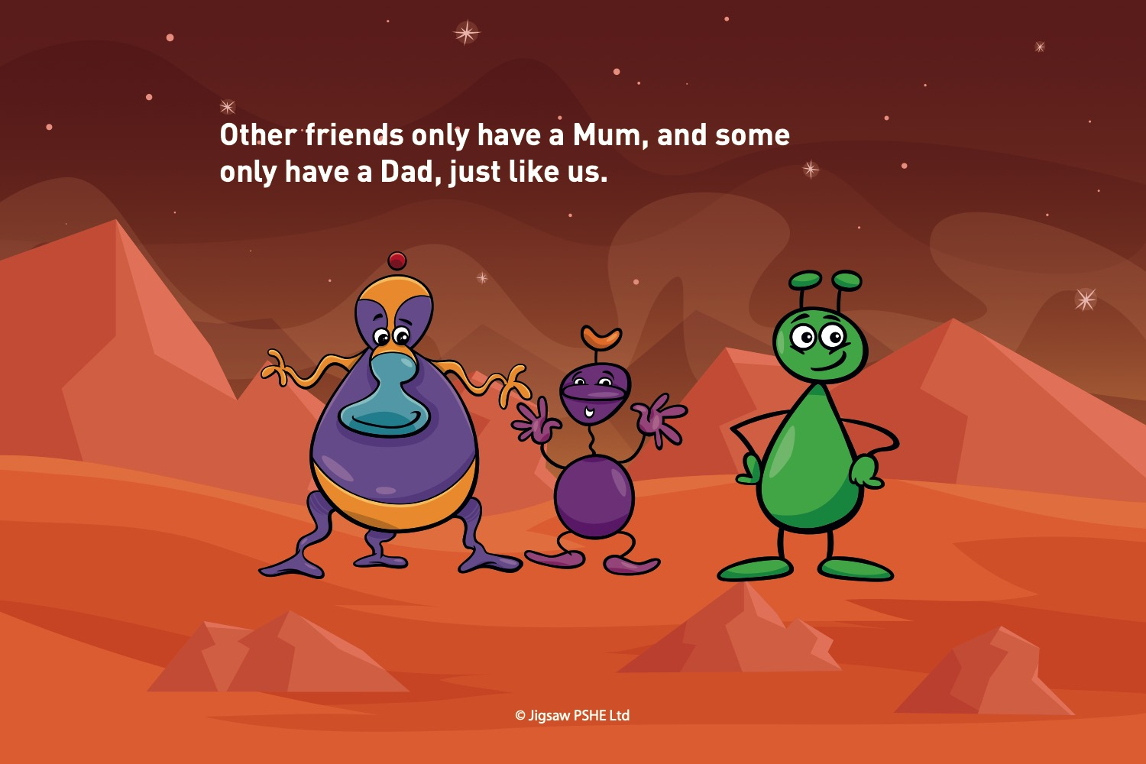

Slide 7
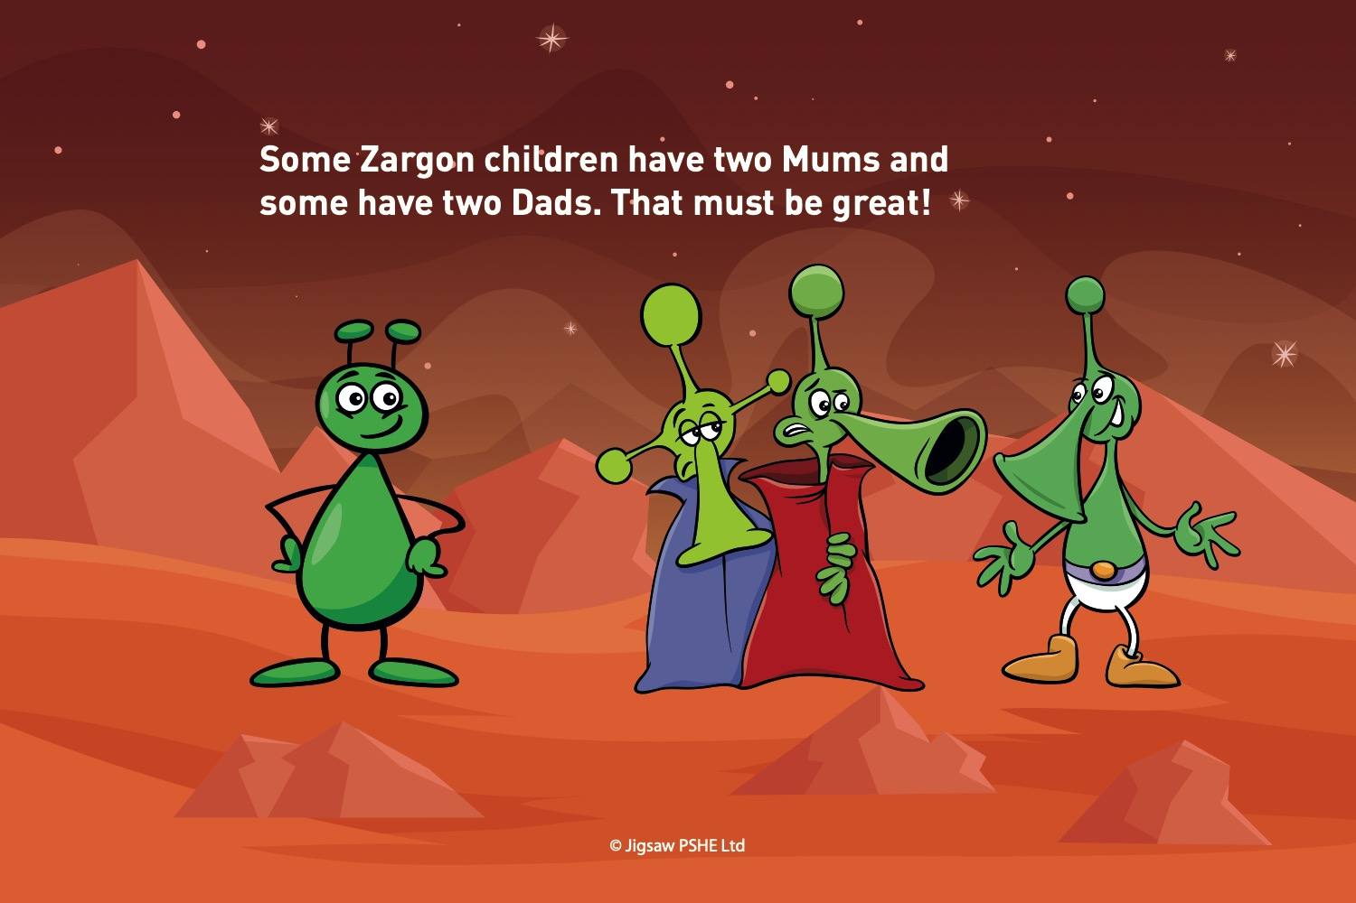

Slide 8
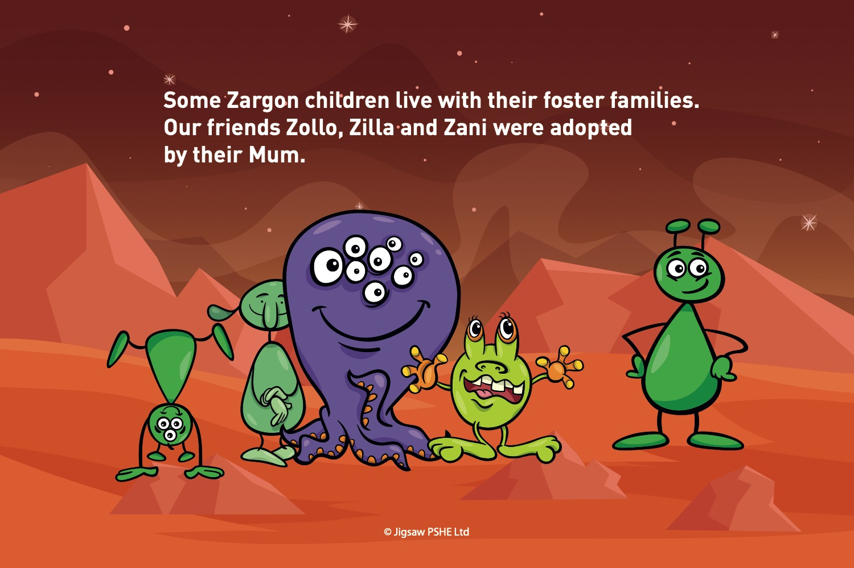

Slide 9
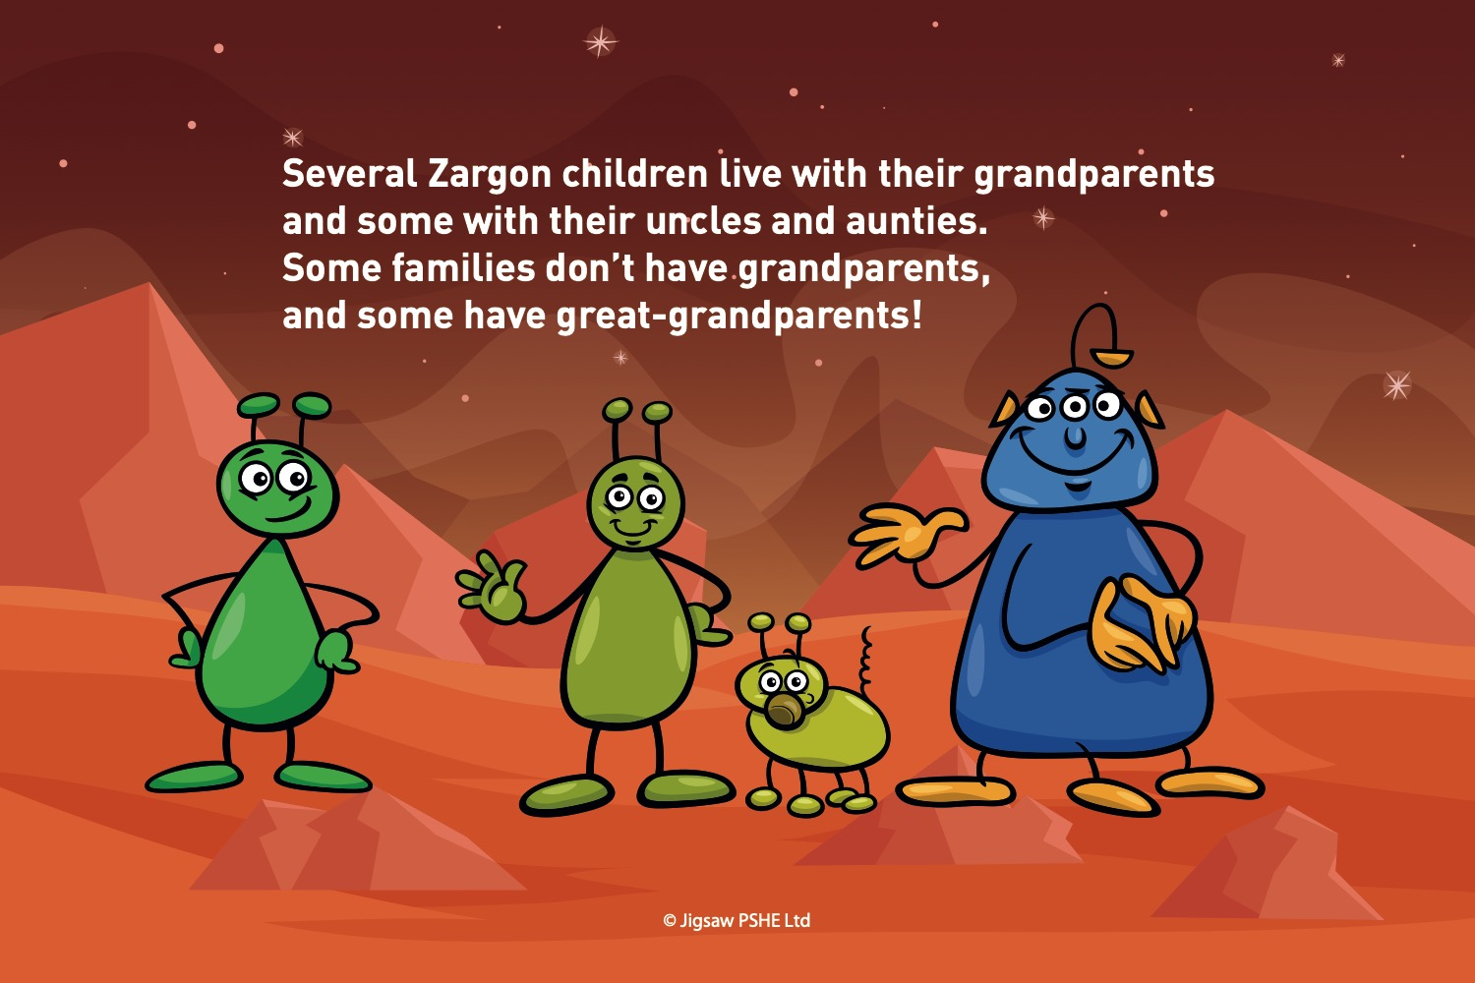

Slide 10
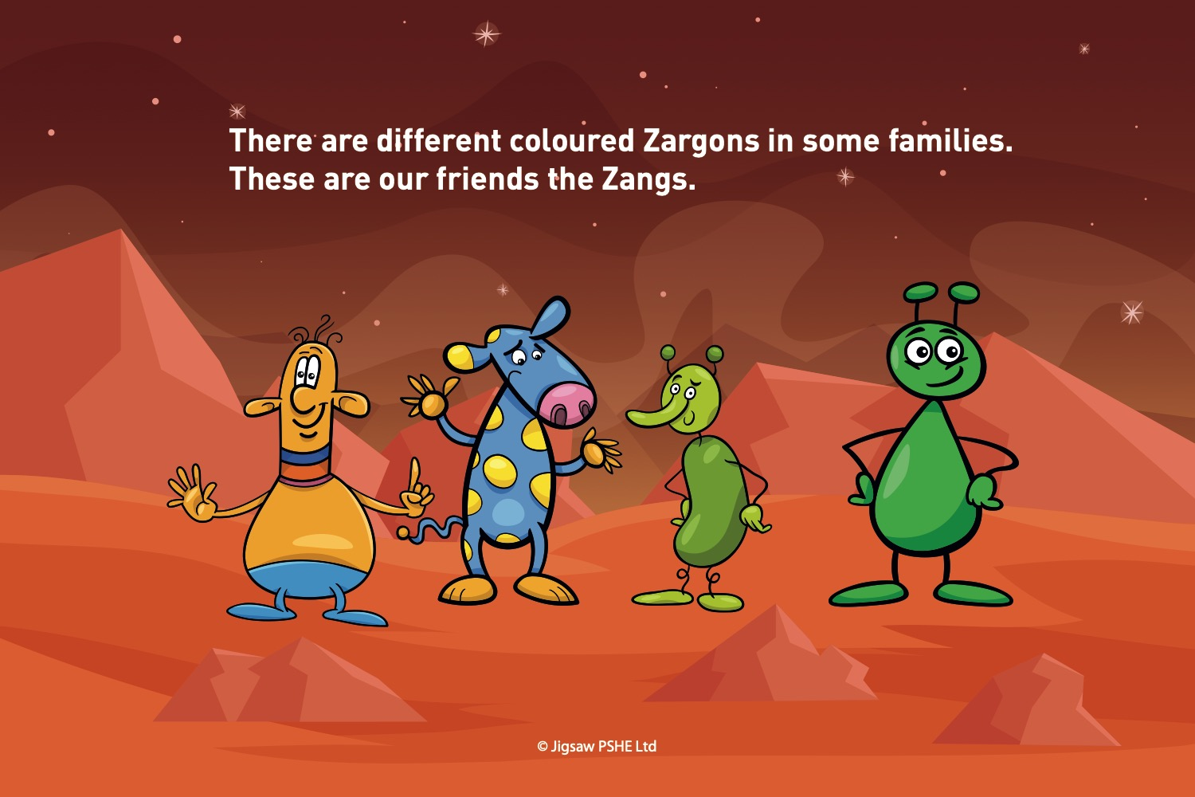

Slide 11
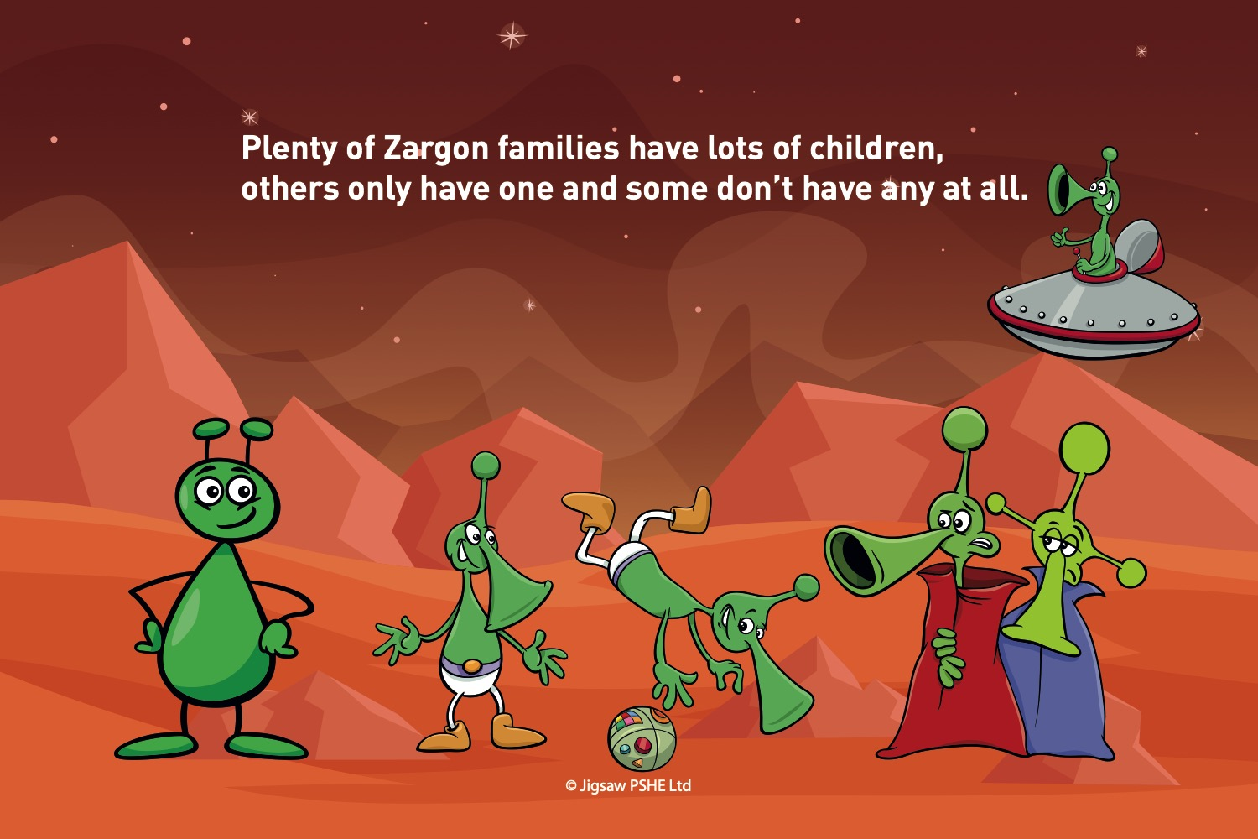

Slide 12
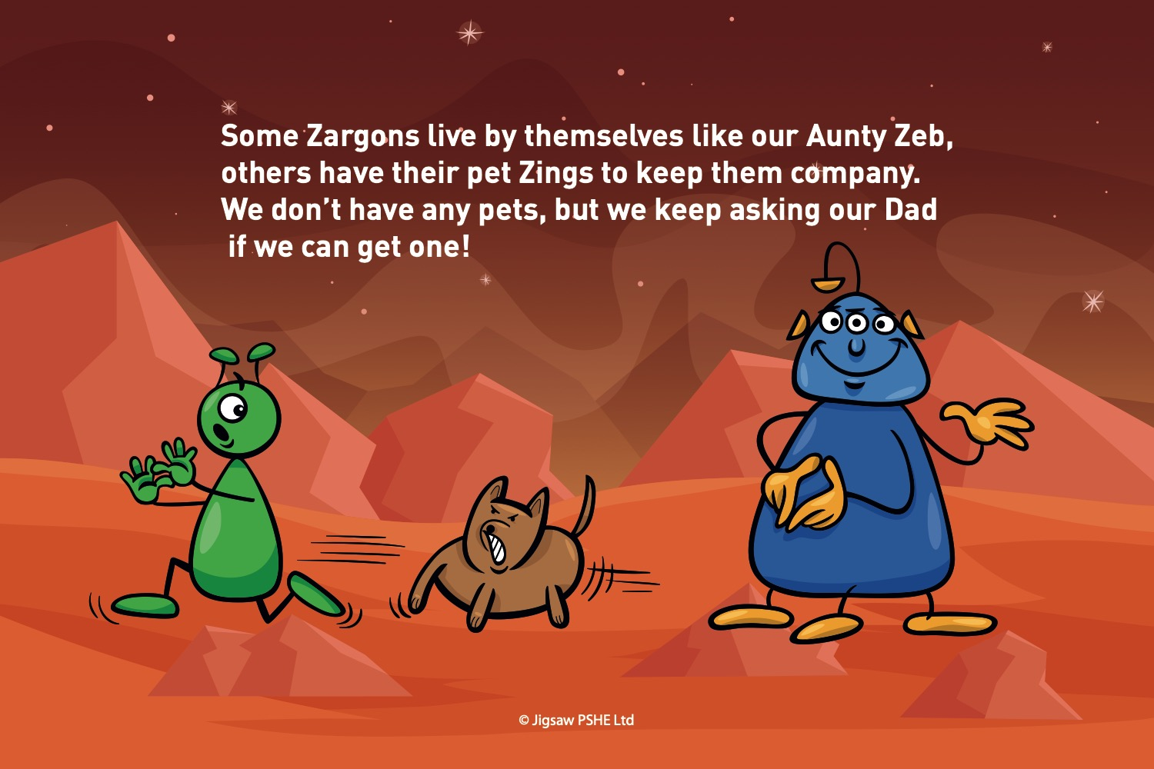

Slide 13
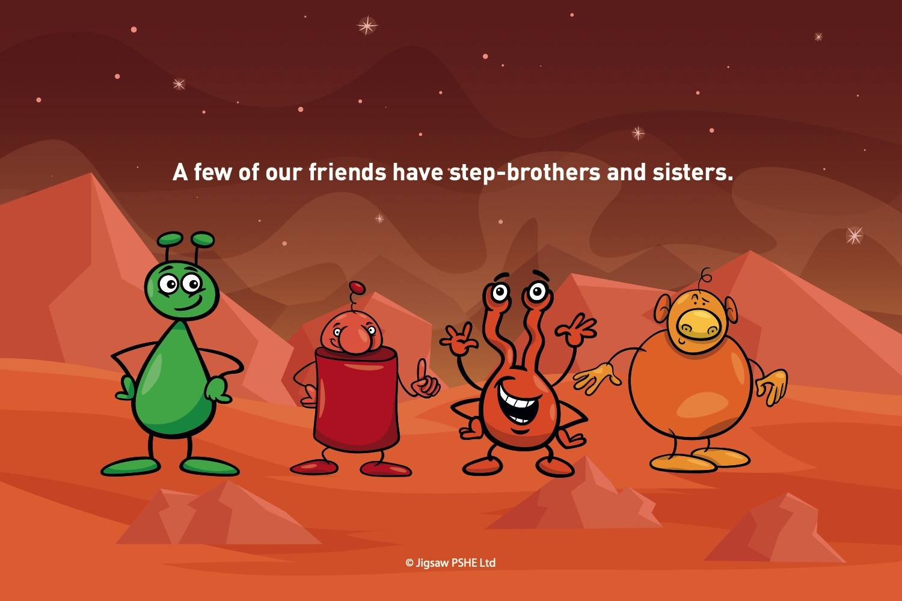

Slide 14
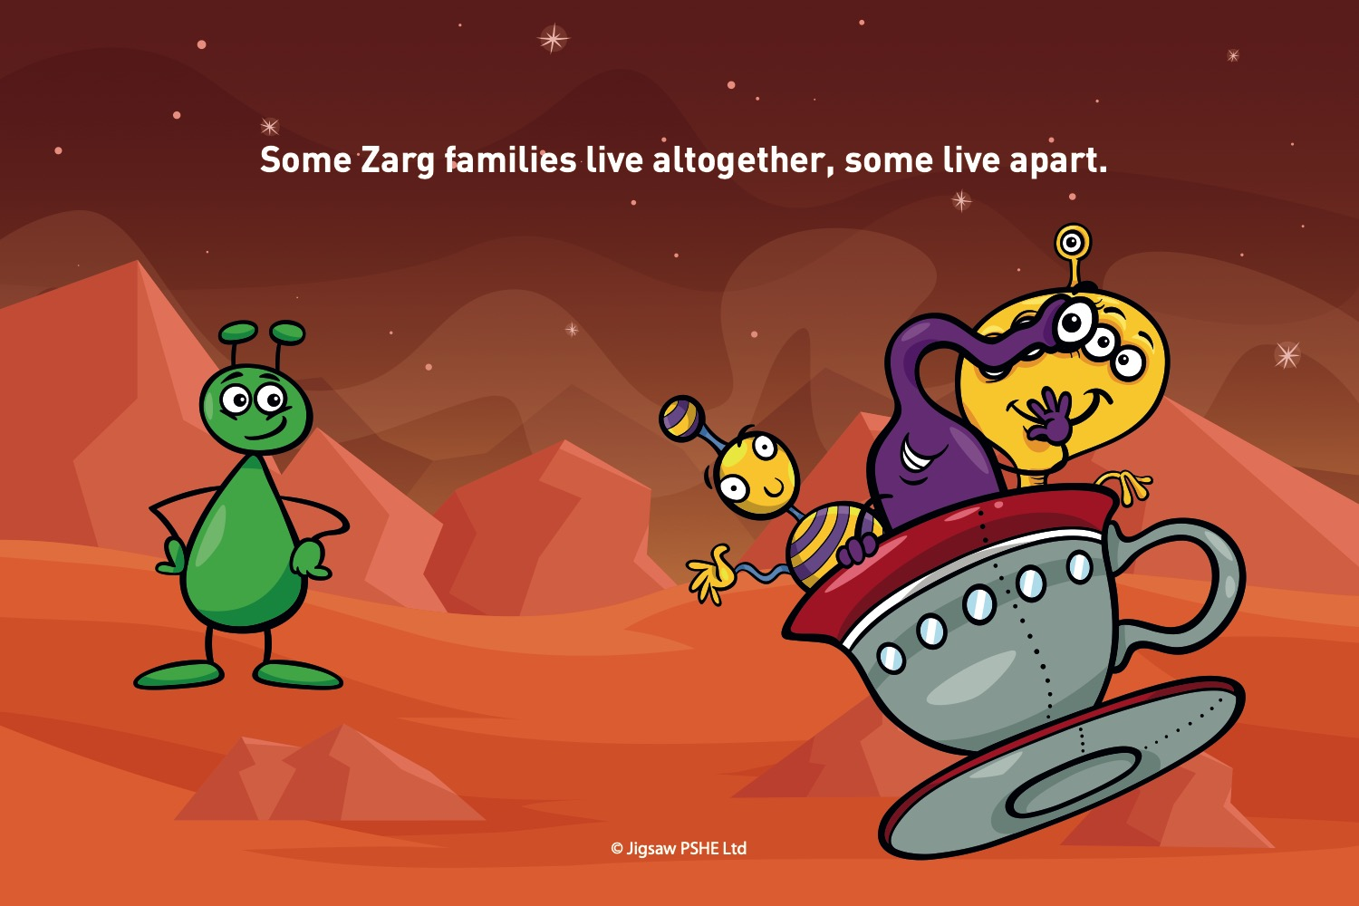

Slide 15
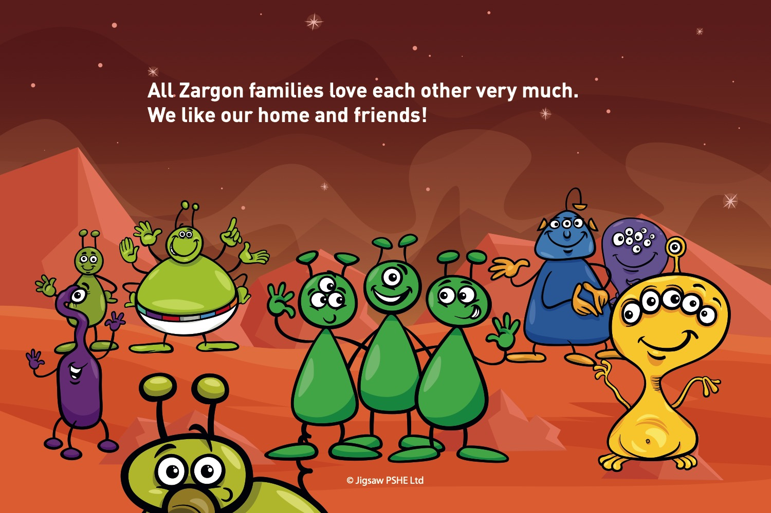

Slide 16
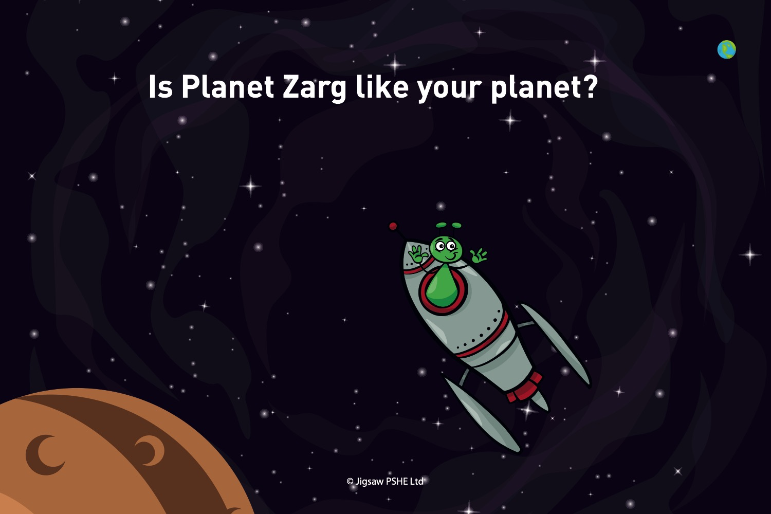

Slide 17
Tell me show me: Why do we have families?
Discuss:
Are all families the same?
What is a family?
Can some people be part of your family and not live in the same home as you?

Slide 18
Let me learn: Who is in your family?
When you think about the word family, does this also mean your pets?
How does it feel to be part of a family?
Who are the members of your family?
How do you feel in your family home?

Slide 19
Task
Snorkellers/paddlers: Draw and label a picture of your family in your PSHE book.
Divers: First, draw and label a picture of your family in your PSHE book.
Next, choose one person from your family. Describe them and say why they are special to you.

