Slide 1
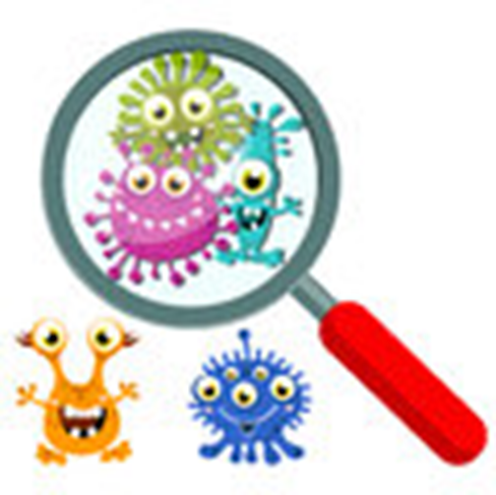
A Story about Coronavirus
and staying healthy

Slide 2
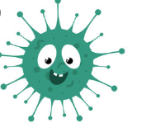
Coronavirus is a type of germ that
can make us unwell.

Slide 3
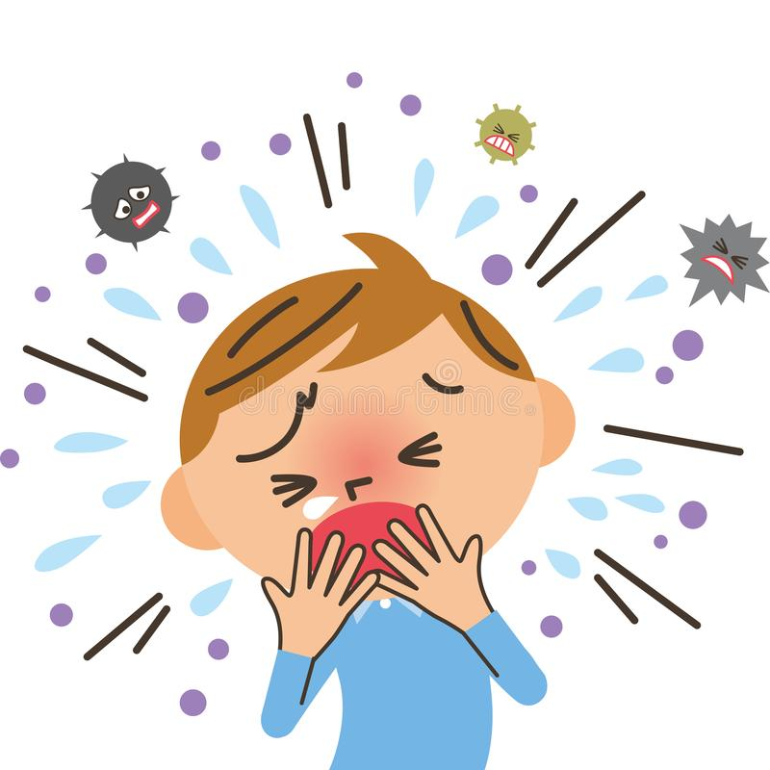
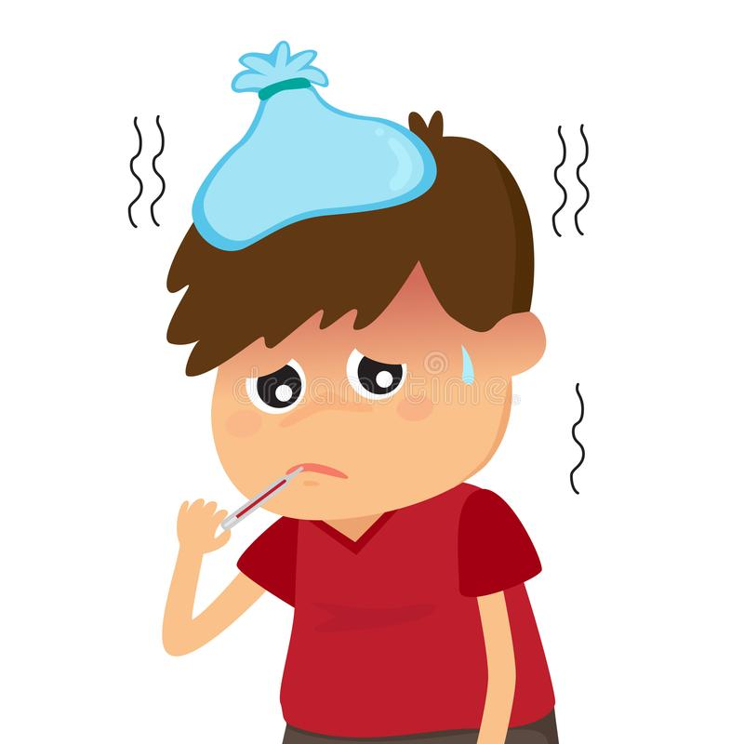
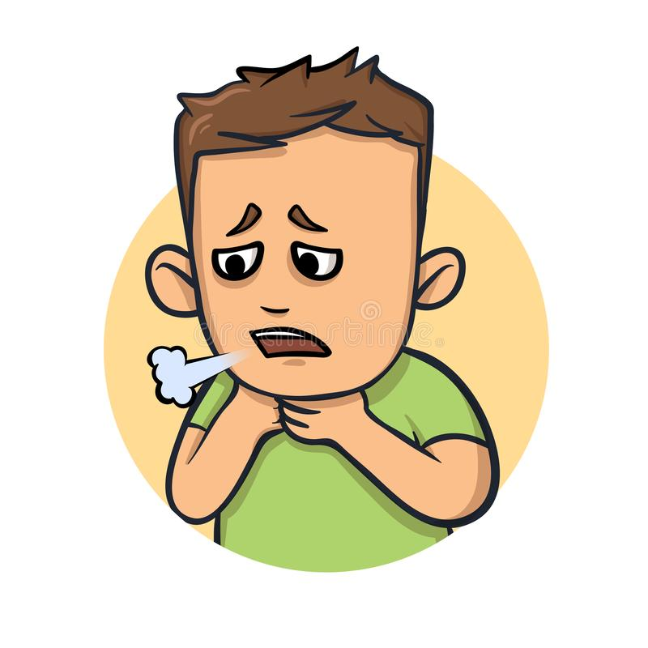
It can make us cough, feel very hot
or make it hard to breathe

Slide 4
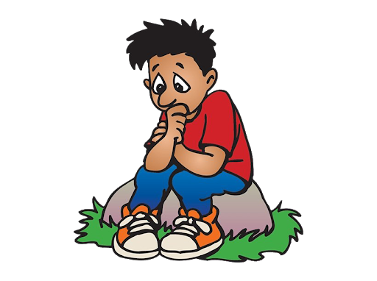
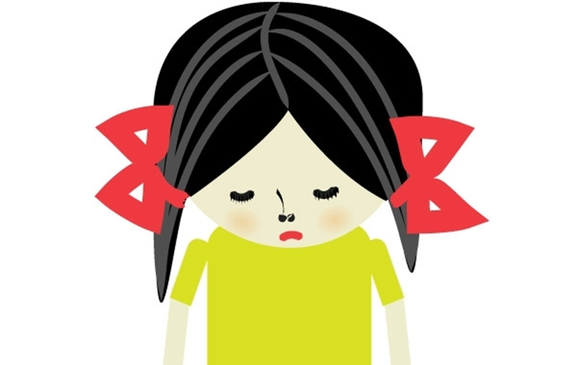
Sometimes I worry about Coronavirus
and becoming unwell.

Slide 5

It’s totally normal to feel a little worried
about this.

Slide 6
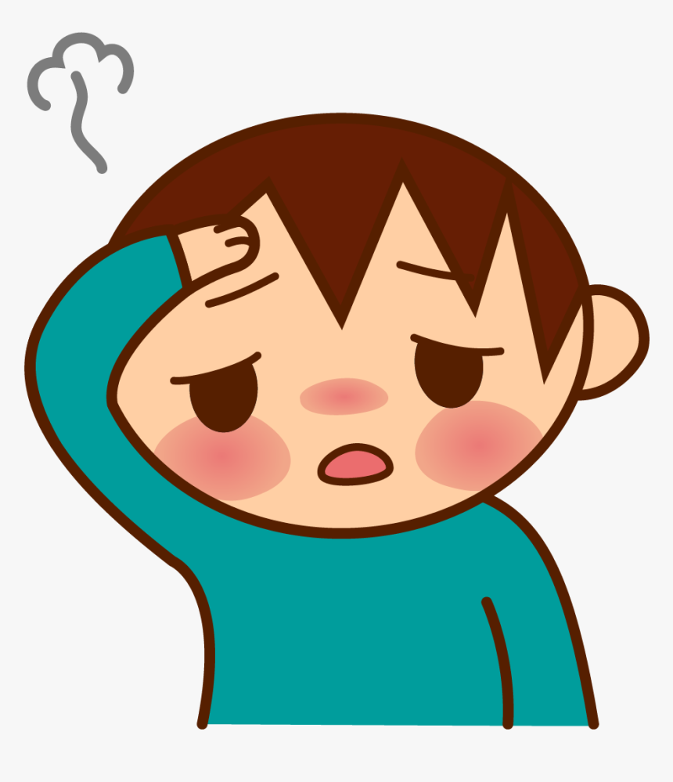
If I let my worry get too big this could also make
me feel unwell. It does not mean that I have the Coronavirus

Slide 7
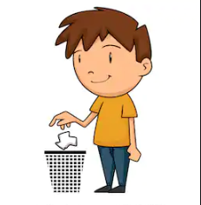
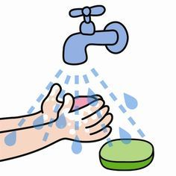
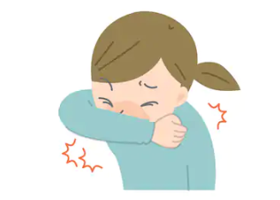
Things I can do to help stay healthy are…
Sneeze into my sleeve or a tissue, put the tissue straight into the bin and then wash my hands

Slide 8
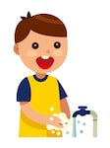

I must wash my hands regularly with soap for 20 seconds.
You can count or sing any song, so long
as it lasts at least 20 seconds.

Slide 9

When I do the these things I can relax, I
have tried my best to stay well.

Slide 10
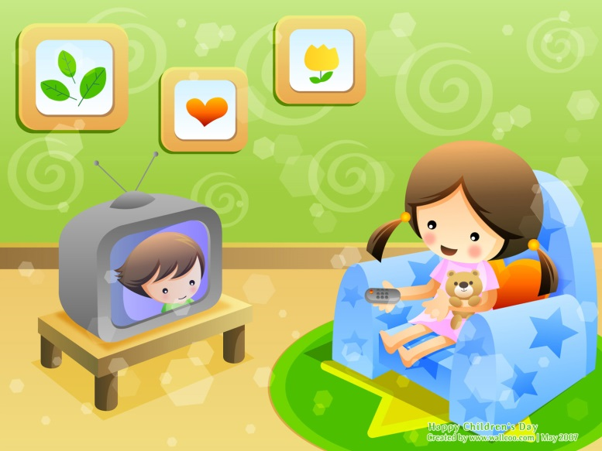


I might still get unwell, this may or may not be due to the Coronavirus.
If I listen to what I’m told and follow the instructions I will get well again and not pass on any nasty germs.

Slide 11
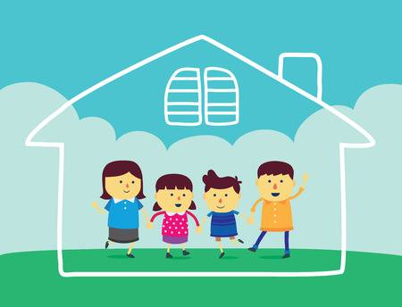
I might be asked to stay at home with my family.
That’s so we don’t spread germs.
We might not be allowed to go shopping, to the soft
play centre or out other clubs and hobbies.
It’s not Mum or Dad being mean, the government
are advising and telling us all what to do.

Slide 12

This is to help me keep others healthy

Slide 13

When I stay at home I can be proud that I am helping.
Original story author unknown rewrite by Anita Duncan ELSA

