Slide 1
17.6.2021
L.O: To use fractions
C: Fractions of a set of objects (2)

Slide 3




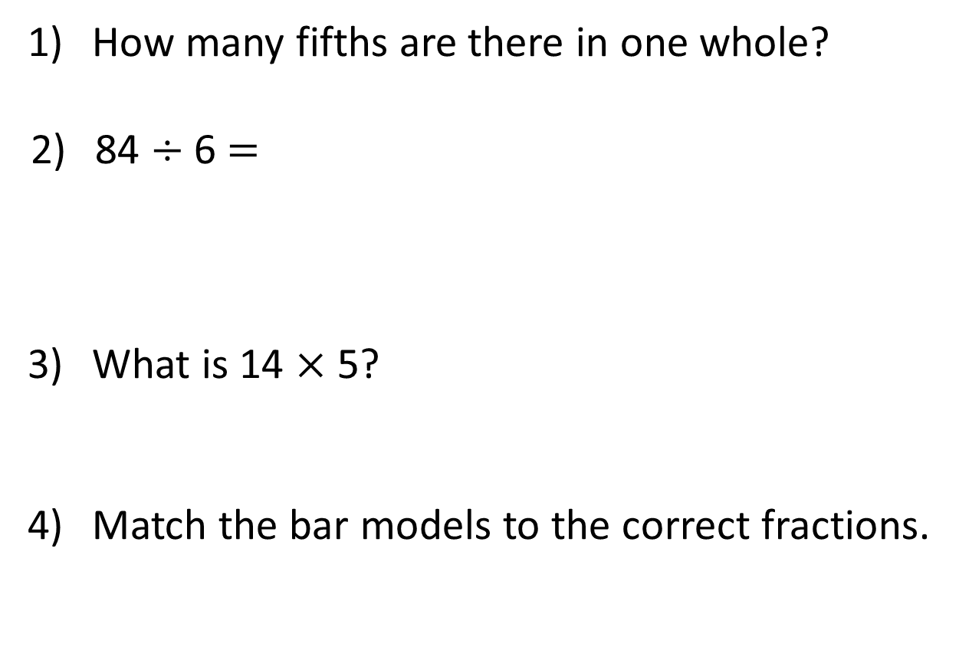
How many fifths are there in one whole?
84 $÷$ 6 $=$
What is 14 $×$ 5?
Match the bar models to the correct fractions.
$\frac{\text{2}}{\text{3}}$
$\frac{\text{3}}{\text{4}}$
$\frac{\text{3}}{\text{8}}$
$\frac{\text{5}}{\text{6}}$

Slide 4


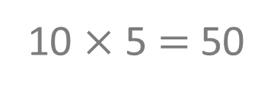

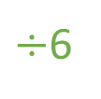

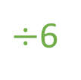
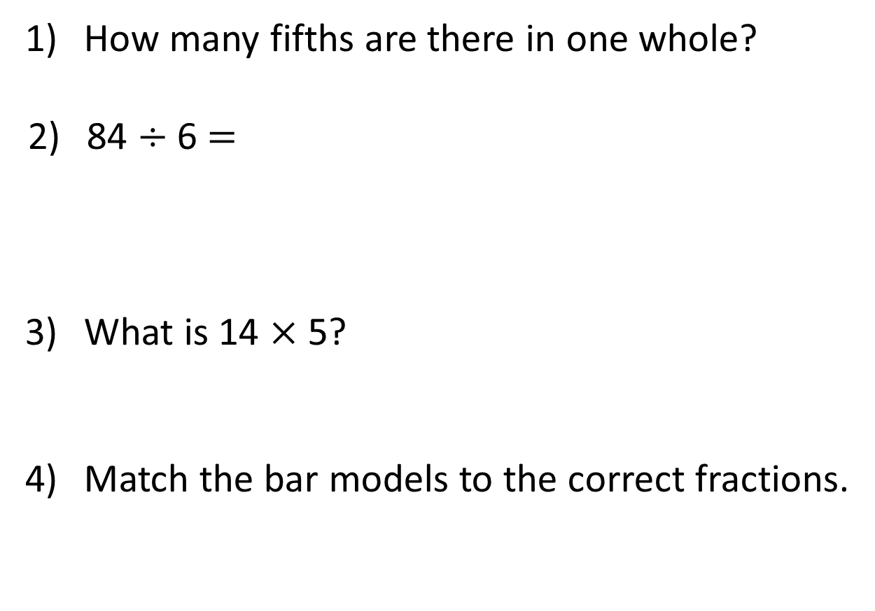
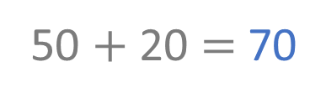

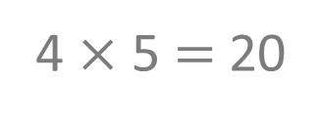
How many fifths are there in one whole?
84 $÷$ 6 $=$
What is 14 $×$ 5?
Match the bar models to the correct fractions.
5
14
84
60
24
$÷$6
$÷$6
10 $×$ 5 $=$ 50
10
4
4 $×$ 5 $=$ 20
50 $+$ 20 $=$ 70
$\frac{\text{2}}{\text{3}}$
$\frac{\text{3}}{\text{4}}$
$\frac{\text{3}}{\text{8}}$
$\frac{\text{5}}{\text{6}}$

Slide 6


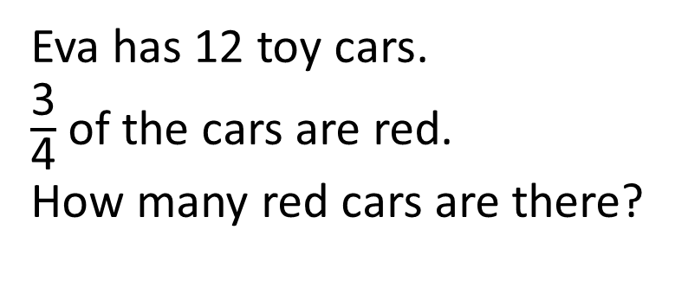
Eva has 12 toy cars.
$\frac{\text{3}}{\text{4}}$ of the cars are red.
How many red cars are there?
There are 9 red cars.

Slide 7


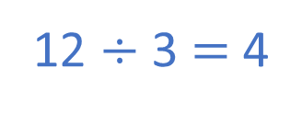
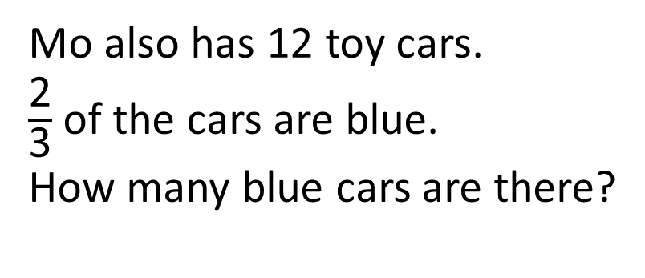
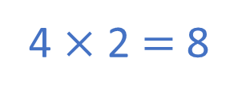
Mo also has 12 toy cars.
$\frac{\text{2}}{\text{3}}$ of the cars are blue.
How many blue cars are there?
Have a think
12 $÷$ 3 $=$ 4
4 $×$ 2 $=$ 8
There are 8 blue cars.

Slide 8


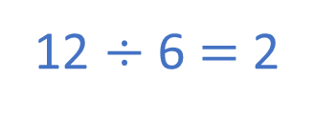

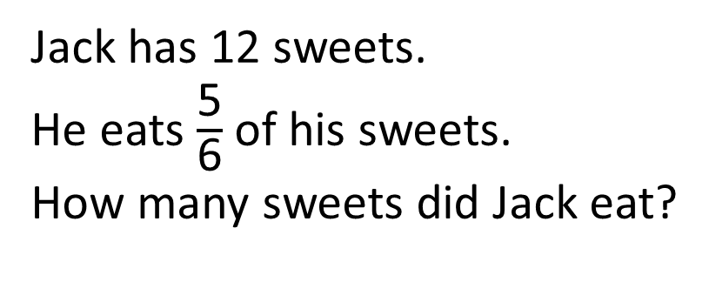
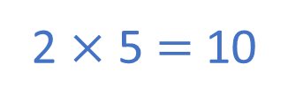
Jack has 12 sweets.
He eats $\frac{\text{5}}{\text{6}}$ of his sweets.
How many sweets did Jack eat?
How many sweets does Jack have left?
What fraction are left?
2
$\frac{\text{1}}{\text{6}}$
Have a think
12
2
2
2
2
2
2
12 $÷$ 6 $=$ 2
2 $×$ 5 $=$ 10
Jack eats 10 sweets.

Slide 9
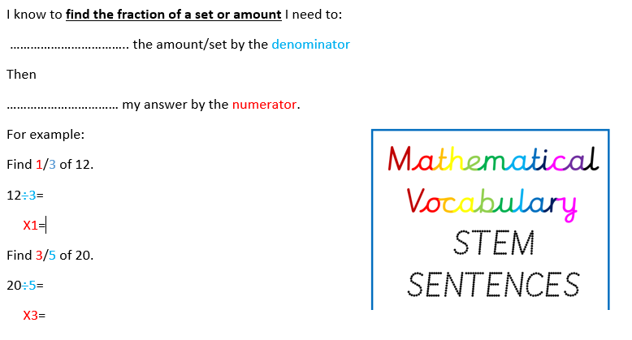
Let’s fill in this STEM sentence guide together!

Slide 10
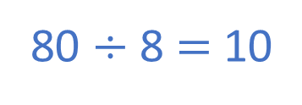
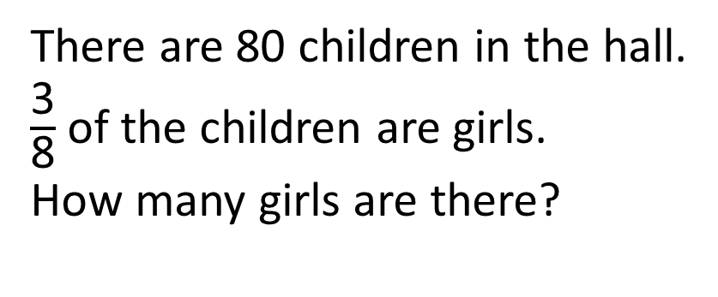
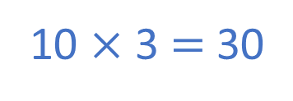
There are 80 children in the hall.
$\frac{\text{3}}{\text{8}}$ of the children are girls.
How many girls are there?
Have a think
80 $÷$ 8 $=$ 10
10 $×$ 3 $=$ 30
There are 30 girls.
80
10
10
10
10
10
10
10
10

Slide 11


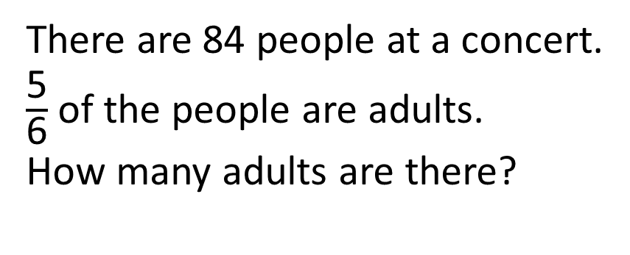
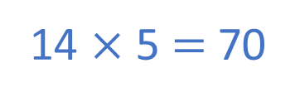
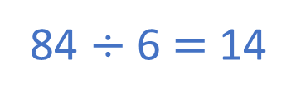
There are 84 people at a concert.
$\frac{\text{5}}{\text{6}}$ of the people are adults.
How many adults are there?
84 $÷$ 6 $=$ 14
14 $×$ 5 $=$ 70
Have a think
There are 70 adults.
84
14
14
14
14
14
14

Slide 12
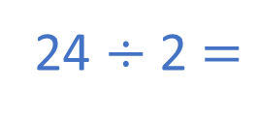
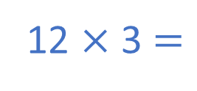
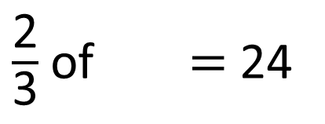
$\frac{\text{2}}{\text{3}}$ of $=$ 24
36
Have a think
36
?
12
12
12
24
24 $÷$ 2 $=$
12
12 $×$ 3 $=$
36

Slide 13
It’s your turn!
There is a red-pen question if you finish. ☺

