Slide 1
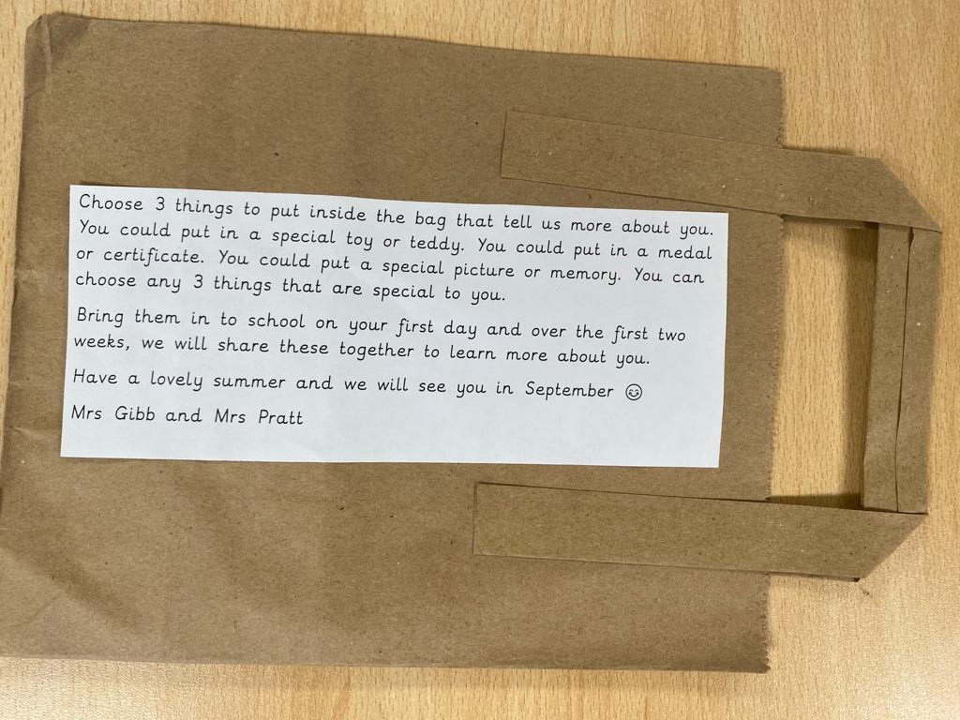
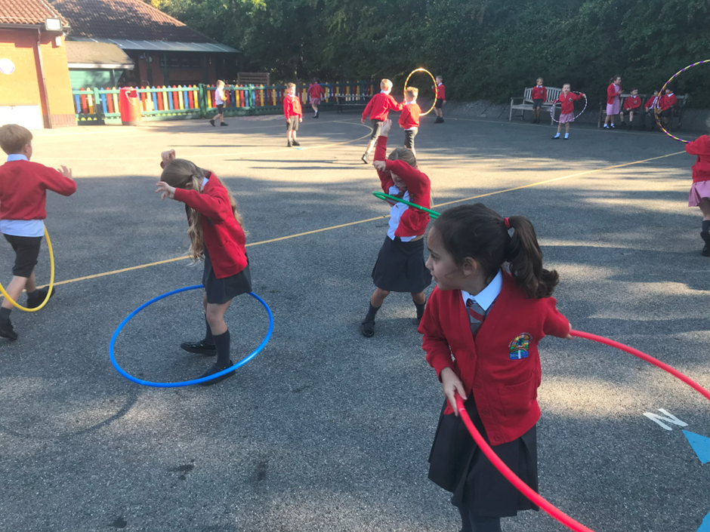
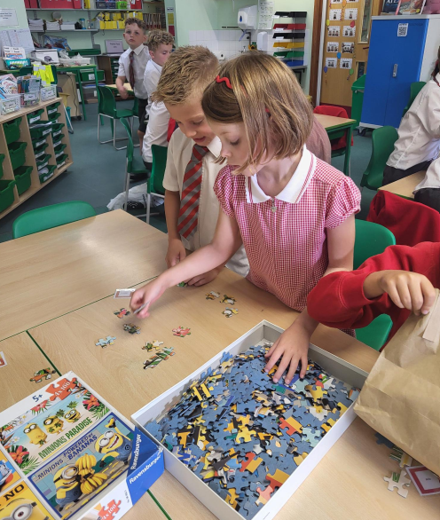
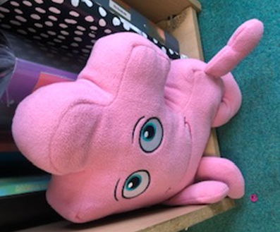
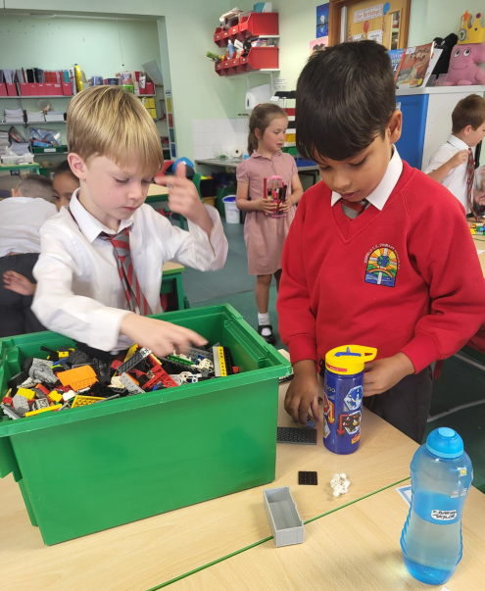
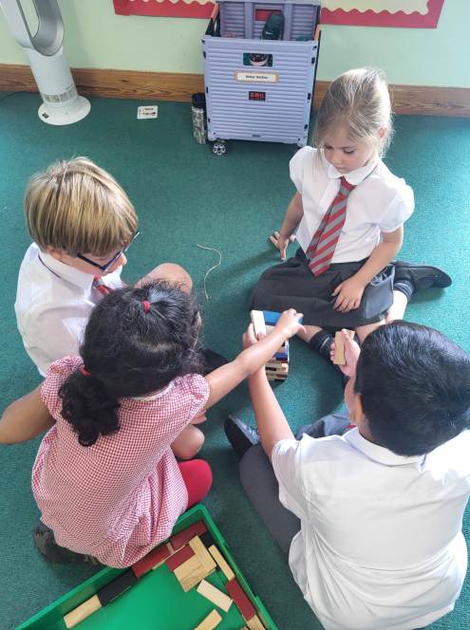
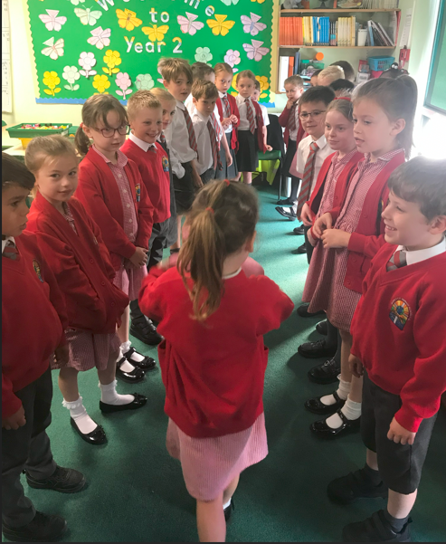
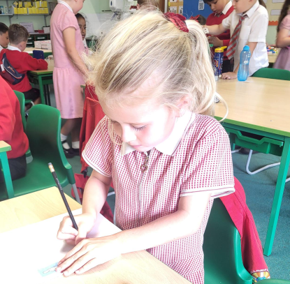
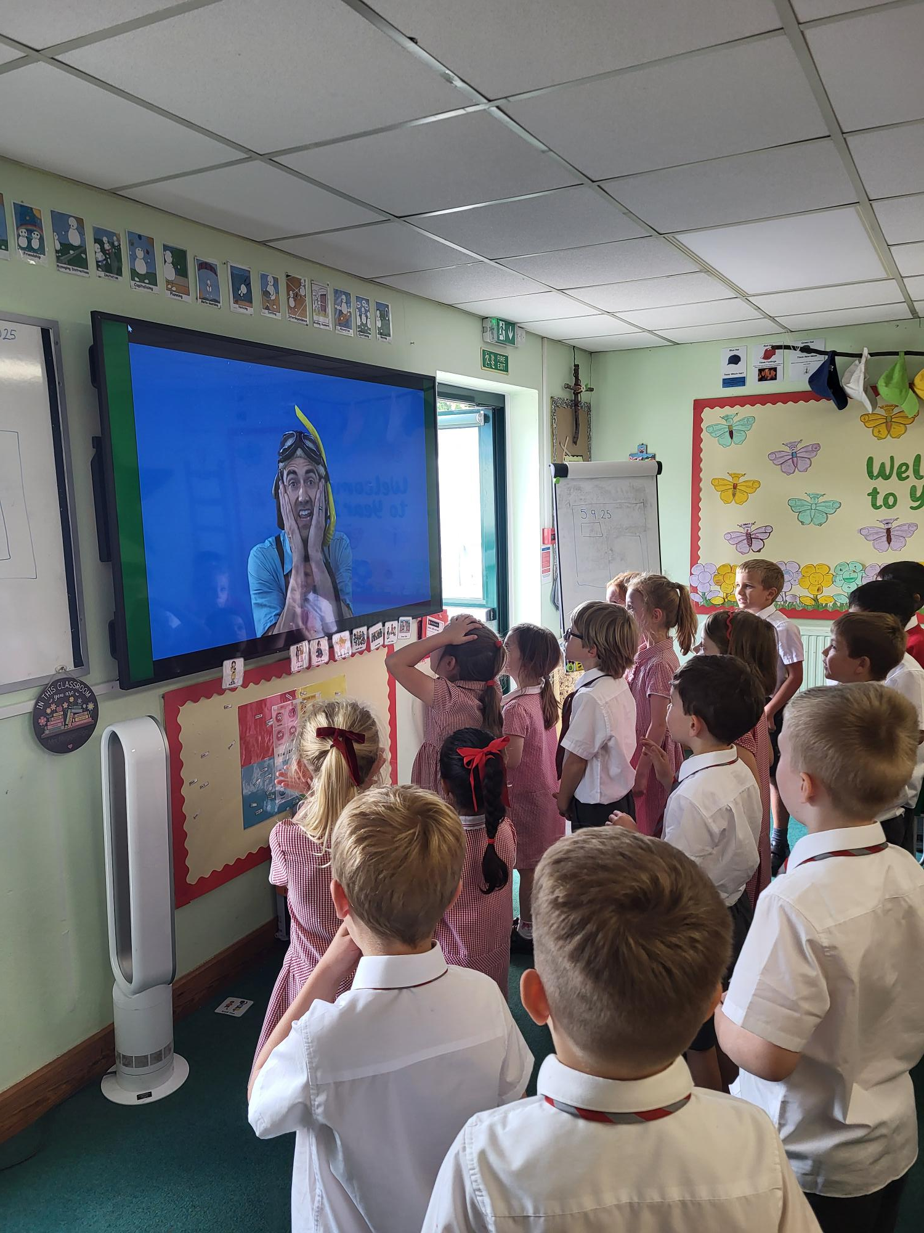
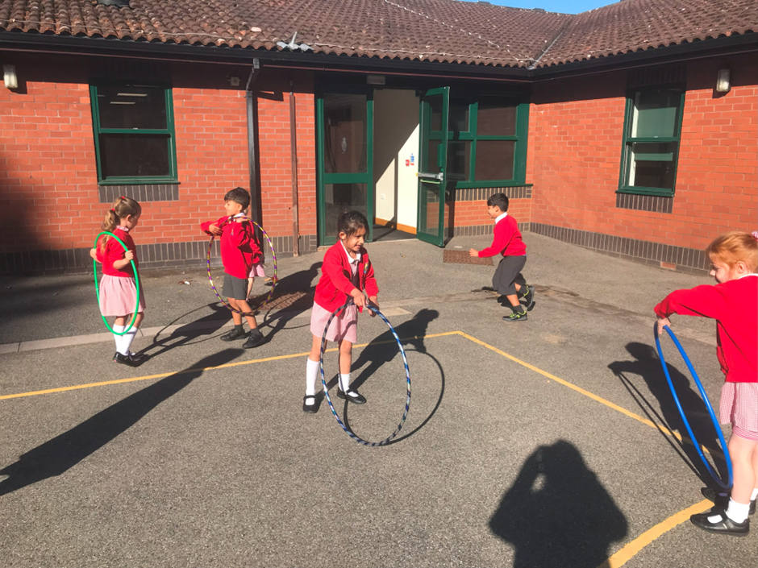
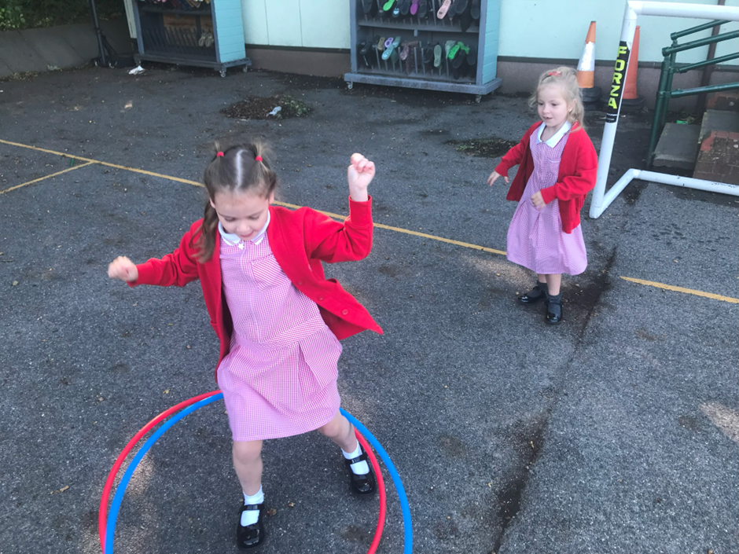
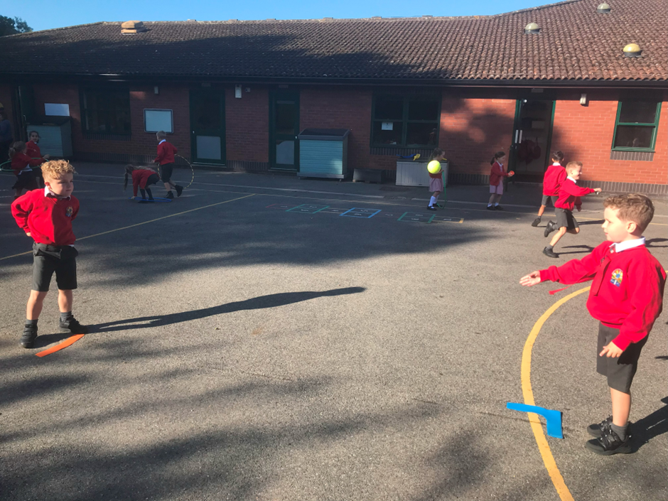

This is what we have done so far...

Slide 2
Welcome to Year 2

Slide 3


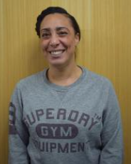
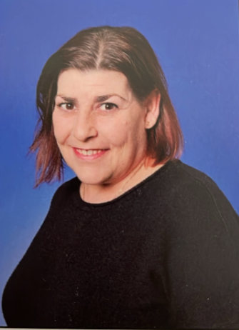
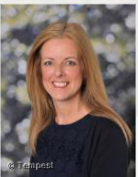

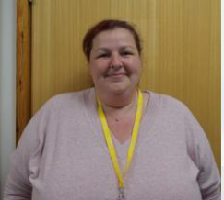

Miss Ridnell
(Teacher- 2HR)
Mrs Muggeridge (Teacher – 2EM)
Miss Richardson
(LSA)
Ms Savage
(LSA)
The Binfield Support Partnership Team
Mrs Brazell (SENDCO), Mrs Cox and Mrs Gray provide support for pupils and families with learning and behaviour.

Slide 4
Year 2 Highlights
Florence is visiting!
Clubs
Nativity Play
Outdoor learning in the BOLE
Walk to church
Sports Week
We’re going to Windsor Castle!
Music Week

Slide 5
English
Daily, plus extra spelling, grammar, reading comprehension and handwriting
Grammar teaching: new rules introduced regularly and integrated into writing
Importance of neat handwriting as well as checking spellings, punctuation and grammar in all books.
We will have different stories as hooks into writing
We will teach subjects in a cross-curricular manner where possible e.g. taking time to write about Florence Nightingale in History lessons.
Spellings are in their Home Learning books. These are a guide to what we are focusing on.
To support your child at home, encourage them to read a range of quality texts (this can be together) and then talk about them. Also, exposure to different texts e.g. Magazines and newspapers can really help their learning.

Slide 6



Spellings
- For those who have finished RWI, they will follow RWI spelling which leads on from the phonics scheme
- Taught patterns and spelling rules
- All children will have spellings to learn each week. We will focus on these set words in class. These will start as common high frequency words

Slide 7
Maths
Daily, including mental maths and basic skills coverage
Lots of emphasis on mental recall of number facts, problem solving and reasoning. We will be following a Mastery Maths programme.
Times tables are really important. The National Expectation is that children will know their 2x, 5x and 10 times tables by the end of Year 2. They will also be able to count in 3s and 4s.
Children are expected to know all their tables up to 12x12 by the end of Year 4.
TA support in lessons and leading small groups
Application of understanding to ‘real life’ contexts
Applying taught skills to word problems
Basic counting, number bonds and quick addition/subtraction are important
All children will have a log in for Numbots, and later on in the year TT Rockstars.
Support your child at home by encouraging them to use their maths skills. Examples of this include using measures in the kitchen, telling the time and using money whilst shopping.

Slide 8
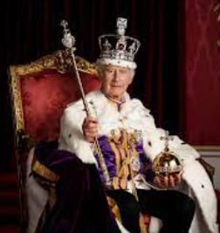
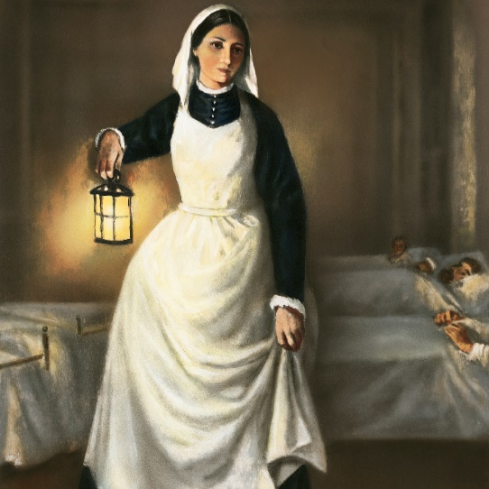

Themes
Detailed information about the topics we shall be covering can be found in the termly ‘Learning News’. This is also available on the school website.
Spring Term
Autumn Term
Summer Term
The
Coronation
Florence Nightingale
Islands

Slide 9
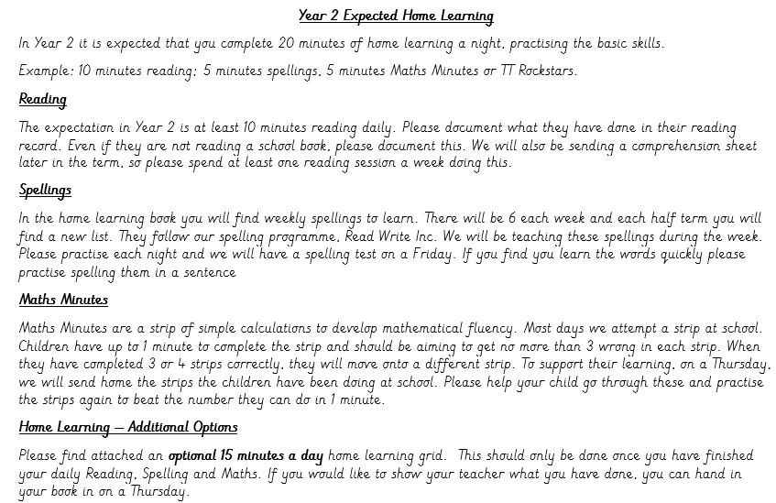
Autumn Home Learning

Slide 10

Reading
Teachers and LSAs will hear children read regularly.
Children should bring in their reading book and yellow log book daily.
Their books will be changed at least once a week. Please feel free to write notes about any other books, magazines or recipes they read in their yellow books too.
All reading is important to us! It is also important for you to share stories with your child, and they hear you read.

Slide 11

Reading

Slide 12
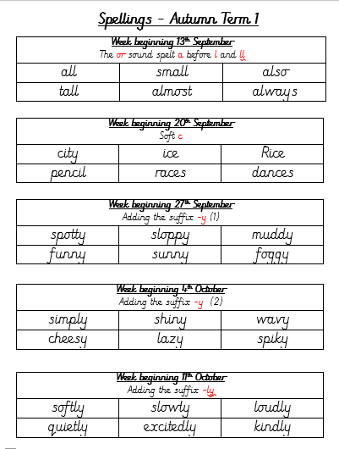
Home Learning

Slide 13
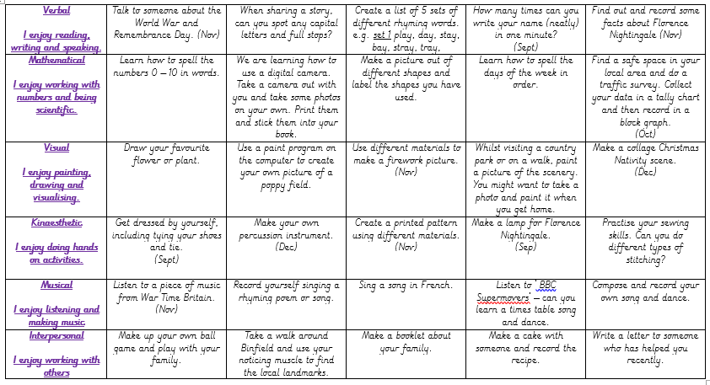
Optional Home Learning

Slide 14
Expectations in Year 2
We encourage children to become more independent and take responsibility for their learning.
Organisation:
Bringing in reading book and reading record on a daily basis and ensuring it is signed by an adult
Bring PE kits to school on a Monday and take them home on Fridays.
BOLE kits to remain in school all term. We will send home if too muddy
Encouraging children to go to the toilet at break times (where appropriate)
Learning to tie their shoelaces and ties!

Slide 15
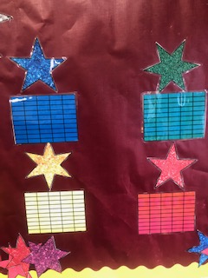
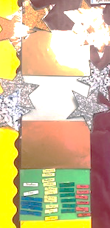
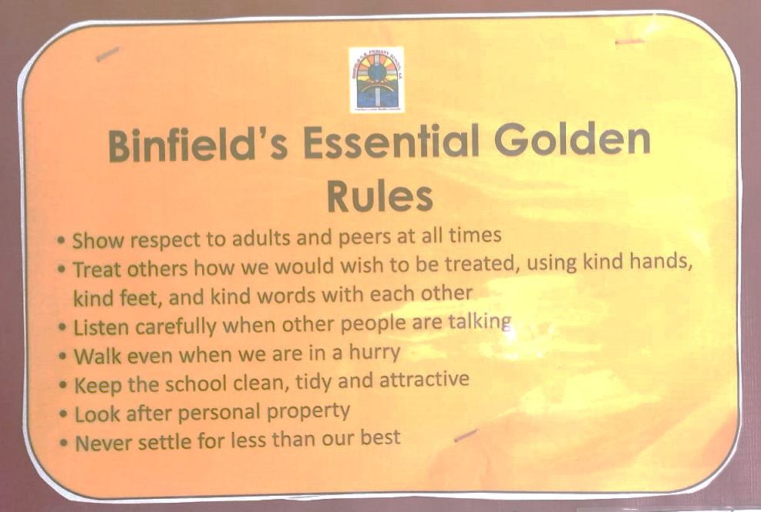
Behaviour

Slide 16
Rewards
In line with our behaviour policy focusing on consistent ‘Binfield Essentials’ behaviour we now have a reward system in place.
-Bronze award
-Silver award
-Gold award
Children’s names are entered into the Gold Book.
We also have a class marble jar, which they earn as a collective group.

Slide 17
Snacks
A snack is provided daily for KS1 children, usually a piece of fruit.
You may provide your own fruit or vegetable for your child if you would like to.

Slide 18
Attendance
At Binfield, we work toward 100% attendance for every child.
In the case of illness, please call the office before 8.55am each day.
On return from illness, please provide a written letter explaining the reason for absence.
Any request for leave of absence should be made with at least two weeks notice using the “Request for Leave of Absence” form, which can be found on the school website or is available from the office.
Where possible, medical appointments should be taken outside of school hours.

Slide 19
Uniform
Winter: mid grey trousers / skirt (no playsuits)
Summer: dresses / shorts can be worn
White shirt – top button done up and shirt tucked in
Tie to be done up to meet collar
School shoes (black – no trainers)
Hair tied back with red, white, grey or black hair tie. No extreme hairstyles
Nail varnish not to be worn
Earrings: gold or silver studs. (To be removed for P.E)
Watch can be worn.
Please make sure all items are named
Keep PE kit in school all week, in case of clubs, change of lessons etc.
BOLE Kit (Wellies, waterproof coat and trousers) to be in school all week.

Slide 20
Uniform
PE:
Red fleece/ jacket
Red Binfield T-shirt
Plain black jogging bottoms and trainers (outdoor games),
Black shorts for indoor PE (Not cycling shorts)
White socks.
Reminder – NO BACKPACKS. Please keep lunchboxes and water bottles to a reasonable size.
Please make sure all items are named
Keep PE kit in school all week, in case of clubs, change of lessons etc.
BOLE Kit (Wellies, waterproof coat and trousers) to be in school all week.

Slide 21
Costings and ‘extras’
Florence Nightingale visit (paid)
Windsor Castle visit (approx. £19.50)
Please can all children bring in a named art apron for Arts and Crafts. This can be a large t-shirt, old shirt, or art apron.
Throughout the school year, we actively take part in fundraising events for different charities

Slide 22
Supporting Your Child
Asking your child questions about what they have learnt at school. Please check Twitter!
Encouragement with areas they find challenging.
Encouragement to join school clubs and participate in different activities.
Making us aware of anything that may affect their well-being and therefore influence their academic progress or attitude towards school life.
Encouragement with home learning (not doing it for them!)
Daily support with reading, spellings and times tables/counting.
Checking home learning diary/using it to communicate.
Supporting FOBS.
Coming in and reading with the children.
Please let us know if you have any skills that we could utilise ☺

Slide 23
Other reminders
Please let the office know if someone else is picking up or they are not attending a club
Individually wrapped cakes are allowed for birthdays – no sweets
Please send children with a hat (if hot or cold) and water bottle every day
Don’t forget swimming on Friday!

Slide 24
What to do if you have any queries...
Speak to your class teacher when you pick up your child.
Send a sealed letter in with your child.
Arrange a meeting with your class teacher for after school.
Send an email to secretary@binfieldschool.com for the office staff to pass on to the teachers.
If these options are unavailable, please catch your child’s teacher at drop off.
We encourage parents to talk to their child’s class teacher directly if they have any questions or concerns.
Please avoid using social media as a forum for these kinds of issues.
We look forward to working with you this year.

