Slide 1
LO: I understand that every time I learn something new I change a little bit.
I enjoy learning new things
C: Changing Me

Slide 2
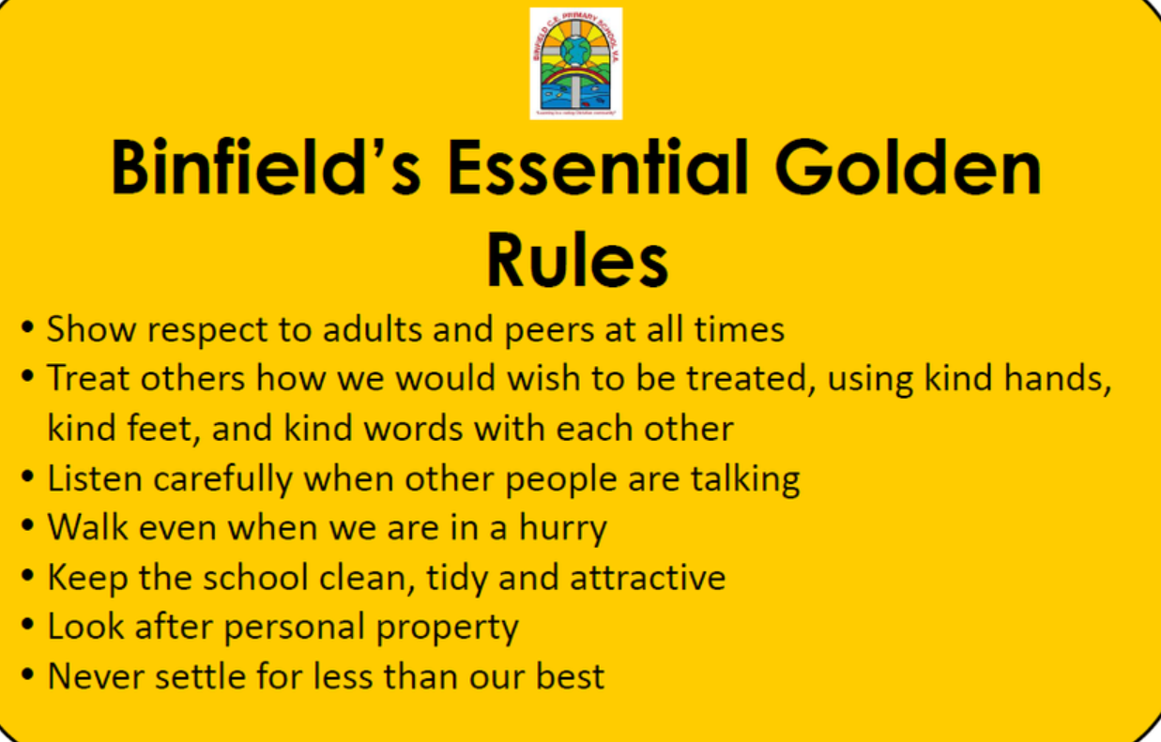
Recap Binfield Golden rules and Extra golden rules

Slide 3
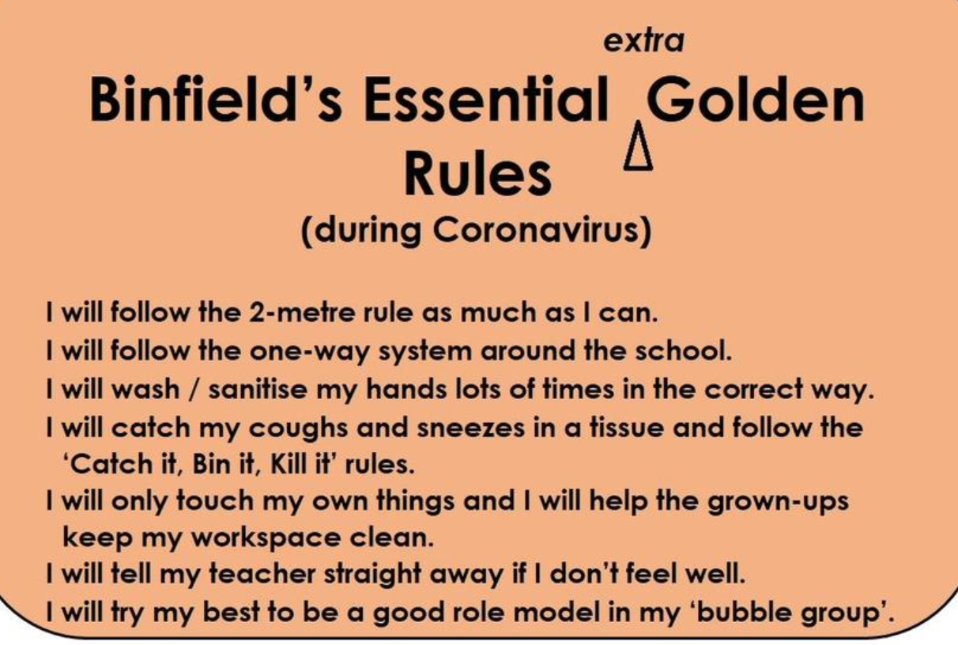

Slide 4
Connect Us:
Change is a part of growing up.
What changes have already happened in your lives?

Slide 5
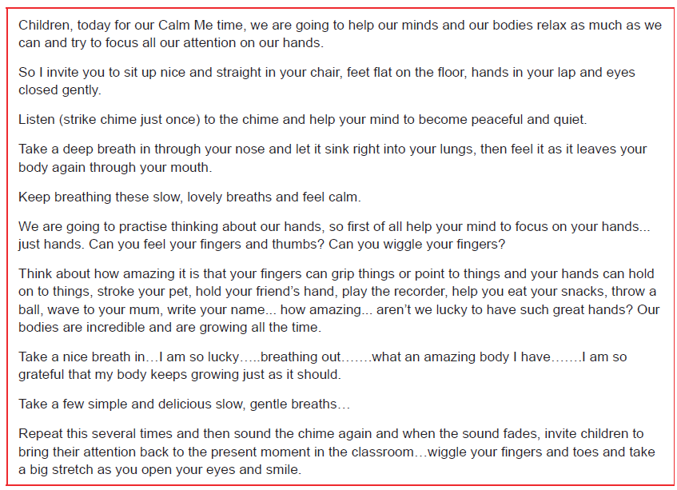
Calm Me:

Slide 6
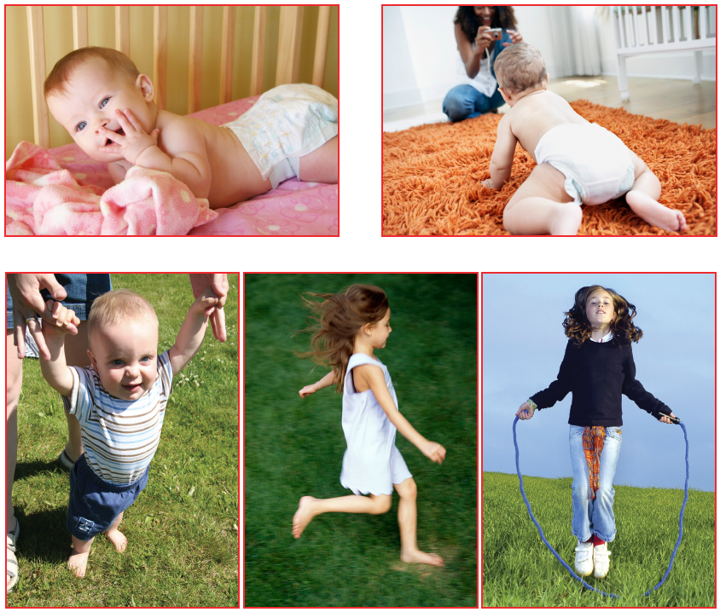
How has this child changed as they’ve grown up?
As we grow, we learn to do more things!

Slide 7
Tell me/show me
Draw the stem and centre of a flower. Add one petal and stick the first picture (baby) into it. Draw the second petal and ask: which picture should go in next?. Continue until the flower is complete, helping children to understand that every time we learn something new, we add a little bit onto ourselves, like adding a petal to a flower.
Take the pictures off the flower and go through the process again, this time asking children things they have learnt that may have changed them a little bit. Add their suggestions to each petal, e.g. learnt to talk, learnt to share toys, learnt to ride a bike. Draw out the learning that however old we are, as we learn things, we grow a little bit.

Slide 9
Let me learn
Children give suggestions as to what they have learnt since they were babies. Teacher writes this list on flipchart and makes sure that some things on the list apply to every child.
Play ‘Let’s be flowers’.
Children find a space and curl up in a ball pretending to be the seed of a new flower. Explain that as you call out something they may have learnt, if this applies to them, they physically grow a little bit as if they are a flower starting to grow, a flower that is blossoming. For example, if you have learnt to walk, make your flower grow a little bit. Continue the process until all of the children are standing up and looking like flowers.

Slide 10

Task:
In each petal of the flower, draw or write something you have learnt that has helped you grow.

