Slide 1
LO: I understand that medicines can help me if I feel poorly and I know how to use them safely.
I know some ways to help myself when I feel poorly
C: Healthy Me piece 4

Slide 2
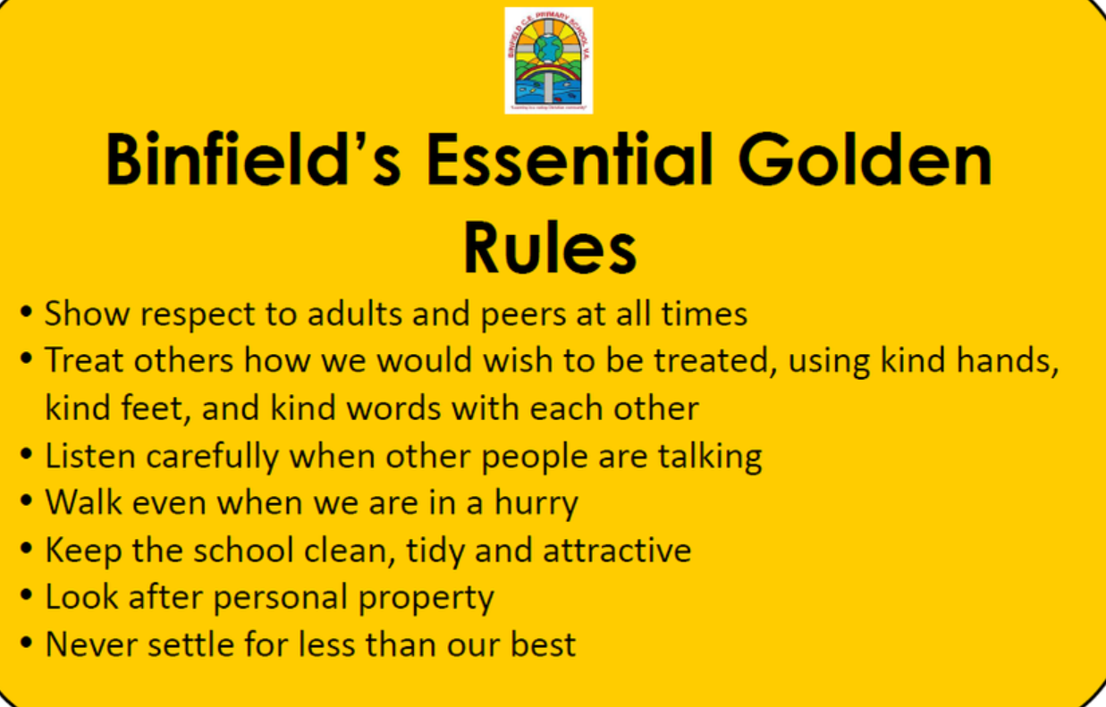
Recap Binfield Golden rules and Extra golden rules

Slide 3
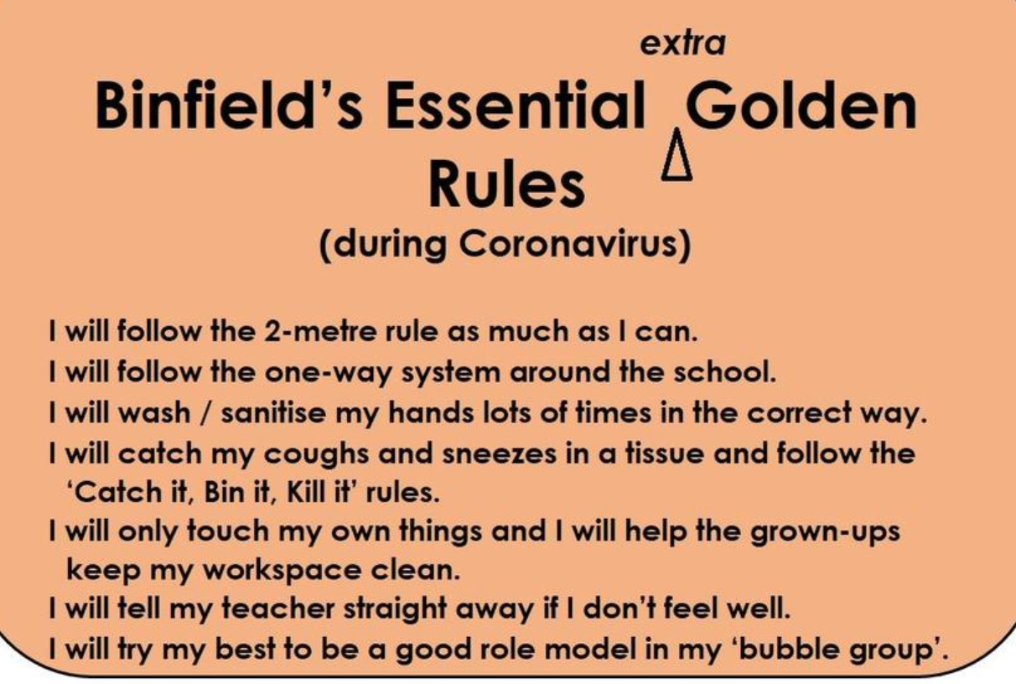

Slide 4
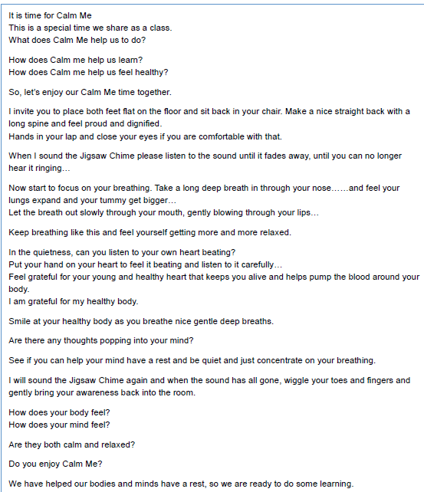
Calm me.

Slide 5
Open my mind:
Split the children into groups of 3 or 4. Ask the children to role-play what happens when they feel poorly.
What do they look like? Who else is there? What do they do to help themselves feel better?
Include how eating healthy food, drinking lots of fluids and taking some medicines can help us feel better.

Slide 6
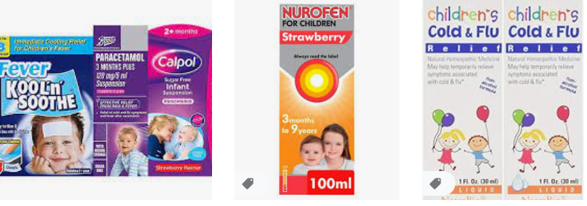
Tell me/Show me: Medicine
Why do medicines have instructions?
What could be the dangers of taking too much medicine?
Who should give medicine to you when you are poorly?

Slide 7
Let me learn:
We are going to play a game to decide whether things are healthy,
unhealthy or OK sometimes.
Working in pairs, look at the picture cards of things we put into our bodies and decide whether they go into the ‘always healthy/safe’ pile, the ‘never healthy/safe’ pile or the ‘OK sometimes’ pile.
Are there any we disagree on? Why might this be?
Notes:
Be aware of any child or relative or a child in the class who may have a long-term health condition and for whom
medication may not be so straightforward.

