Slide 1

Monday 24th May 2021
L.O: To write with purpose
C: Persuasive Letter

Slide 2

Today we are going to start writing our letters!

Slide 3
Let’s start by laying out the start of our letters.

Slide 4
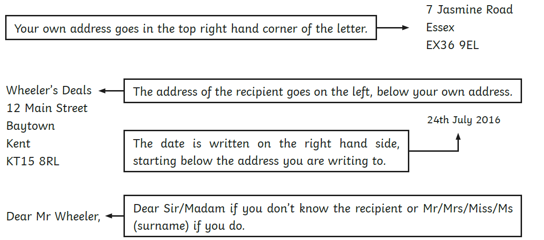

Slide 7
Now we are going to write our introductions!
Our introduction introduces what we are going to be talking about, without giving away too much information.
Let’s look at a model.

Slide 8
Our introduction should introduce who we are and why we are writing.

Slide 9
I am writing on behalf of all of the children in Year 3 at Binfield C of E Primary School, to persuade McDonalds to reflect on and rethink their “Happy Meal” packaging. Over 3.2 million “Happy Meals” are sold worldwide each day. However, we strongly believe it is unfair to call them “Happy Meals” with the current waste they produce. This letter will highlight the problems and offer some invaluable solutions, which will improve your products and boost your brand’s reputation.

Slide 10
Let’s magpie some phrases from the model!

Slide 11
I am writing on behalf of all of the children in Year 3 at Binfield C of E Primary School, to persuade McDonalds to reflect on and rethink their “Happy Meal” packaging. Over 3.2 million “Happy Meals” are sold worldwide each day. However, we strongly believe it is unfair to call them “Happy Meals” with the current waste they produce. This letter will highlight the problems and offer some invaluable solutions, which will improve your products and boost your brand’s reputation.

