Slide 1
LO: To understand values
Key Question: Does celebrating Chanukah make Jewish children feel closer to God?

Slide 2
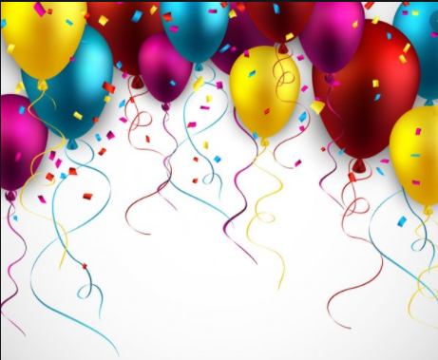
What does celebration mean?

Slide 3
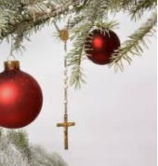
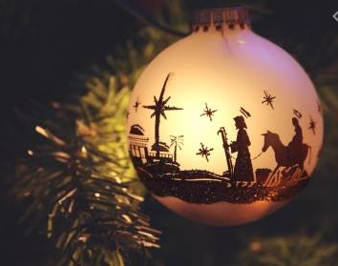
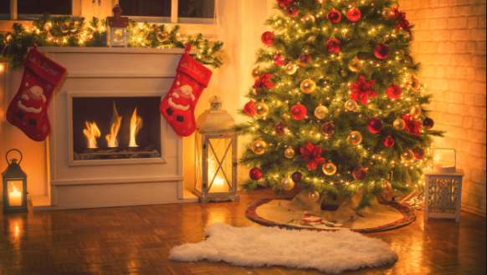
What do Christians do to celebrate Christmas?

Slide 4
Task
Paddling: Draw and label how Christians celebrate Christmas.
(Magpie ideas from class bubble map)
Snorkelling: Draw and label how Christians celebrate Christmas. Describe how you celebrated Christmas this year.
(Use the class bubble map as an aide memoir and add own ideas)
Diving: Draw and label how Christians celebrate Christmas. Explain why you and your family celebrate Christmas in the way that you do.
We give presents because…
We eat turkey because…
We invite our family over because…
Red Pen: What does Christmas time make you think about?

