Slide 1
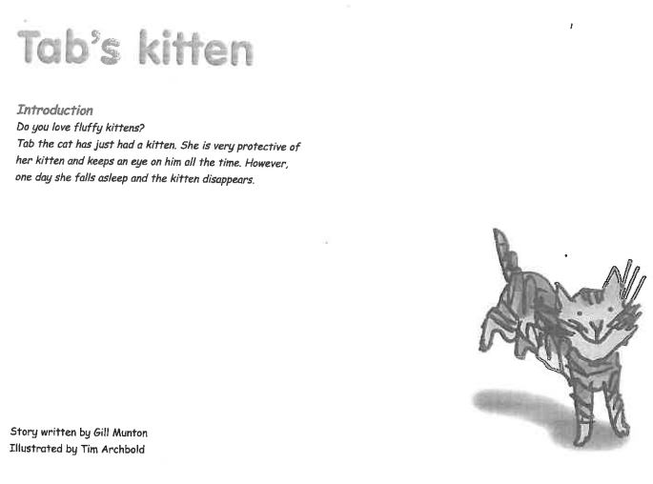


Slide 2
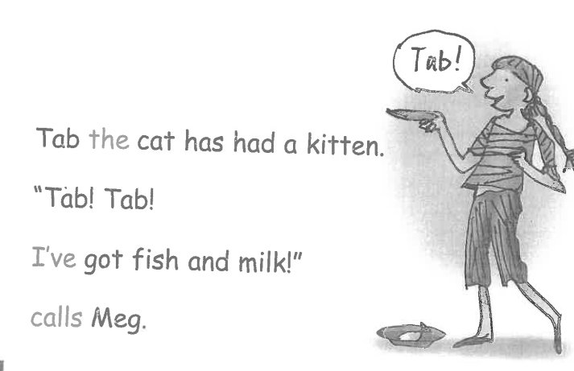
What is Meg feeding the kitten?

Slide 3
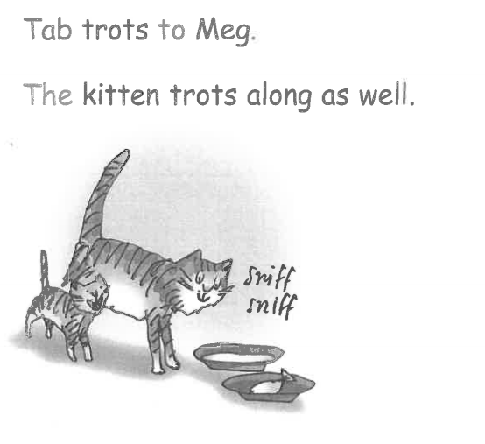
How does the kitten follow its mum

Slide 4
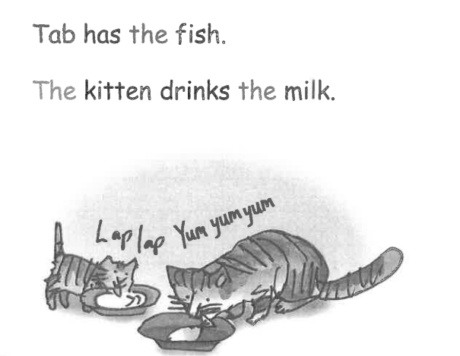
What do Tab and the kitten eat?

Slide 5
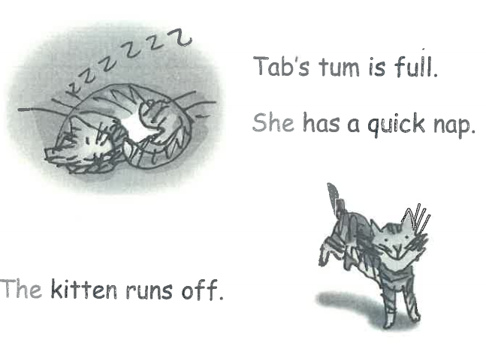
What does the kitten do while Tab has a nap?

Slide 6
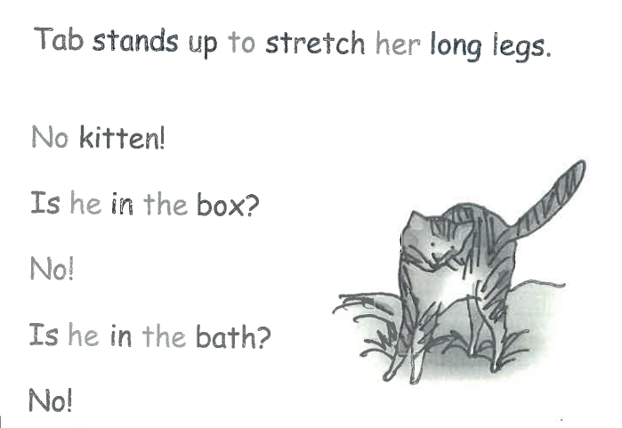
What does Tab think when she can’t see the kitten? How is she feeling?

Slide 7
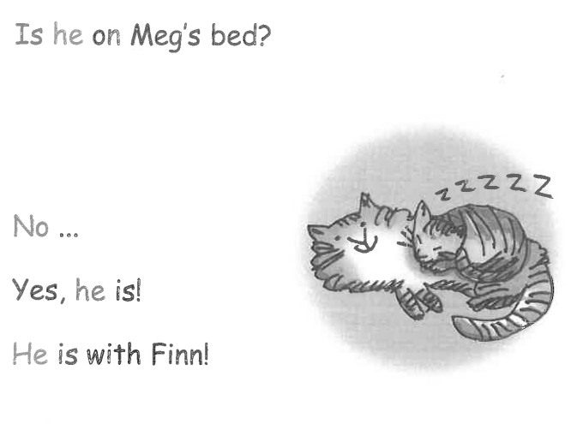
Where does Meg find the kitten? Can you remember who Finn is? (pyjama case)

