Slide 1
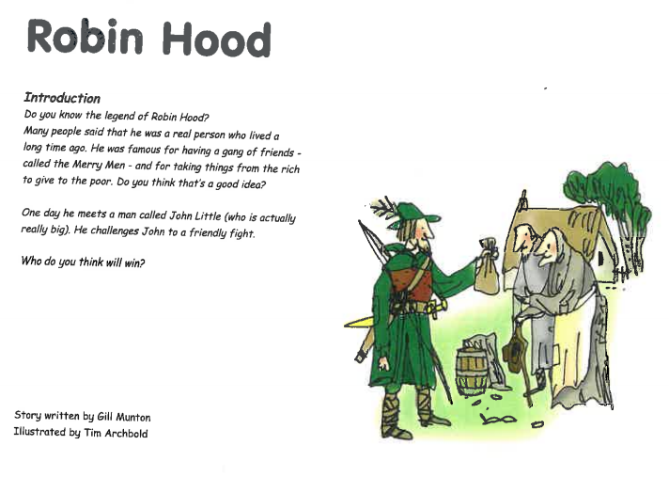


Slide 2
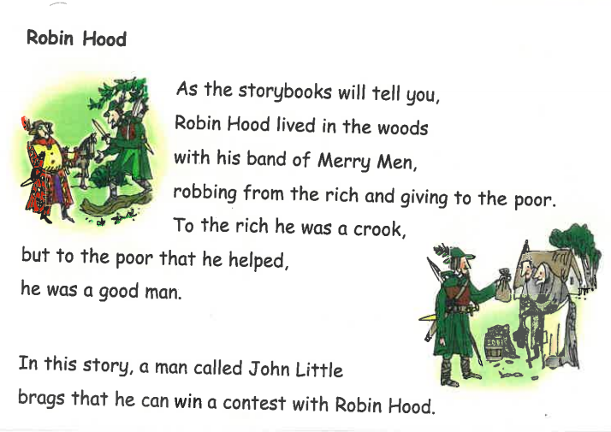
What did Robin Hood do for the poor and why did the rich think he was a crook?

Slide 3
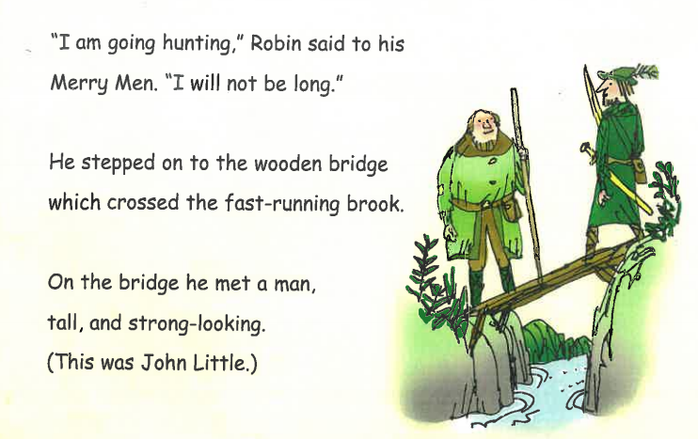
How did John and Robin meet? How did Robin feel about the size of John Little?

Slide 4
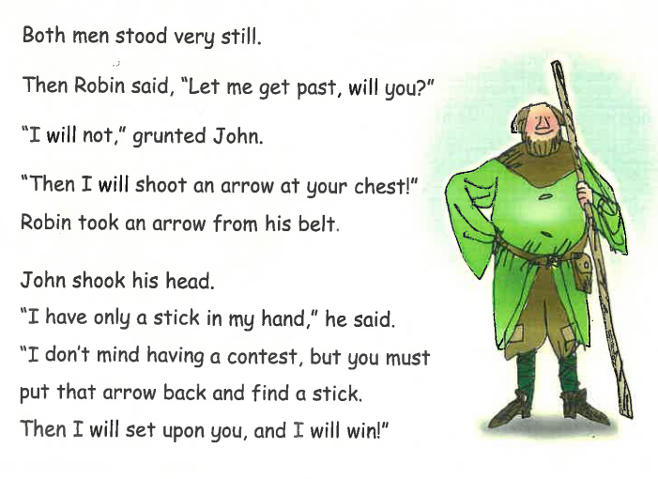
Why did John want Robin to put down his arrow? How was he feeling and why?

Slide 5
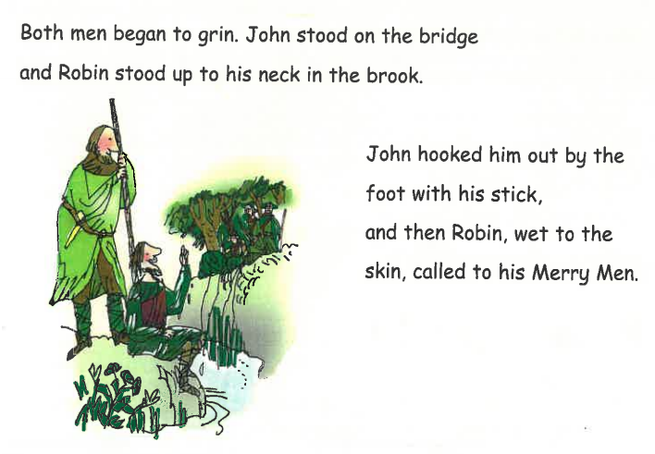
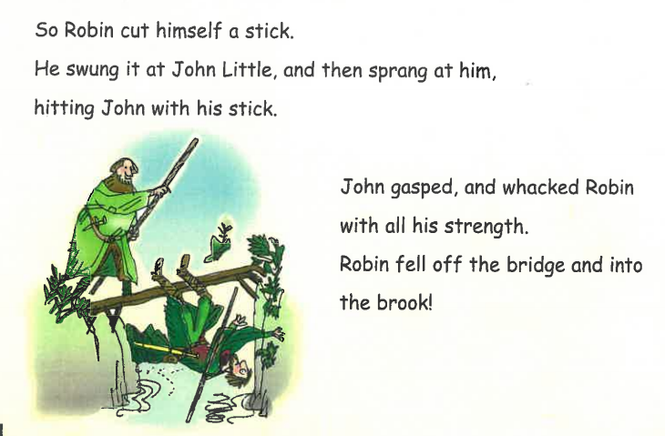
Who won the contest and how did they become friends?

Slide 6
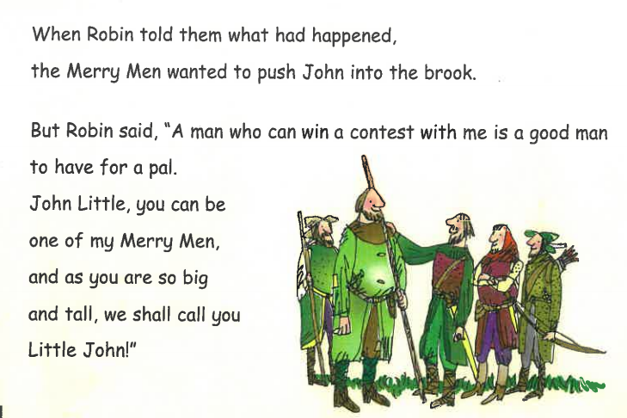
Why did Robin want John to join the Merry Men?

Slide 7
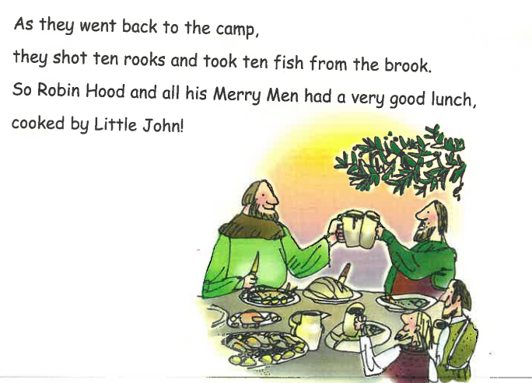
How was Robin feeling and why?

