Slide 1

LO: To Master Techniques

Slide 2
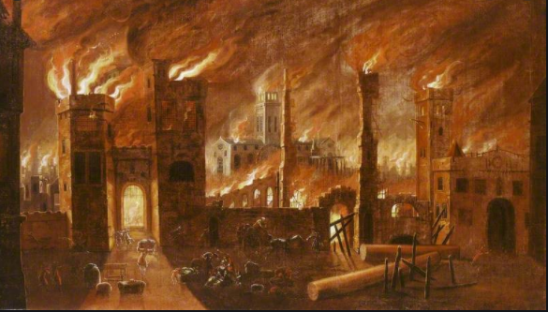
Which colours are you going to use in your painting? Can you use your imitation muscles to copy those colours and shades in your own painting?

Slide 3
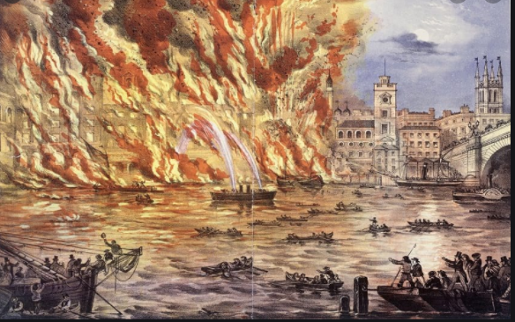

Slide 4
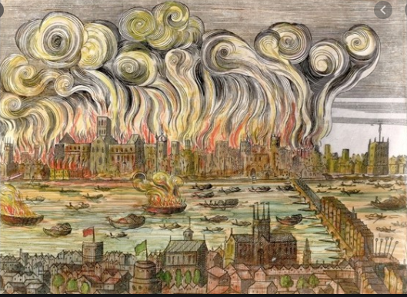

Slide 5
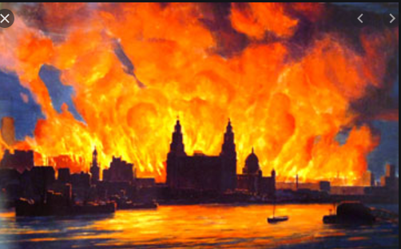
Which colours are you going to use in your painting? Can you use your imitation muscles to copy those colours and shades in your own painting?

Slide 6


