Slide 1


Slide 2
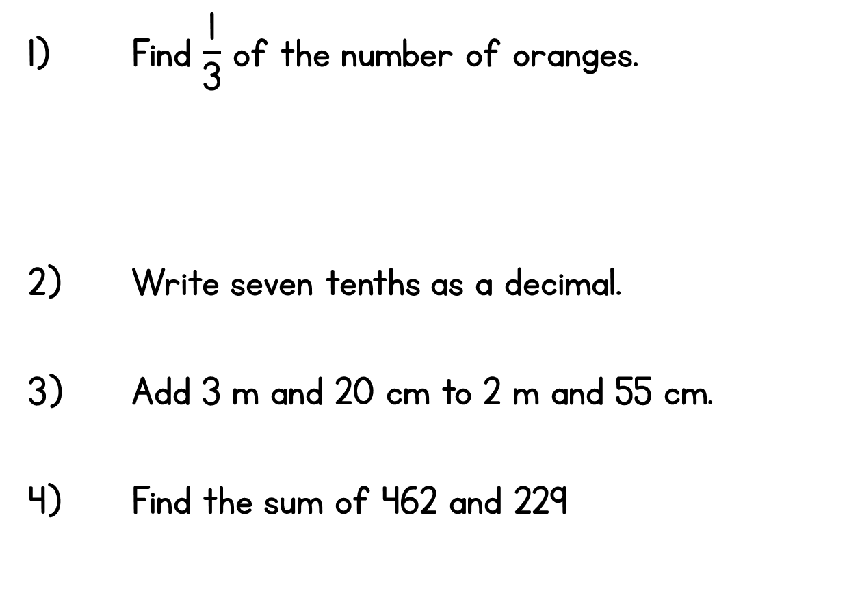
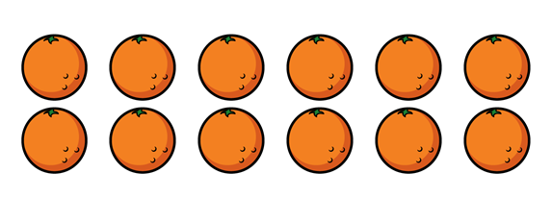

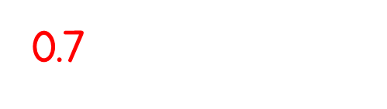
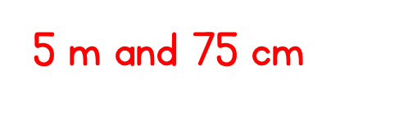
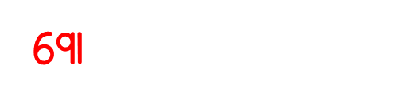

Slide 4

Which sets have one half of the cookies circled?
a)
b)
c)

Slide 5


Which sets have one half of the cookies circled?
a)
b)
c)

Slide 7


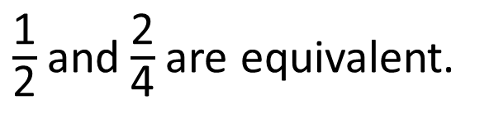
The children are folding and cutting paper to make fractions.
Each piece is one half of the paper.
Each piece is two quarters of the paper.
Who is correct?
$\frac{\text{1}}{\text{2}}$and$\frac{\text{2}}{\text{4}}$are equivalent.
Both boys are correct.

Slide 8



Shade $\frac{\text{1}}{\text{2}}$ of the shapes.
Shade $\frac{\text{2}}{\text{4}}$ of the shapes.
What do you notice?

Slide 9



Shade $\frac{\text{1}}{\text{2}}$ of the shape.
Shade $\frac{\text{2}}{\text{4}}$ of the shape.
Have a think

Slide 10



Circle $\frac{\text{1}}{\text{2}}$ of the birds.
Circle $\frac{\text{2}}{\text{4}}$ of the birds.

Slide 11


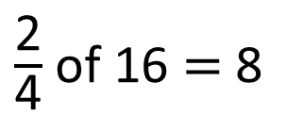

Mo and Amir are finding $\frac{\text{2}}{\text{4}}$ of 16
I think that two quarters of 16 is equal to 8 because half of 16 is 8
Let’s use a bar model to check.
$\frac{\text{2}}{\text{4}}$ of 16 $=$ 8
16
8
?

