Slide 1
LO: I can tell you some things about me that have changed and some things about me that have stayed the same.
I know that changes are OK and that sometimes they will happen whether I want them to or not.
C: Changing me

Slide 2
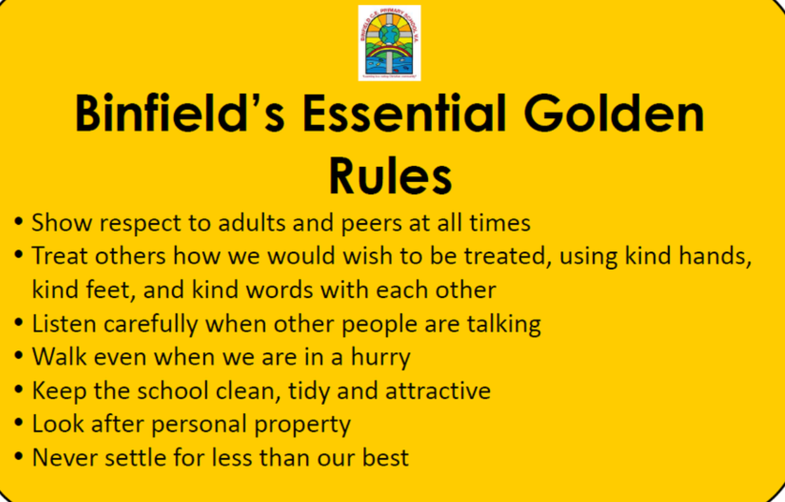
Recap Binfield Golden rules and Extra golden rules

Slide 3
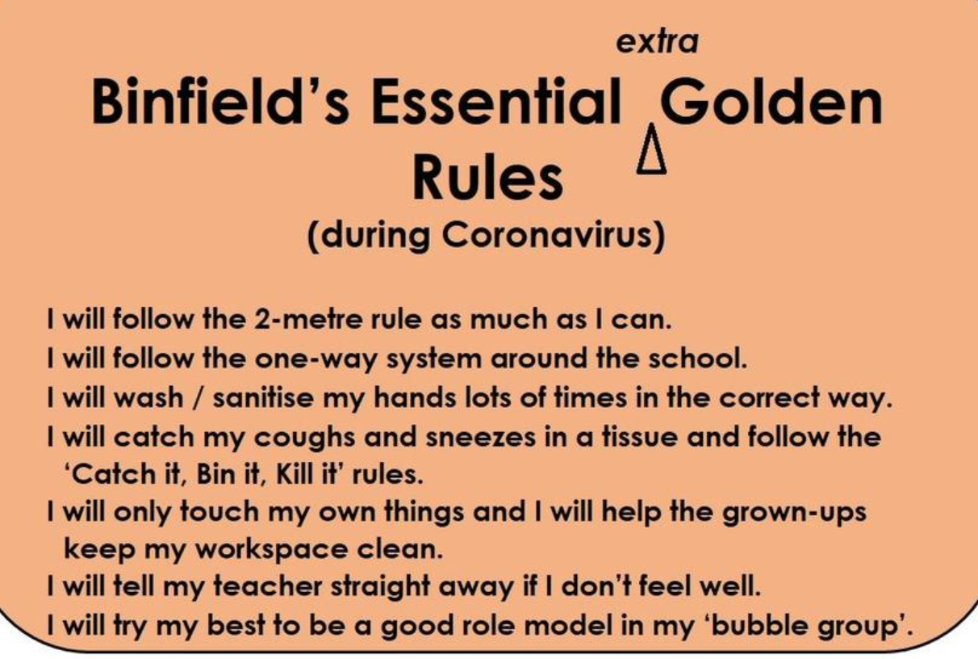

Slide 4
Connect us
Play Change. Ask the children to move around the room as if they are mice e.g. tiptoe, little squeaks, rubbing whiskers, etc. Then tell the children that when you shout the word ‘change’ and an animal, e.g. ‘change

Slide 5
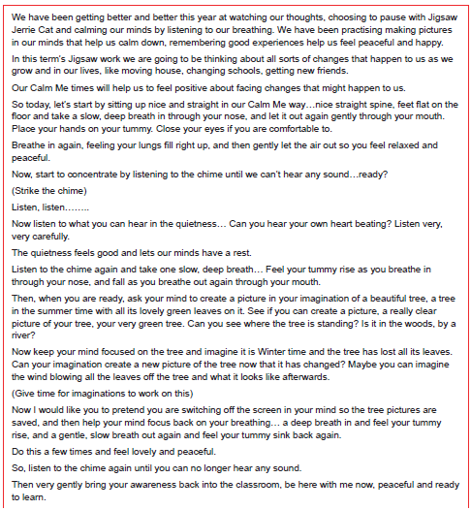
Calm me:

Slide 6
Open my mind:
Have a think. What things can you do now, that you couldn’t do when you were a baby?
We all change at some point and that is ok.

Slide 7
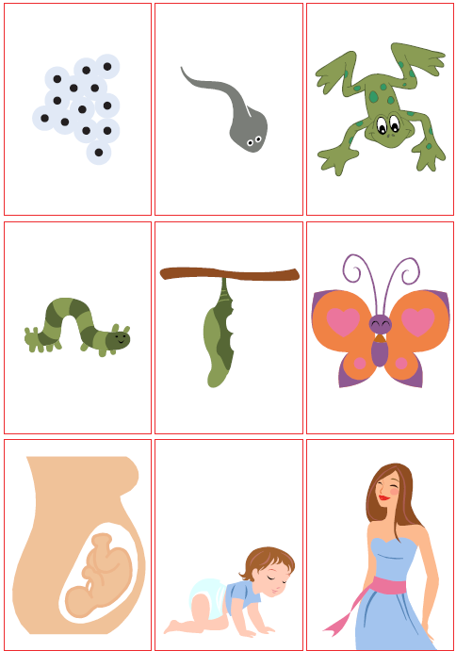
Tell me/Show me
Look at the life cycle cards that we ordered last lesson. How have the living things changed as they’ve grown up?
How have you changed as you’ve grown up?

Slide 9
Let me learn - Concertina booklets.
Each child has a ready-made concertina book.
In the final space, draw a picture of yourselves as you are now.
Think about how you have changed from when you were a baby, a two-year old, and so on.
Start drawing in the other 2 sections, the first showing you as a baby and the second as a toddler (aged 2-3).
You can take your concertina book home to show your family. Talk to your family members to help you know what you were like at each age.

