Slide 1
Let’s read a story to help us understand how Jews feel about Rosh Hashanah

Slide 2
The Rabbi and the Shoemaker
Rabbi walked past shoemaker’s house and he was still mending shoes even though it was late and he was working by candlelight. The shoemaker assured the Rabbi, “as long as the candle is still burning, it is possible to accomplish and to mend our mistakes (and our world).”
What is the story about?
What was the shoemaker doing?
What has this story got to do with forgiveness and changing our actions?
How do you think this story makes Jewish people feel?

Slide 3
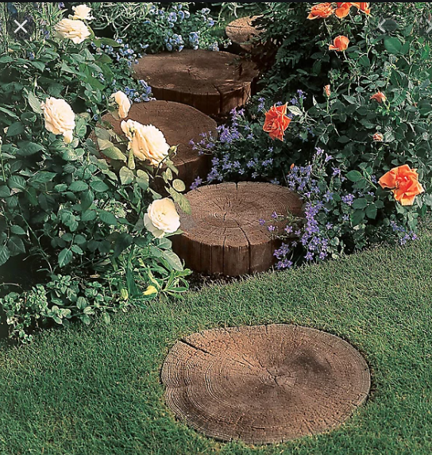
Jewish people believe they can become better people one step at a time with perseverance and God’s help.
How can we help ourselves to achieve our goals?

Slide 4
How might I achieve my goal of improving my joined up writing?
Steps to success:

Slide 5
Task: Look at the goal on your flag from our first lesson.
On the other side of the flag, write down the steps you could take to help you achieve this goal.

