Slide 1
LO: I can tell you about changes that have happened in my life.
I know some ways to cope with changes
C: Changing Me

Slide 2
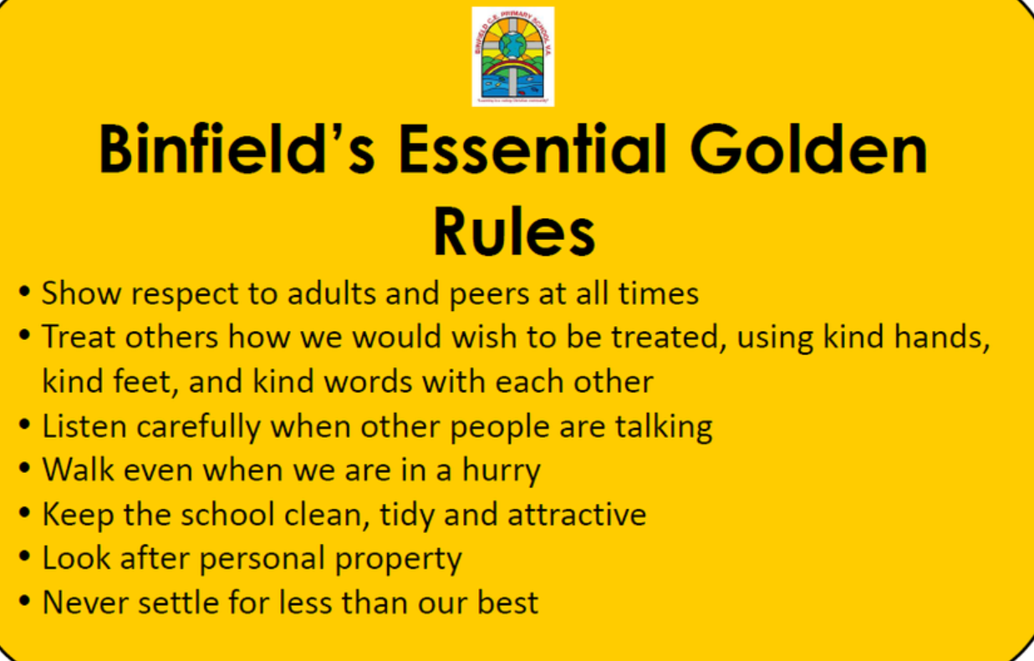
Recap Binfield Golden rules and Extra golden rules

Slide 3
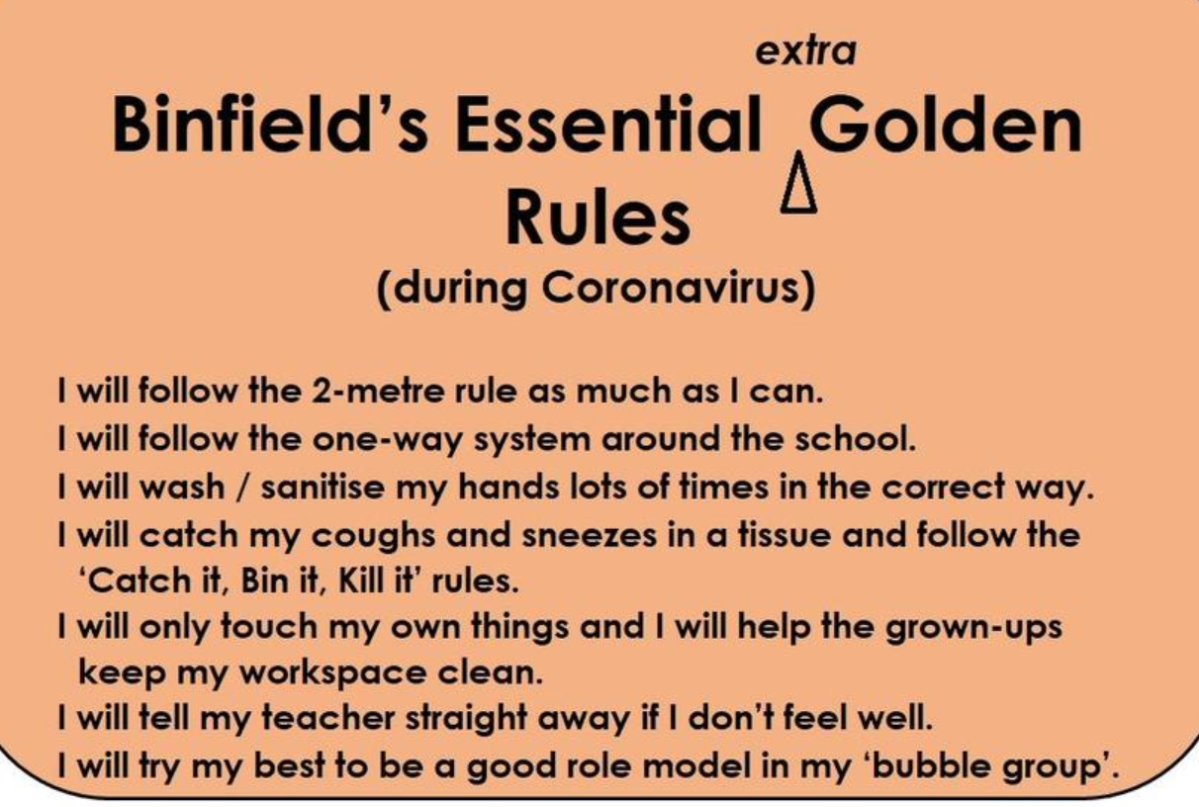

Slide 4
Connect us: Play Change
Ask the children to move around the room as if they are mice e.g. tiptoe, little squeaks, rubbing whiskers, etc. Then tell the children that when you say the word ‘change’ and an animal, e.g. ‘change

Slide 5
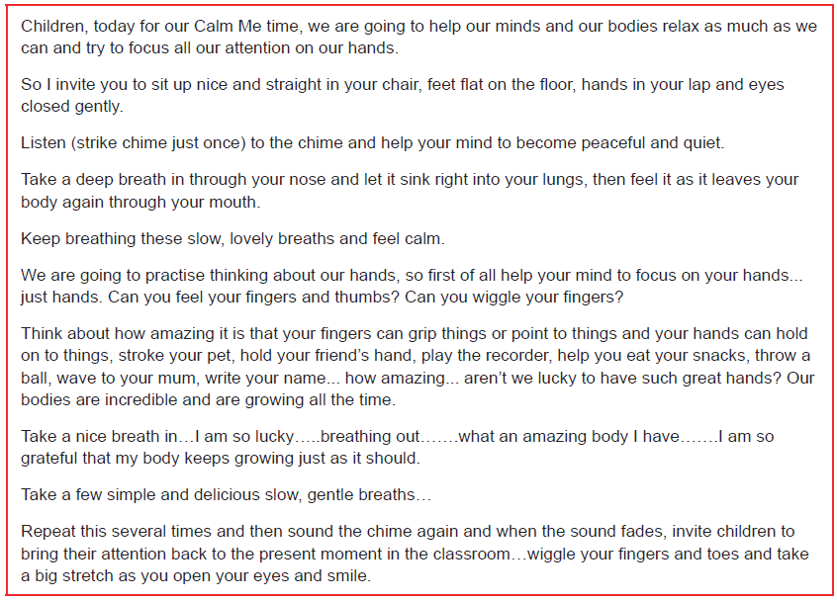
Calm Me

Slide 6
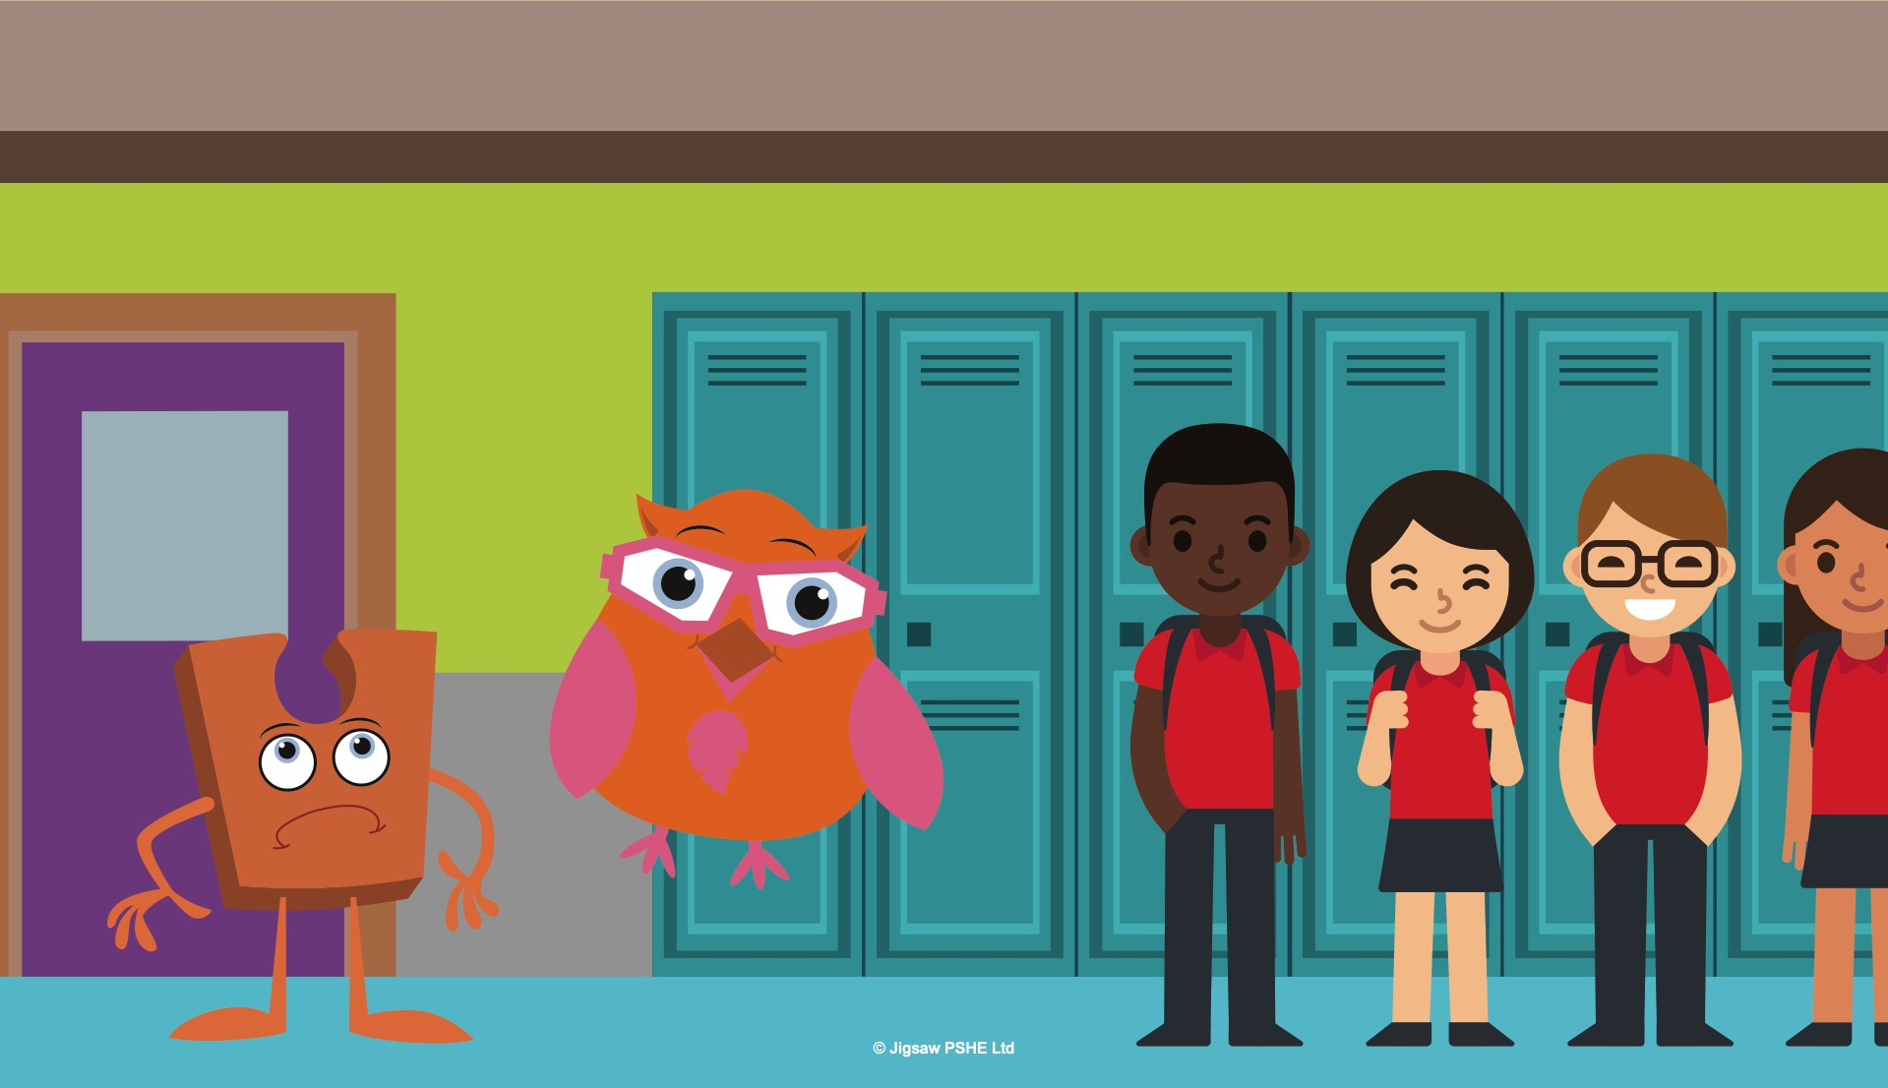
Open my mind: Story
All change for Jack
Notes:
Note to teacher: Your children may have chosen whether their Jigsaw Jack is a particular gender. In some places in this story you will need to use the correct pronoun for your Jack. This story also uses Abbey Owl (from Discovery RE) who you may also have in your classroom if you use this resource (https://discoveryschemeofwork.com)
It was the end of the school year and it seemed to Jack that everything was changing.
Two of the children in the class were moving away to go to a different school. Most of the other children were going to be moving up to the next class after the holidays. Jack was staying where (he/she) was. This made Jack feel sad. (He/she) felt left behind.
As the end of term approached, Jack seemed to get more and more upset, and even (his/her) friend Abbey Owl wasn’t able to cheer (him/her) up. “Try not to be sad Jack, things change all the time, some of these changes we might like, and others might not feel so good. There are things we can do to help with the not so good ones.” She said. Abbey Owl was clever and usually always said the right things, but even this didn’t make Jack feel any better.

Slide 7
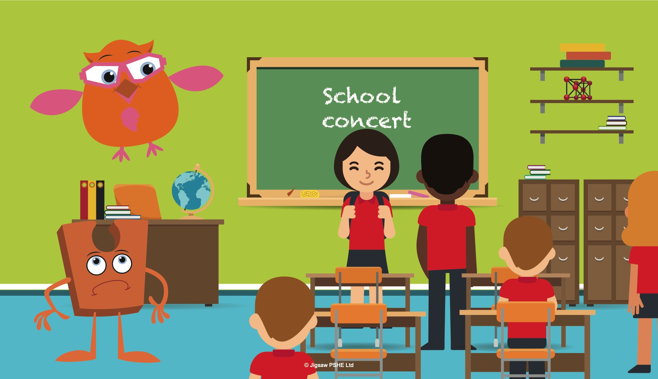
Notes:
It was soon the last week of the school term and the classroom seemed busier than usual. There were special assemblies, end of year concerts and performances and all the classwork had to be finished off. Jack watched everything going on and it just made (him/her) feel miserable.
It was soon time for the children’s last Jigsaw lesson of the year. The teacher said that everyone was going to be learning about change. “You see,” hooted Abbey Owl excitedly, “this lesson is going to really help Jack. Some of the children are feeling a little bit worried and sad about not being in this class anymore, so it’s not just you feeling like this.”

Slide 8
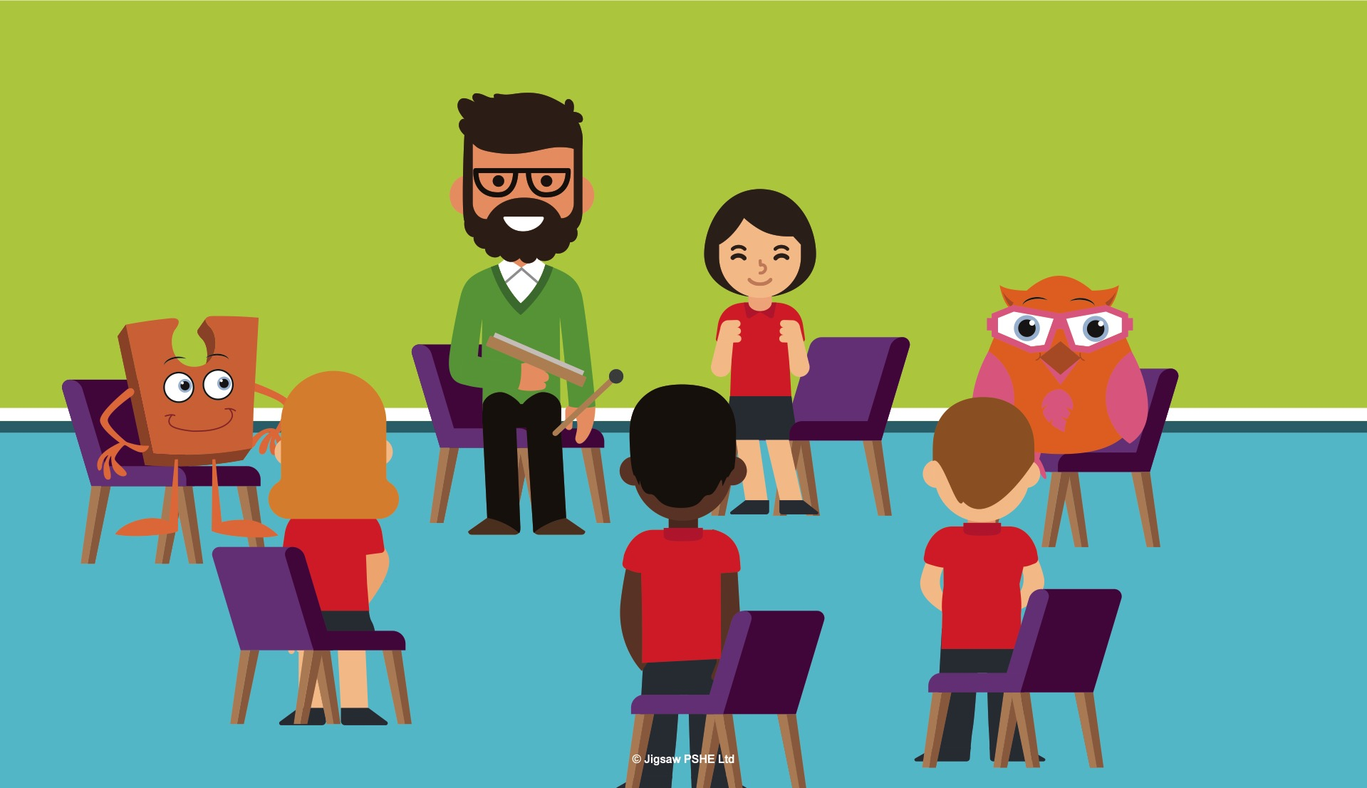
Notes:
Jack hadn’t really noticed how some of the children were feeling. (He/she) had only really been thinking about (himself/ herself) and how things were going to change. Jack listened to the lesson carefully hoping it was going to help. Jack practised the Calm me time with the children. It was so relaxing listening to the chime and the teacher’s voice, and when everyone opened their eyes Jack thought (he/she) felt a little better.
Have you just had your Calm me time? How do you feel?

Slide 9
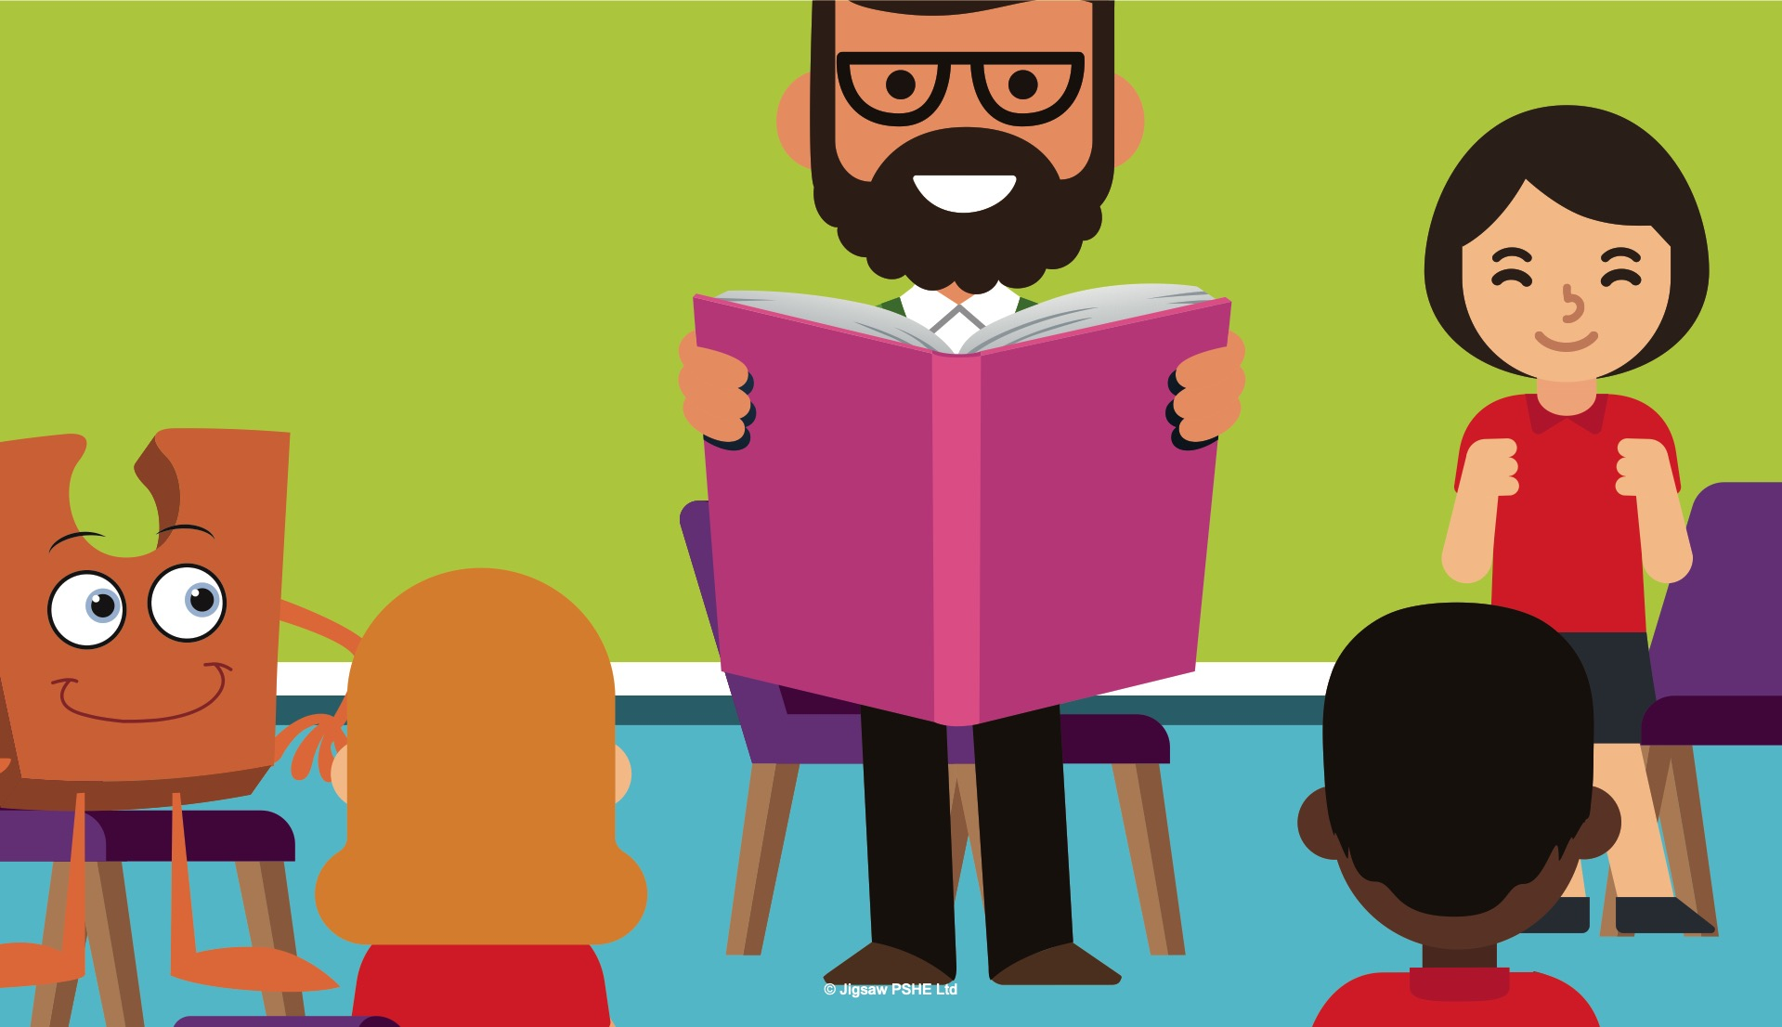
Notes:
The teacher then read a story all about Jack and how (he/she) was worried about things changing? Jack thought this was AMAZING!
The children talked about some of the things they were looking forward to about the next school year and some of the things that made them feel anxious. The teacher said that when things change people often can feel worried or scared and that it was perfectly normal. Jack felt better hearing that, because up to this point (he/she) thought that it was only (him/her) feeling this way.
In the next part of the lesson the teacher had some special objects in a bag, and when the children took them out, the teacher played a game, asking the children to guess what sort of ‘change’ the object might link to. The children were very good at guessing, much better than Jack.

Slide 10
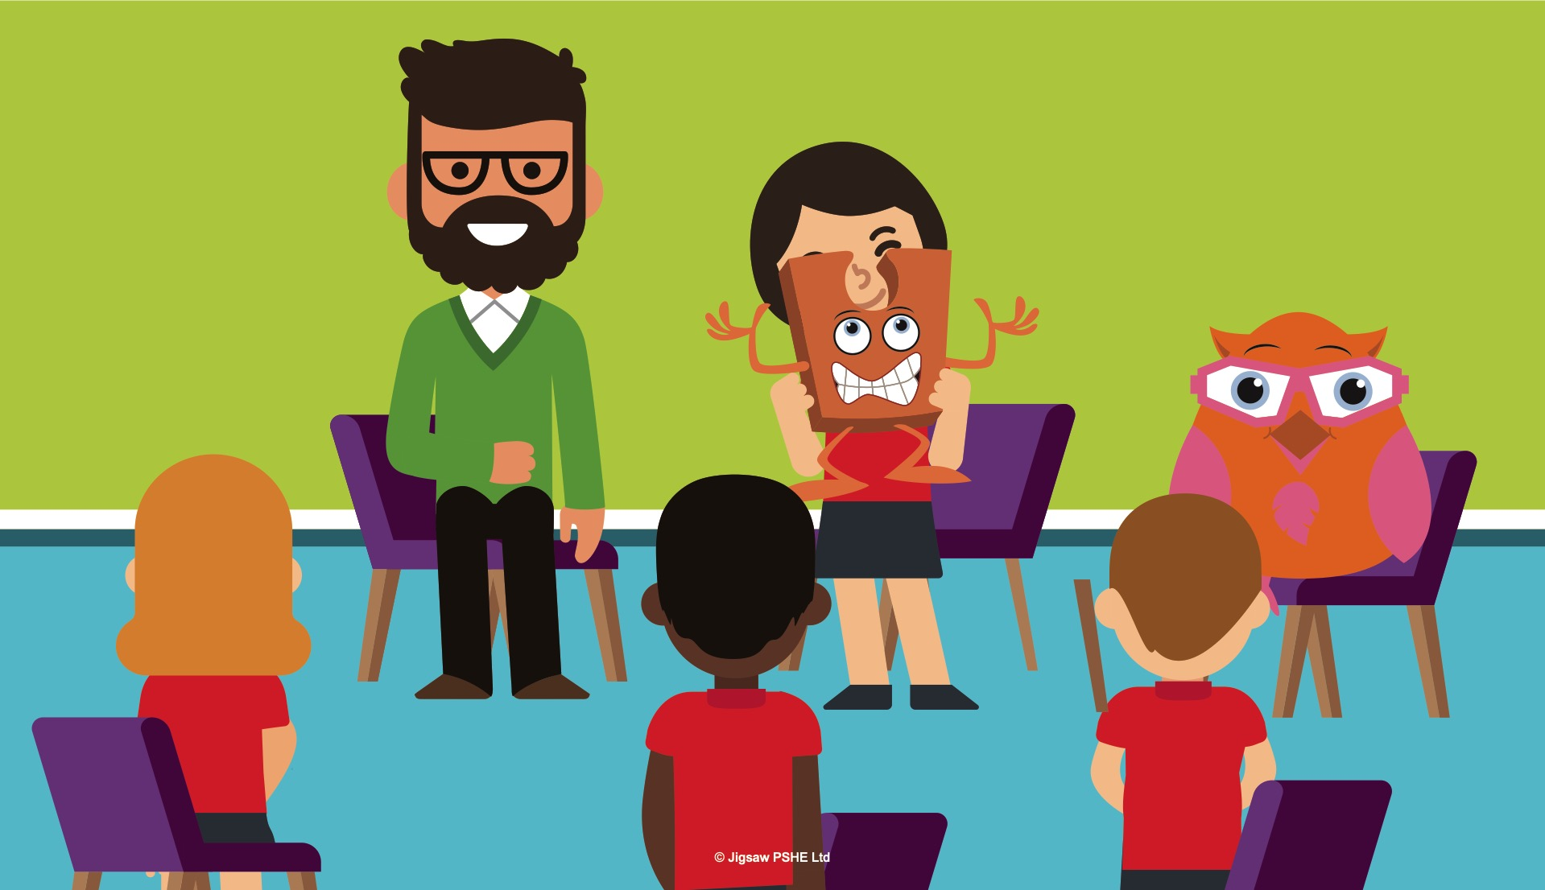
Notes:
Abbey Owl smiled, she knew what was coming next, because she had seen the teacher do the lesson with a different group of children.
For each change, the teacher asked the children how they might be able to manage their feelings through the change. At first everyone found this a little bit difficult, but with the teacher’s help they soon had a huge list of ideas they could use. Jack felt much better now.
At the end of the lesson Jack was passed around the children, (he/she) always liked this bit the best, and they each told (him/her) one thing they were really looking forward to about changing class. At the end the teacher asked Jack to whisper something that (he/she) was looking forward to, and (he/she) said, “I will have some new children to meet next year and make friends with and that will be exciting. I won’t be sad because the children this year will meet Jigsaw Jo in their next class, so they will still have a very special Jigsaw Friend.”

Slide 11
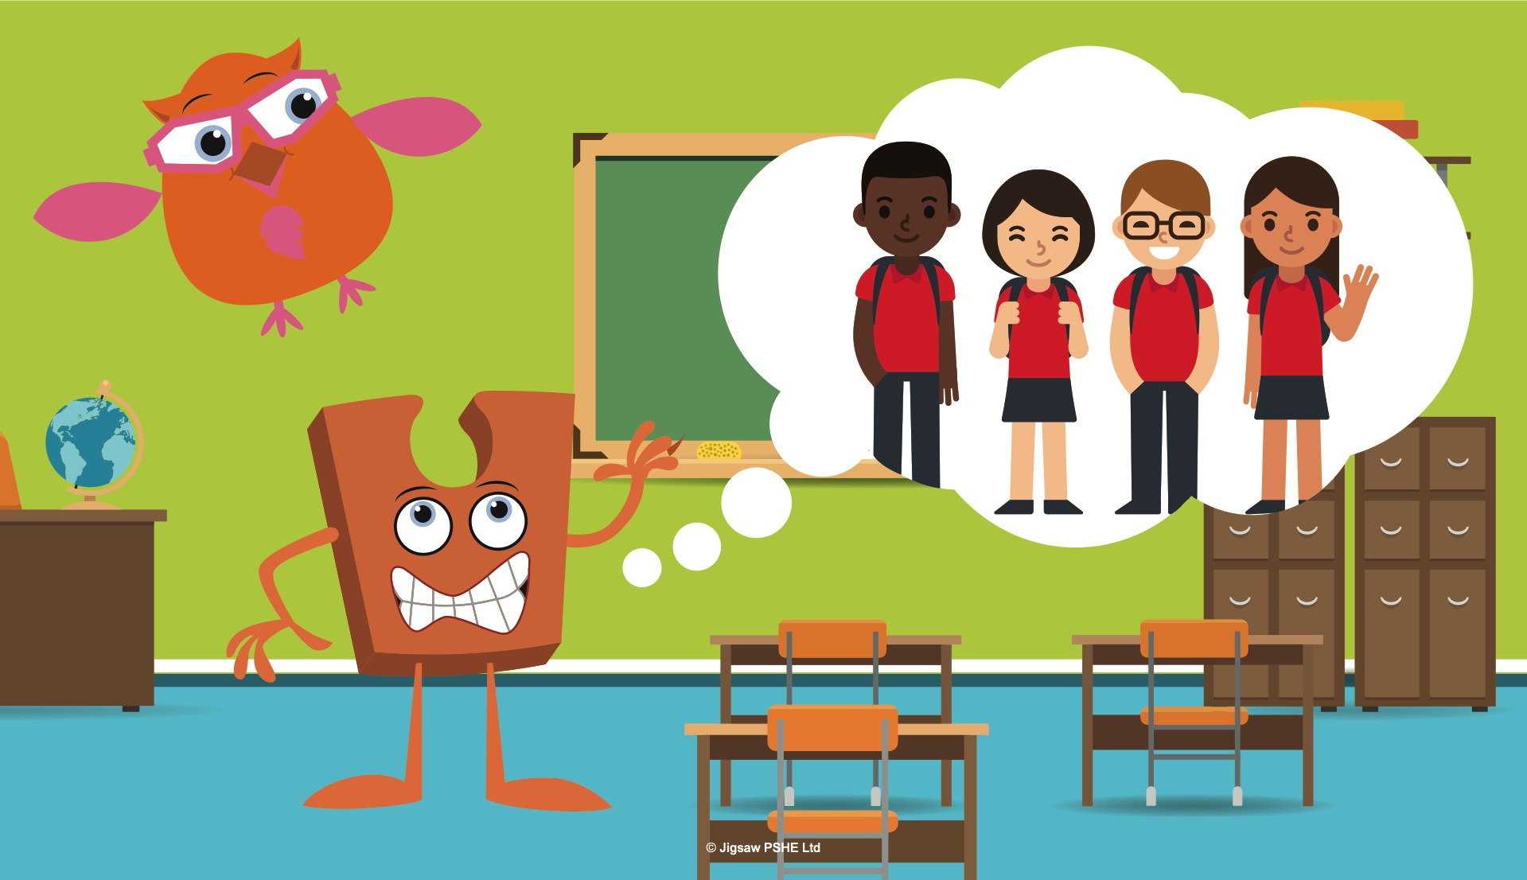
Notes:
The teacher thanked Jack and said to everyone, “Jack is right, it can really help to look at the good things about a change. Sometimes we do leave friends behind but they are in our thoughts, memories and hearts, and that will NEVER change! If we look at a change as a new adventure it doesn’t seem so bad does it? Not all changes are bad, some are very exciting!”
Everyone, including Jack felt excited about the new adventures and experiences they were going to have in the next school year. Jack felt less worried now and much happier.
Abbey owl hooted proudly, she was always right! What a clever owl!

Slide 12
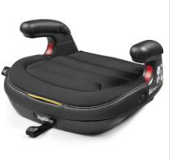
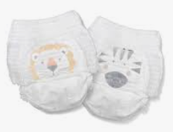
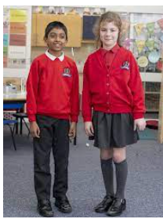
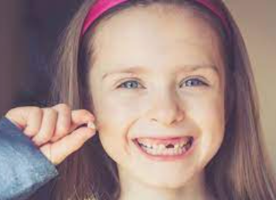

Tell me/show me: What big changes do you go through as you grow up?
How do these changes make you feel?
How could we manage these feelings? Who could help us?

Slide 13
Let me learn: Task
In the box, draw a change you have experienced.
In the speech bubble, write how you felt when this change was happening (remote learning might be a good example to model/discuss).

