Slide 1
Tuesday 18th MAY 2021
LO: To describe some of the teachings of a religion.
LO: To show an understanding of the term ‘morals’.
C: Sikhism – sharing and community

Slide 2
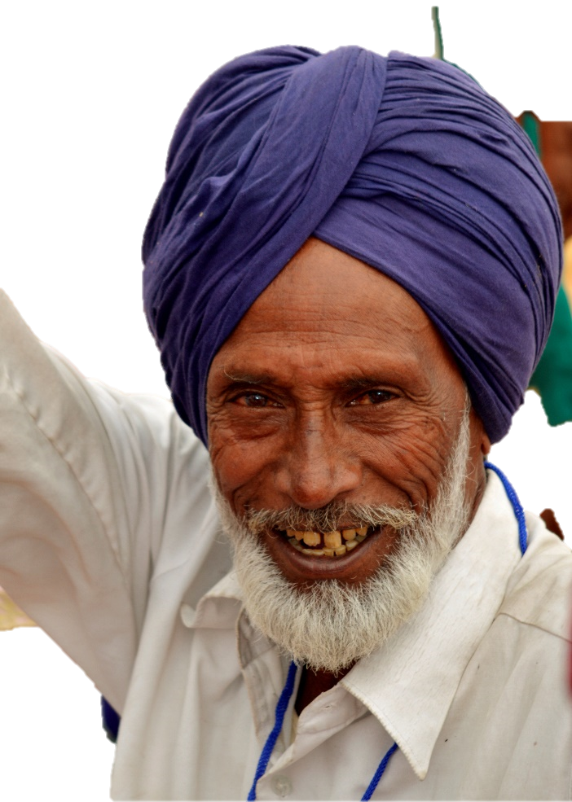
What Guru’s have we learnt about this year? Look in your books to help you.

Slide 3
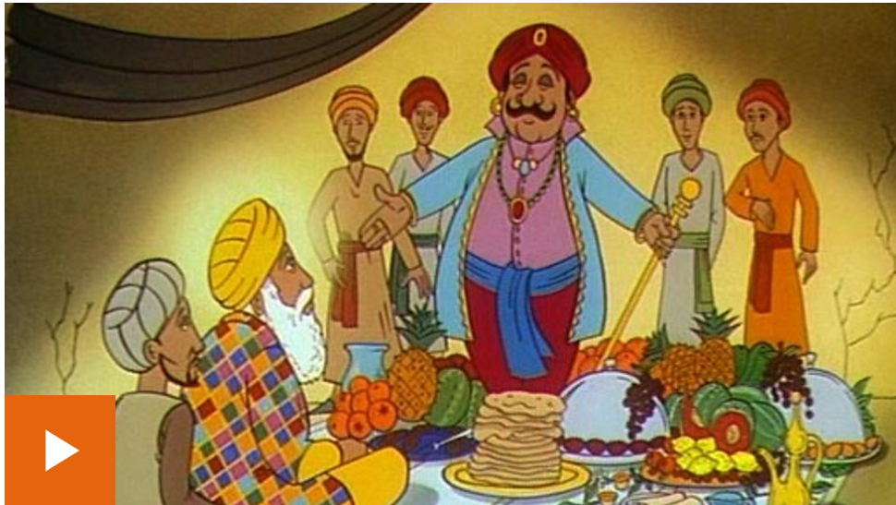
The Langar and ‘seva’
https://www.bbc.co.uk/bitesize/clips/zvx6yrd

Slide 4
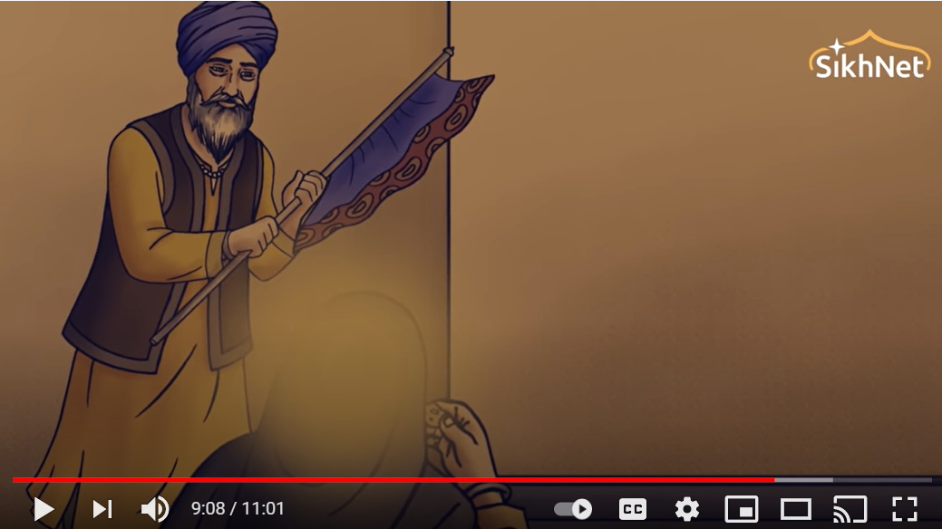
Listen to this next story. What is the moral of it?
https://www.youtube.com/watch?v=3dUR9K5cToo

Slide 5
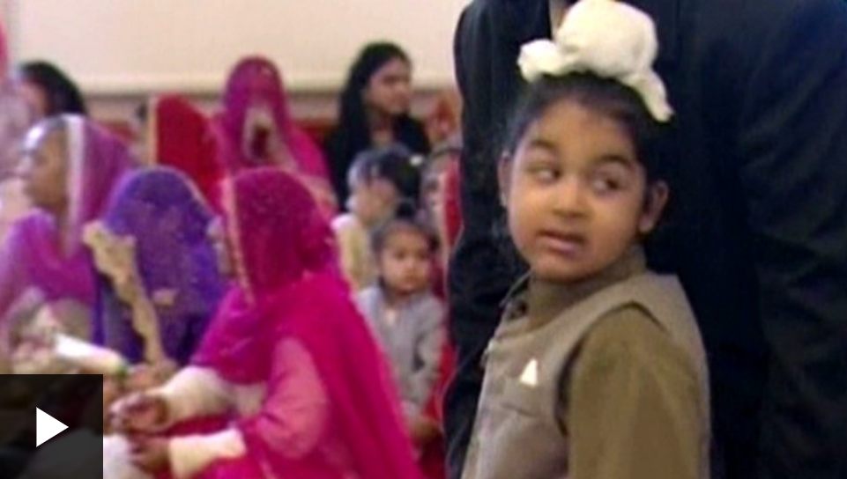
Why is sharing important to Sikhs.
https://www.bbc.co.uk/bitesize/clips/zmkq6sg

Slide 6
RP: How does the sharing of Karah Parshad and the Langar make people equal?

