Slide 1
LO: I can start to understand the life cycles of animals and humans.
I understand that changes happen as we grow and that this is OK.
C: Changing me

Slide 2

Recap Binfield Golden rules and Extra golden rules

Slide 3
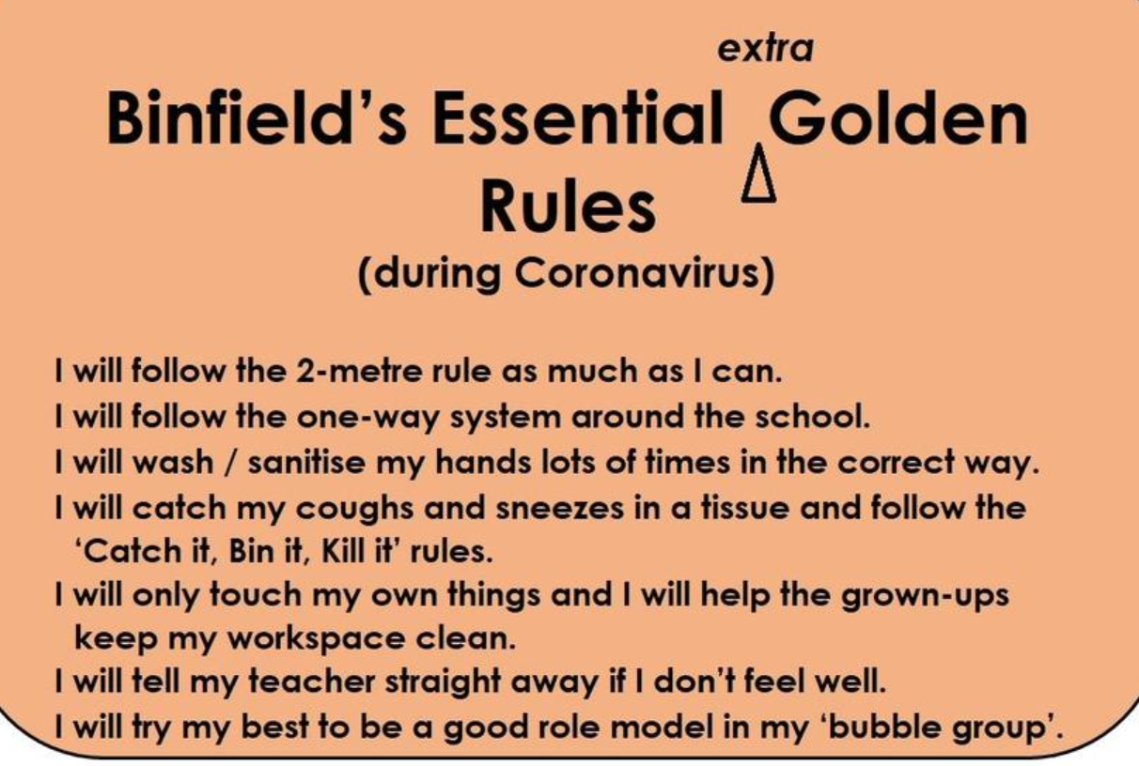

Slide 4
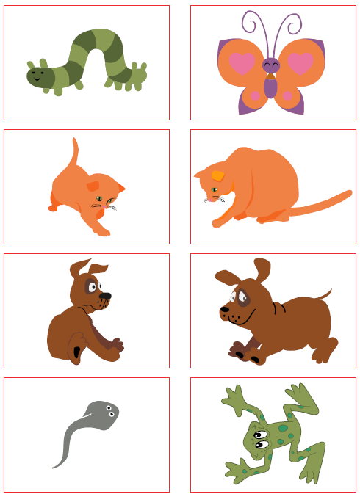
Connect us: Game – Find your pair
Each of you will be given a card. An adult, or baby version of the same animal. Find your pair!

Slide 5
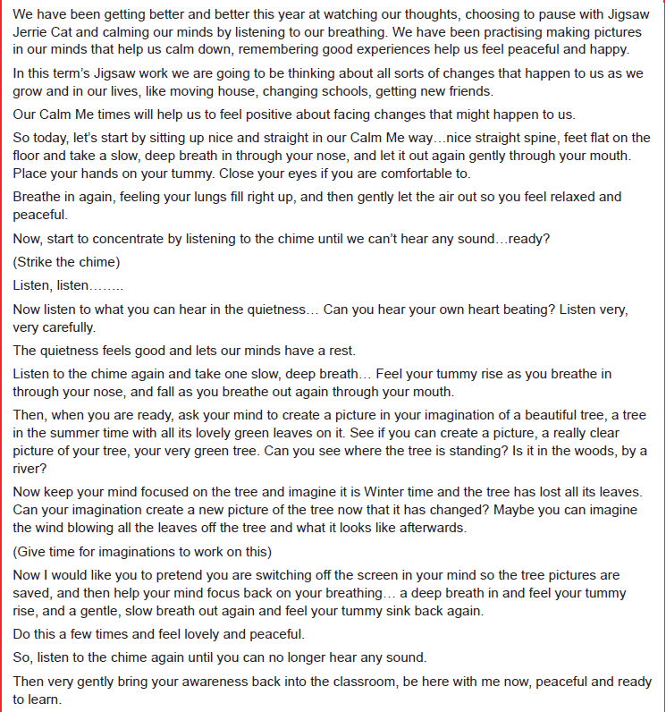
Calm me:

Slide 7
Tell me/Show me:
How does the frogspawn turns into the frog. What do they think happens and in what order?
LIFECYCLE OF AN AMPHIBIAN (FROG) – YouTube
Show the children a series of photos of yourself in sequence from a baby to adult. As you show the photos explain that everyone starts as baby and goes through different stages of growth. Also explain that not everybody grows at the same rate because our bodies are all unique.
Reinforce the stages of growth and change by muddling up the sequence of photographs and invite two children to come into the circle and put them in the right order explaining as they go.

Slide 8
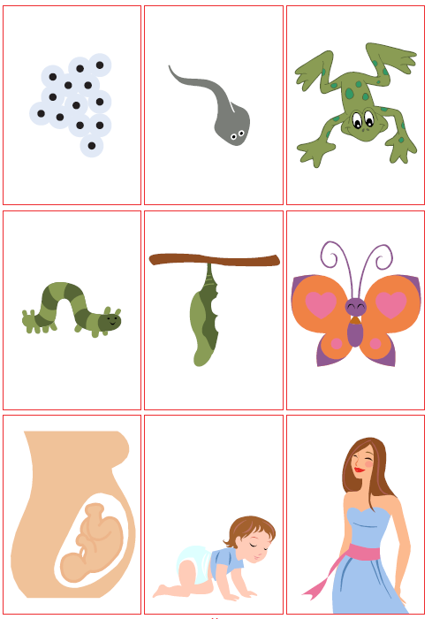
Let me Learn: Task
Introduce the concept of ‘Life cycle’ and explain that this means growing from birth to adulthood.
Order the set of life cycle cards you are given from ‘baby’ to ‘adult’

