Slide 1
1770s England vs 1770s Australia

Slide 2
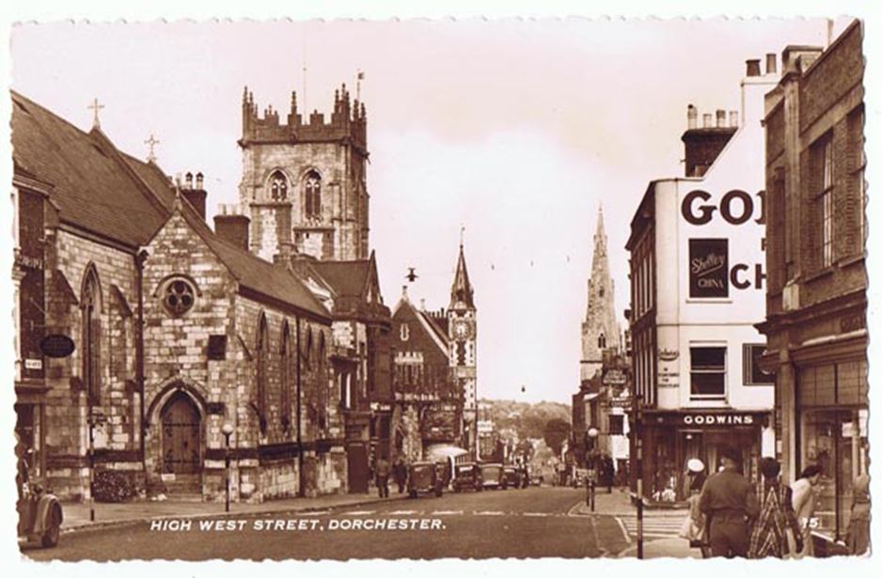
Dorset, England

Slide 3
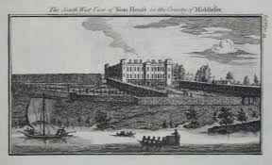

Slide 4
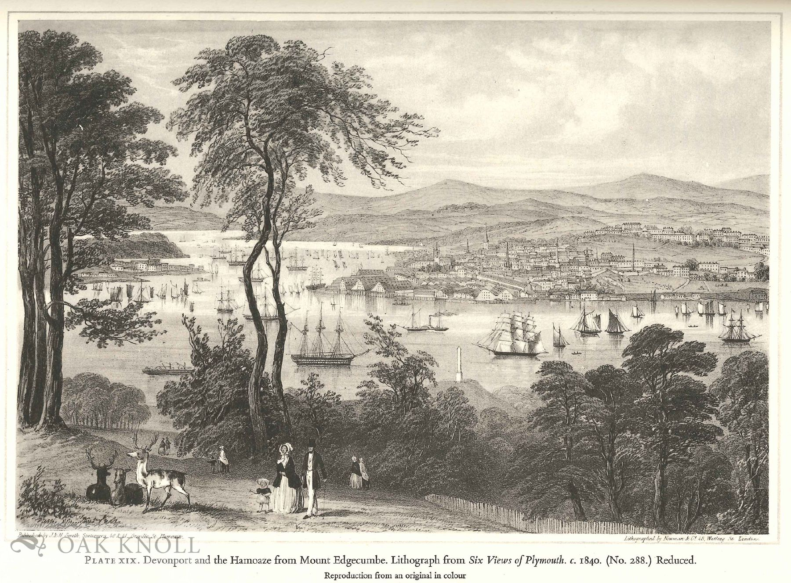

Slide 5
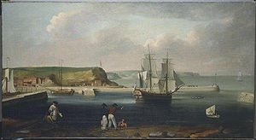
Botany Bay

Slide 6
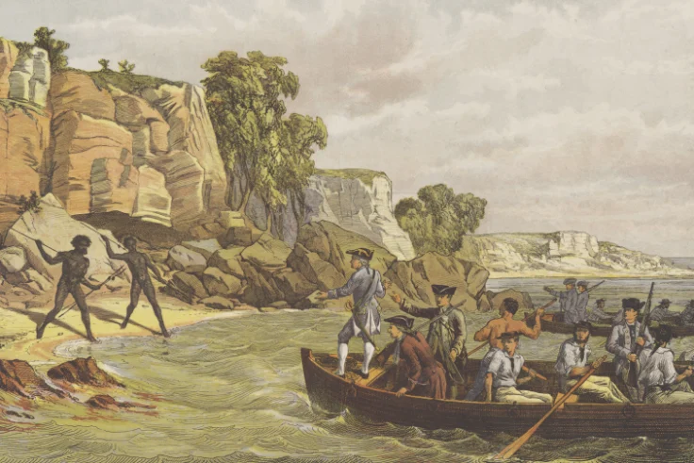

Slide 7


