Slide 1

LO: I know how to work well with a partner.
C: Dreams and goals.

Slide 2
Sometimes, we cannot always achieve our goals on our own.
Sometimes we need to work with others to achieve our goals.
What skills do we need to be able to work well with others?
Think, pair, share.

Slide 3
Mirroring activity.
Stand in a space opposite a partner. One is the leader, the other the mirror. Place your palms together. The leader needs to move their hands and the mirror’s hands, still touching so they do exactly the same movements. Then move your hands apart with space between the palms and repeat the activity, the mirror has to follow the leader’s palms as accurately as they can. After a minute or two, change roles with the leader becoming the mirror and repeat the activity again.
How good were you at noticing your partner’s movements?

Slide 4
Task: Collaborate to achieve your goals.
Either with a friend (if you are at school) or family member (if you are at home), collaborate with them to design a welly that illustrates a goal you both share.
It could be anything, here are some examples.
To feel more confident with remote learning.
To get out every day to do some exercise.
To read more frequently.

Slide 5
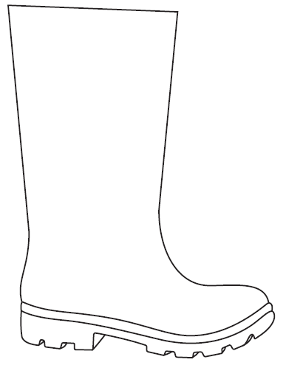
Remember to:
Listen to your partner’s ideas.
Collaborate
Respect each other’s ideas.
Compromise when/if you don’t agree.

