Slide 1
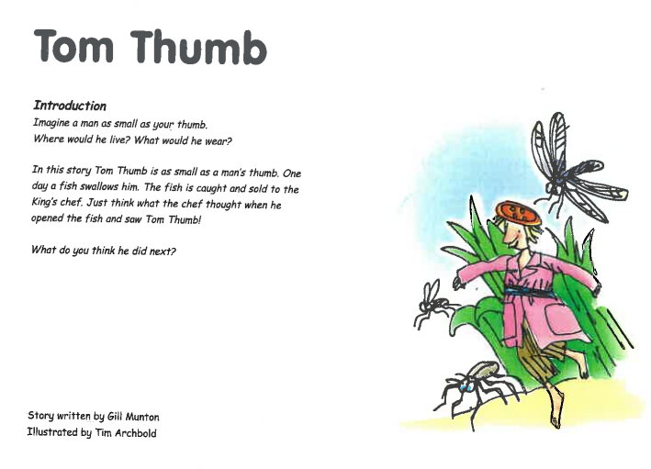


Slide 2
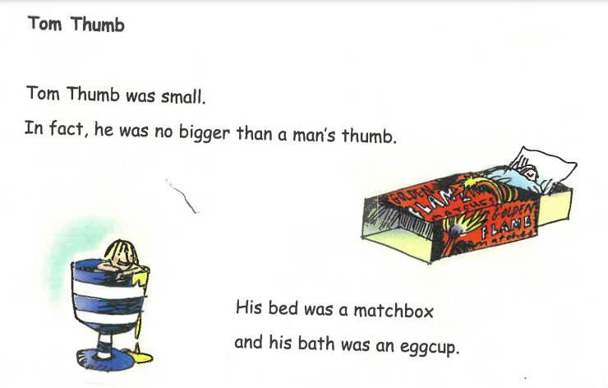
How big is Tom Thumb?

Slide 3
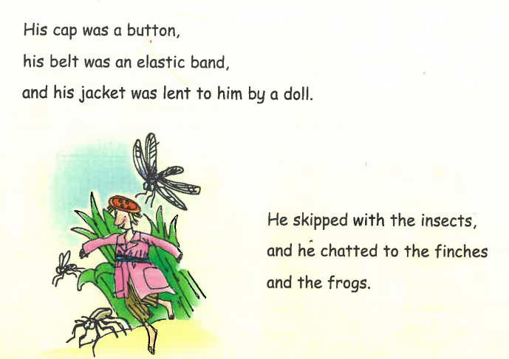
What did he wear. What did he do for fun?

Slide 4
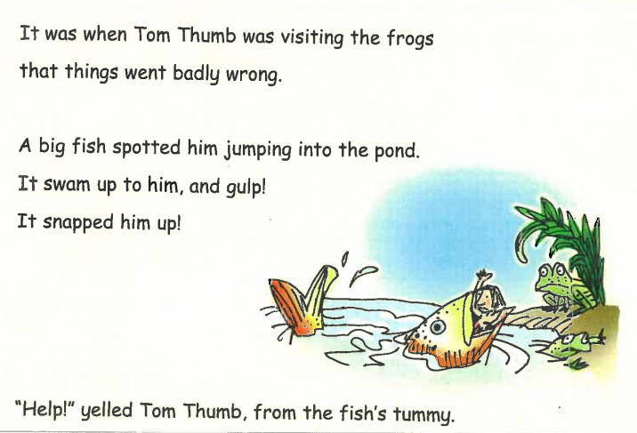
What happened when Tom was visiting the frogs?

Slide 5
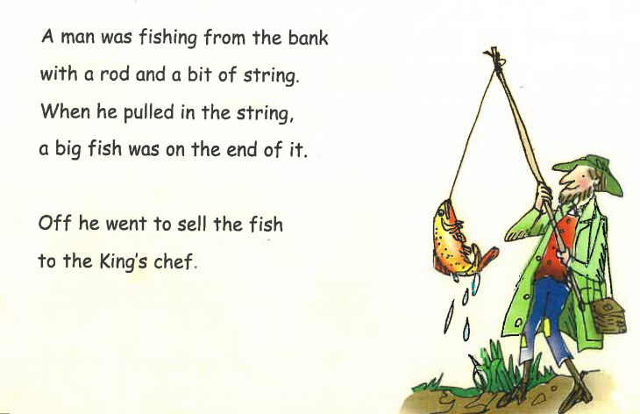

Slide 6
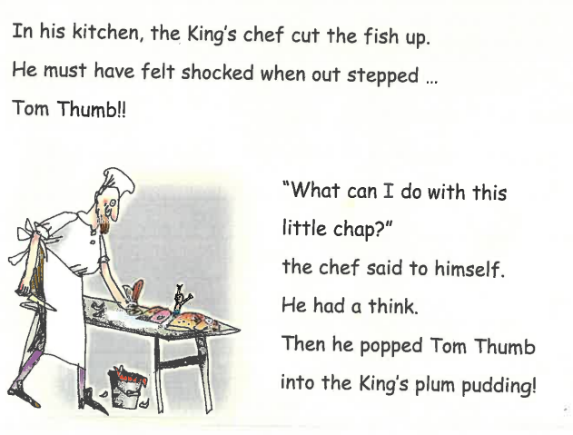
What did the king's chef decide to do with Tom?

Slide 7
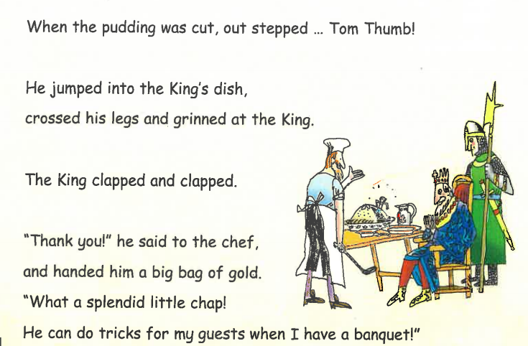
What did the king want Tom to do for him?

Slide 8
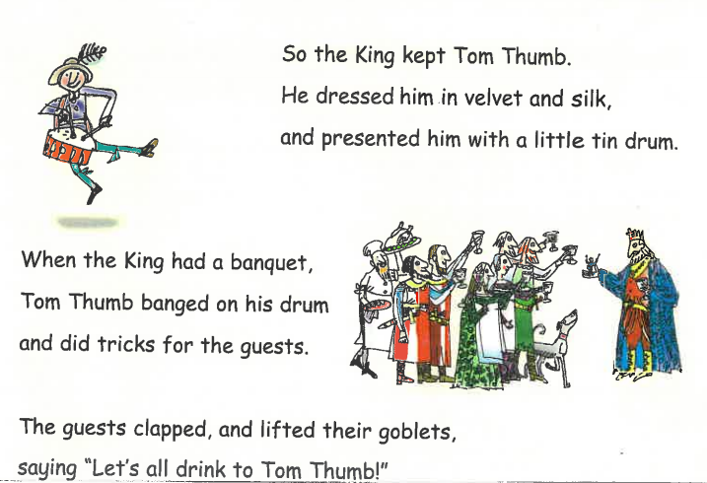
What might Tom be thinking as he performs for the king?

