Slide 1


Slide 2
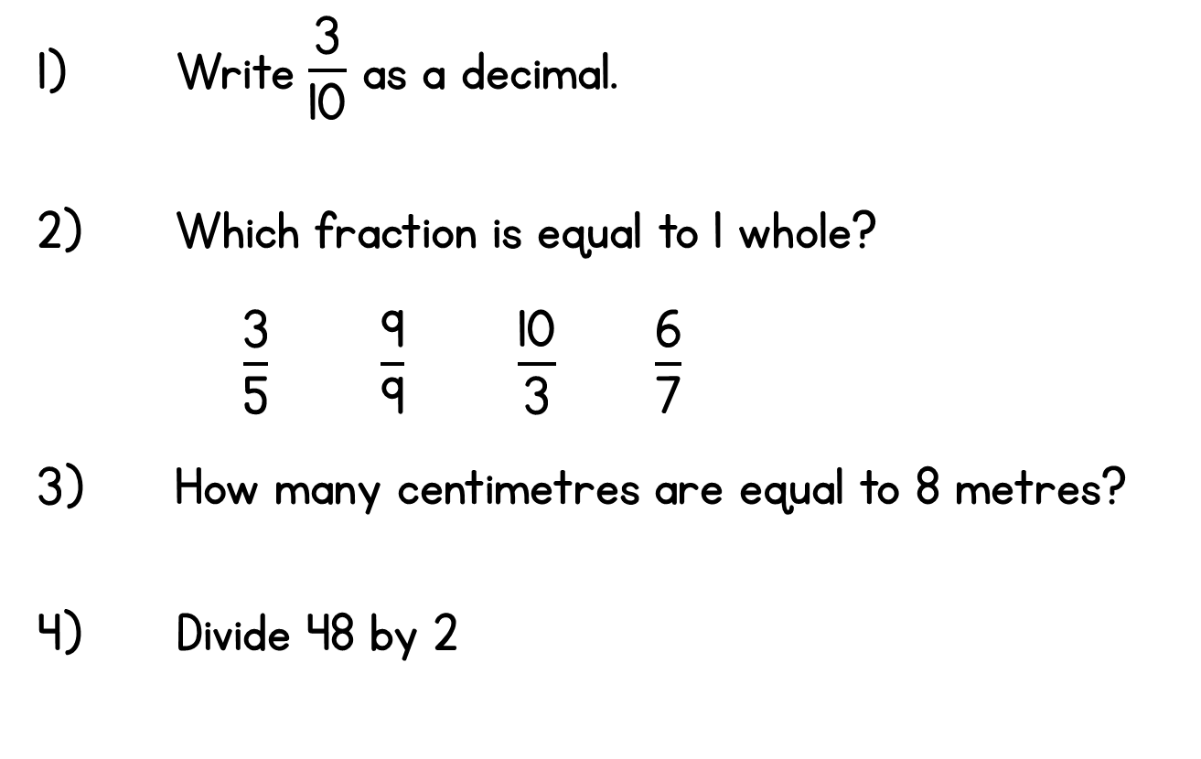
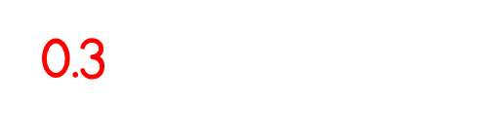
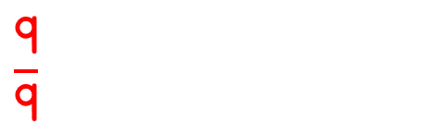



Slide 4


1) Complete the sentences.
There are ____ halves in one whole.
There are ____ quarters in one whole.
There are ____ thirds in one whole.
2) What fraction of each shape is shaded?

Slide 5
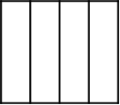





1) Complete the sentences.
There are ____ halves in one whole.
There are ____ quarters in one whole.
There are ____ thirds in one whole.
2) What fraction of each shape is shaded?
2
4
3
$\frac{\text{1}}{\text{4}}$
$\frac{\text{2}}{\text{4}}$
$\frac{\text{1}}{\text{2}}$
$\frac{\text{3}}{\text{4}}$
$\frac{\text{4}}{\text{4}}$
or

Slide 7




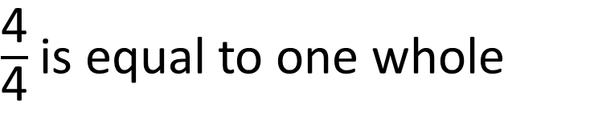
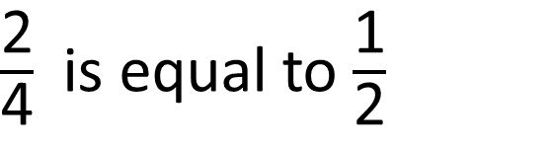
What fraction of each shape is shaded?
$\frac{\text{1}}{\text{4}}$
$\frac{\text{2}}{\text{4}}$
$\frac{\text{3}}{\text{4}}$
$\frac{\text{4}}{\text{4}}$
$\frac{\text{2}}{\text{4}}$ is equal to $\frac{\text{1}}{\text{2}}$
$\frac{\text{4}}{\text{4}}$is equal to one whole

Slide 8




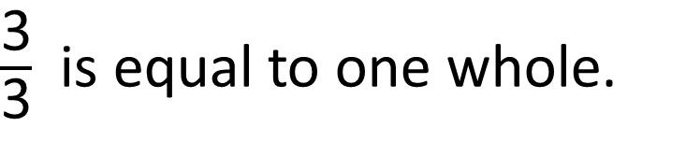
What fraction of each shape is shaded?
$\frac{\text{1}}{\text{3}}$
$\frac{\text{2}}{\text{3}}$
$\frac{\text{3}}{\text{3}}$
$\frac{\text{3}}{\text{3}}$ is equal to one whole.
Have a think

Slide 9







Mo is counting in fractions.
I will count in thirds.
$\frac{\text{1}}{\text{3}}$
$\frac{\text{2}}{\text{3}}$
Have a think
$\frac{\text{3}}{\text{3}}$
I don’t think you can have four thirds.
1
$\frac{\text{4}}{\text{3}}$
$\frac{\text{1}}{\text{3}}$
1
What will come next?

Slide 10







Mo is counting in fractions.
$\frac{\text{1}}{\text{3}}$
$\frac{\text{5}}{\text{3}}$
$\frac{\text{2}}{\text{3}}$
1
$\frac{\text{2}}{\text{3}}$
$\frac{\text{6}}{\text{3}}$
2
$\frac{\text{3}}{\text{3}}$
1
$\frac{\text{7}}{\text{3}}$
$\frac{\text{1}}{\text{3}}$
2
$\frac{\text{4}}{\text{3}}$
$\frac{\text{1}}{\text{3}}$
Have a think
1
What will come next?

Slide 11











How many oranges?
There are 5 and a half oranges.
$\frac{\text{1}}{\text{2}}$
$\text{1} \frac{\text{1}}{\text{2}}$
2
$\text{2} \frac{\text{1}}{\text{2}}$
3
$$\text{1}$$
$\text{3} \frac{\text{1}}{\text{2}}$
4
$\text{4} \frac{\text{1}}{\text{2}}$
5
$\text{5} \frac{\text{1}}{\text{2}}$

Slide 12







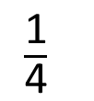










Annie is counting fractions on a number line.
$\frac{\text{1}}{\text{4}}$
1
is the same as $\frac{\text{5}}{\text{4}}$
$\frac{\text{5}}{\text{4}}$
$\frac{\text{6}}{\text{4}}$
$\frac{\text{7}}{\text{4}}$
$\frac{\text{8}}{\text{4}}$
$\frac{\text{1}}{\text{4}}$
$\frac{\text{2}}{\text{4}}$
$\frac{\text{3}}{\text{4}}$
$\frac{\text{4}}{\text{4}}$
0
$\frac{\text{1}}{\text{4}}$
$\frac{\text{2}}{\text{4}}$
$\frac{\text{3}}{\text{4}}$
1
$\frac{\text{1}}{\text{4}}$
$\frac{\text{2}}{\text{4}}$
$\frac{\text{3}}{\text{4}}$
2
1
1
1

