Slide 1

LO: To Master Techniques
C: Colour mixing

Slide 2
What is colour? How do we make colour?
https://www.bbc.co.uk/bitesize/guides/z3bqycw/revision/1
Colour - Video - National 5 Art and Design - BBC Bitesize

Slide 3
Talk Pair Share.
Can you list primary colours?
How would you use primary colours to make other colours?

Slide 4
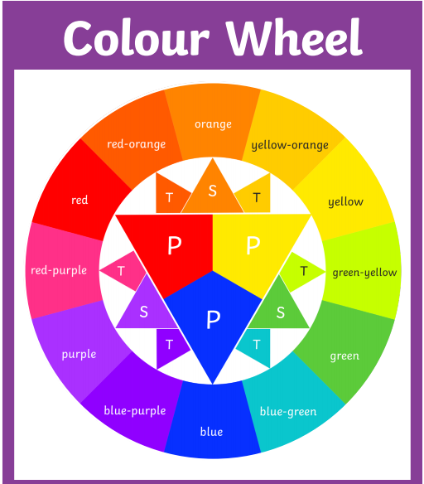

Slide 5
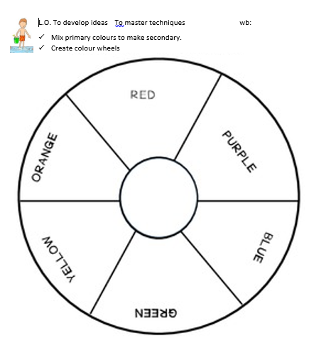
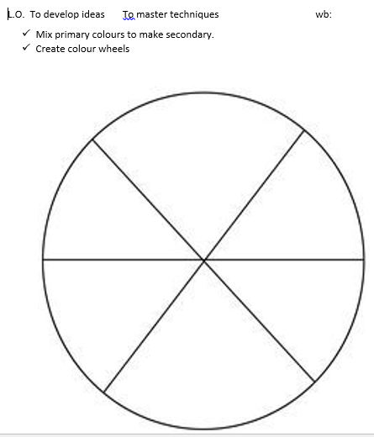
Task: Mix primary colours to make secondary colours

