Slide 1

Monday 24th May 2021
L.O: NFER- Filling the Gaps
C: Prefixes

Slide 2
Let’s explore what prefixes are and how they can change or alter the meaning of a word!
https://www.bbc.co.uk/bitesize/topics/z8mxrwx/articles/z9hjwxs

Slide 3
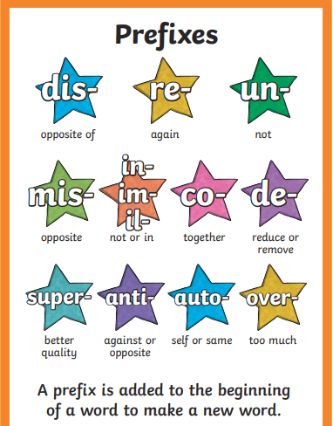
Now stick in your handy help sheet, which you can refer to next time you are writing!

Slide 4
Now that we have explored what a prefix is, let’s play a matching game!
Can you work with your partner to match the prefixes with the root words?

Slide 5
Next, have a go at the challenge sheet and practice your amazing new suffix skills!

